Slide 1

WooCommerce
+ Generative AI
Course Code: C6
Build a Professional eCommerce Store with Generative AI
Version 2.0 · 4 November 2026
Conducted by Tertiary Infotech Academy Pte Ltd
UEN: 201200696W
www.tertiarycourses.com.sg | enquiry@tertiaryinfotech.com | +65 6100 0613
© Tertiary Infotech Academy Pte Ltd. All rights reserved.

Slide 2




YOUR TRAINER
About the Trainer
Qualifications ACTA / ACLP / DDDLP
PF
Expertise AI (Claude, Gemini, ChatGPT), WordPress web design, WooCommerce and Shopify eCommerce, Xero, Search and Generative Engine Optimisation
Patrick Foo
Certified trainer and
courseware developer
Experience Over 20 years across the industries above
Contact WhatsApp 9817 3260 · patrick@businessonlinecentre.com
© Tertiary Infotech Academy Pte Ltd
Build a Professional eCommerce Store with Generative AI · C6
2

Slide 3

YOUR TRAINER
About the Trainer
Role Principal Trainer, Tertiary Infotech Academy Pte Ltd
AA
Expertise eCommerce, WordPress and WooCommerce content management systems, applied AI
Dr. Alfred Ang
Principal Trainer
Tertiary Infotech Academy
Delivers Courses on eCommerce, web development, digital marketing and data analytics
Founder Founder and lead instructor at Tertiary Infotech / Tertiary Courses
© Tertiary Infotech Academy Pte Ltd
Build a Professional eCommerce Store with Generative AI · C6
3

Slide 4




ICE-BREAKER
Let's Know Each Other
One minute each — then we build a fashion store together.
Your name and role
Your experience with WordPress or online selling
How you use AI today
One product you would sell online
© Tertiary Infotech Academy Pte Ltd
Build a Professional eCommerce Store with Generative AI · C6
4

Slide 5






HOUSEKEEPING
Ground Rules
Phones on silent
Participate actively
Mutual respect
Step out quietly for calls.
No question is too small.
Agree to disagree.
Be punctual
Full attendance
Stay hands-on
Return from breaks on time.
Stay for the whole day to finish every lab.
Build along in every lab.
© Tertiary Infotech Academy Pte Ltd
Build a Professional eCommerce Store with Generative AI · C6
5

Slide 6


BEFORE WE START
Prerequisite
Basic WordPress
Comfortable with a browser
A ChatGPT account
Basic WordPress operation is assumed in this course.
You can find your way round the WordPress admin and upload an image.
A free account works; image generation may be slower on the free tier.
© Tertiary Infotech Academy Pte Ltd
Build a Professional eCommerce Store with Generative AI · C6
6

Slide 7
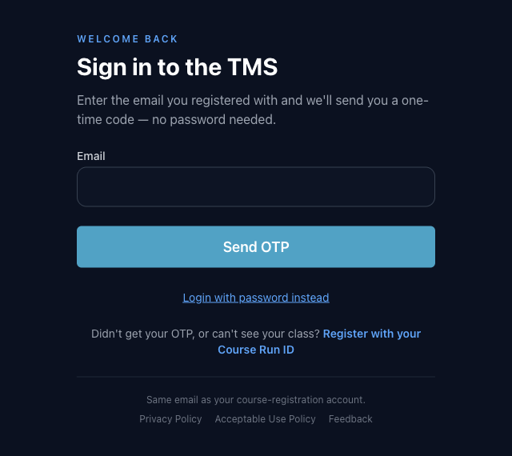
COURSE PORTAL
Login to LMS and Download Course Material
▸ https://lms-tms.tertiaryinfotech.com → sign in with your registered email + OTP → this course → slides, Learner Guide and labs.
© Tertiary Infotech Academy Pte Ltd
Build a Professional eCommerce Store with Generative AI · C6
7

Slide 8
SEVEN TOPICS · ONE DAY · SEVEN LABS
Course Outline
1
AI for WordPress and WooCommerce
AI tools · Effective prompts · WordPress AI connectors · AI features in the editor
2
Overview of WooCommerce CMS
What WooCommerce is · Installing it · Setup wizard · Themes · Widgets & shortcodes · Settings, currency & tax
Lab 1
3
Manage Products on WooCommerce Store
Product types · AI product photos & copy · Variations · Categories, tags & attributes · Up-sells · CSV import
Labs 2–3
4
Manage Payments and Shipping
Store policies · Online & offline payment methods · Gateways · Shipping zones · Flat rate, free shipping & local pickup
Lab 4
5
Manage Sales on WooCommerce Store
Orders & order statuses · Editing single orders · Refunds & restocking · Coupons and promotions
Lab 5
6
Manage WooCommerce Performance
Reports & Analytics · Customer & stock reports · Dashboard widgets · eCommerce metrics · Google Analytics
7
SEO in the Age of AI Search
How search works · SEO, AEO & GEO · E-E-A-T · AI for SEO · On-page SEO · Digital marketing with GenAI
Labs 6–7
© Tertiary Infotech Academy Pte Ltd
Build a Professional eCommerce Store with Generative AI · C6
8

Slide 9
SCHEDULE · DAY 1 · MORNING
Lesson Plan — Day 1 (9:30am – 1:00pm)
Time | Session | Topic
9:30am–9:45am | Welcome, trainer and learner introductions, and ground rules | —
9:45am–10:00am | Learning outcomes and course outline | —
10:00am–10:35am | Topic 1 — AI for WordPress and WooCommerce | T1
10:35am–11:20am | Topic 2 — Overview of WooCommerce CMS | T2
11:20am–11:45am | HANDS-ON — Lab 1: Launch Harbour & Co — WooCommerce Plus an AI-Designed Homepage | T2
11:45am–12:20pm | Topic 3 — Manage Products | T3
12:20pm–12:30pm | HANDS-ON — Lab 2: Shoot and Write a Product with AI | T3
12:30pm–12:50pm | Topic 3 — Variable products, categories, tags and attributes, up-sells and cross-sells, the CSV importer, the Customizer and WooCommerce Blocks | T3
12:50pm–1:00pm | HANDS-ON — Lab 3: Let AI Build the New-Season Catalogue | T3
1:00pm–1:30pm | Lunch break | —
© Tertiary Infotech Academy Pte Ltd
Build a Professional eCommerce Store with Generative AI · C6
9

Slide 10
SCHEDULE · DAY 1 · AFTERNOON
Lesson Plan — Day 1 (1:30pm – 5:30pm)
Time | Session | Topic
1:30pm–2:15pm | Topic 4 — Manage Payments and Shipping | T4
2:15pm–2:40pm | HANDS-ON — Lab 4: AI Drafts the Policies, You Switch On Payments and Shipping | T4
2:40pm–3:20pm | Topic 5 — Manage Sales | T5
3:20pm–3:45pm | HANDS-ON — Lab 5: Run a Day of Orders — Refund, Restock, Reply with AI | T5
3:45pm–4:20pm | Topic 6 — Manage Performance | T6
4:20pm–4:55pm | Topic 7 — SEO in the Age of AI Search | T7
4:55pm–5:05pm | HANDS-ON — Lab 6: Get Found — AI Writes the SEO, You Approve It | T7
5:05pm–5:15pm | HANDS-ON — Lab 7: Launch the Resort Linen Drop — Social, Newsletter, Results | T7
5:15pm–5:30pm | Course summary, Q&A, next steps and course feedback | —
TIP 9:30am – 5:30pm · 7.5 instructional hours · seven topics, seven hands-on labs.
© Tertiary Infotech Academy Pte Ltd
Build a Professional eCommerce Store with Generative AI · C6
10

Slide 11


THE COURSE SCENARIO
Meet Harbour & Co
A Singapore fashion label — the store every lab builds. All data is synthetic.
City wear for the tropics
Studio at 71 Ayer Rajah Crescent
Linen shirts, polos, tees, skirts, trousers, bags — breathable for 32°C, sharp at 20°C.
Founder Rachel Lim sells in person. Today she sells online.
Launch: the Resort Linen Drop
Rules that matter
Four new-season pieces · RESORT15 for 15% off · 14 days.
S$ inclusive of 9% GST · no unprovable claims · Rachel approves anything public.
© Tertiary Infotech Academy Pte Ltd
Build a Professional eCommerce Store with Generative AI · C6
11

Slide 12





HANDS-ON · ONE STORYLINE
Seven Labs, One Fashion Store
Set up with GenAI → get found in search → get customers.
LAB 1 · PHASE 1
LAB 2 · PHASE 1
LAB 3 · PHASE 1
LAB 4 · PHASE 1
LAB 5 · PHASE 1
Launch the store
AI product photos & copy
AI builds the catalogue
Policies, payments & shipping
Orders, refunds & AI replies
Set up the store with GenAI
Set up the store with GenAI
Set up the store with GenAI
Set up the store with GenAI
Set up the store with GenAI
LAB 6 · PHASE 2
LAB 7 · PHASE 3
SEO with AI
Digital marketing with AI
Get found — SEO with GenAI
Get customers — digital marketing with GenAI
© Tertiary Infotech Academy Pte Ltd
Build a Professional eCommerce Store with Generative AI · C6
12

Slide 13
HANDS-ON LAB ENVIRONMENT · TERTIARYTRAINING.COM
Your Demo WordPress Site and Login
The trainer assigns ONE site per learner. Sites are wiped and re-imaged before every class — experiment freely.
Site | Login page | Username | Password
wp1 | https://wp1.tertiarytraining.com/wp-admin | training1@tertiaryinfotech.com | given by your trainer
wp2 | https://wp2.tertiarytraining.com/wp-admin | training2@tertiaryinfotech.com | given by your trainer
wp3 | https://wp3.tertiarytraining.com/wp-admin | training3@tertiaryinfotech.com | given by your trainer
wp4 | https://wp4.tertiarytraining.com/wp-admin | training4@tertiaryinfotech.com | given by your trainer
wp5 | https://wp5.tertiarytraining.com/wp-admin | training5@tertiaryinfotech.com | given by your trainer
TIP Your username matches your site number: wp3 → training3@tertiaryinfotech.com. Never use these sites for a real shop.
© Tertiary Infotech Academy Pte Ltd
Build a Professional eCommerce Store with Generative AI · C6
13

Slide 14
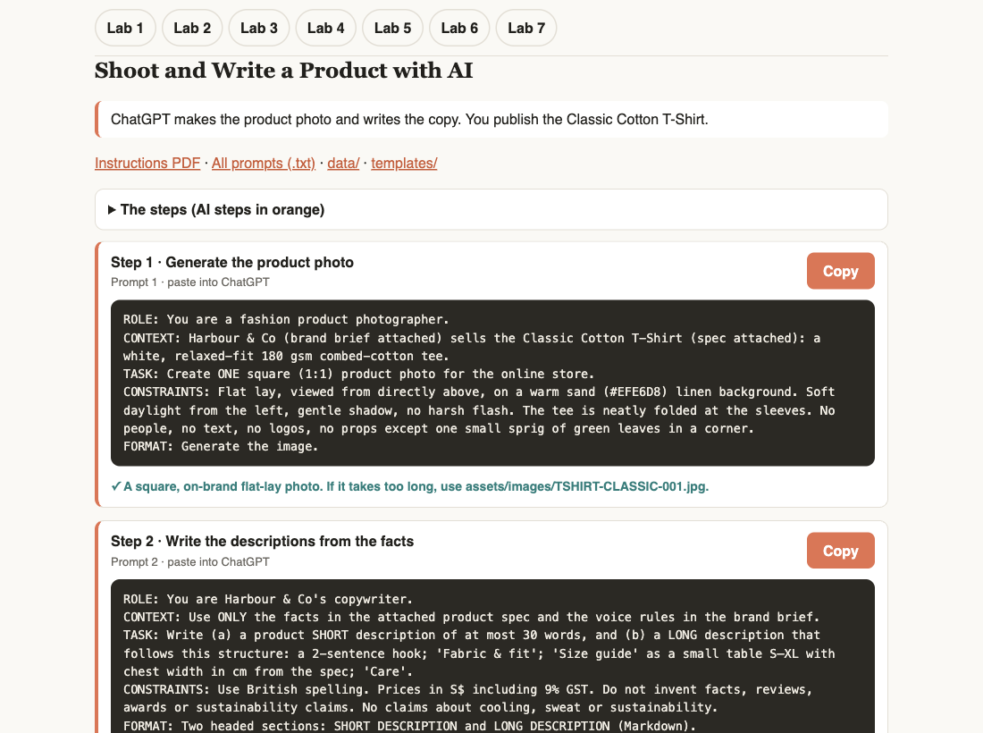



HANDS-ON · YOUR LAB KIT
Every Lab Has Its Own Folder
labs/lab-NN-…/ — instructions PDF, prompts, mock data, product assets, templates.
LAB-NN-Instructions.pdf
Steps, values, logins, plugins — and a Prompt Playbook page: step → prompt → step → prompt.
COPY-PROMPTS.txt + prompts page
labs/prompts/index.html — click Copy, paste into ChatGPT. Works offline.
data/ · assets/ · templates/
Brand brief, CSV catalogue, product images and copy, homepage and policy templates.
plugin/ (Lab 1)
The Harbour & Co Toolkit WordPress plugin — brand styles and block patterns.
© Tertiary Infotech Academy Pte Ltd
Build a Professional eCommerce Store with Generative AI · C6
14

Slide 15
SECTION 1 · TOPIC 1
1
Choosing an AI tool
AI for WordPress and WooCommerce
2
Model tiers
3
Effective prompts
4
WordPress AI Connectors
5
AI features in the editor
The AI toolkit you use in every lab.
© Tertiary Infotech Academy Pte Ltd · C6

Slide 16

TOPIC 1 · WHAT YOU'LL LEARN
Key Concepts in This Topic
Choosing an AI tool
Model tiers
Effective prompts
ChatGPT, Gemini and Claude compared on strengths, ease of use and price.
From fast and budget to heavy-duty models, for each provider.
Role, context, task, constraints, format and examples.
Prompting in practice
WordPress AI Connectors
AI in the editor
Generate a replacement About Us page in line with E-E-A-T.
Connect Google, Anthropic or OpenAI from Settings > Connectors (WordPress 7.0+).
Enable AI features, and know the WooCommerce Classic Editor limits.
© Tertiary Infotech Academy Pte Ltd
Build a Professional eCommerce Store with Generative AI · C6
16

Slide 17
TOPIC 1 · CHOOSING A TOOL
ChatGPT, Gemini or Claude?
Dimension | ChatGPT (OpenAI) | Google Gemini (Google) | Claude (Anthropic)
Best Suited For | Generalist tool for daily tasks Image generation (DALL-E) Complex multi-step reasoning Voice interactions & custom GPTs | Deep integration with Google Workspace (Docs, Gmail, Drive) Processing massive files/documents (up to 1M-2M context window) Video/multimodal processing & YouTube research | Natural, human-like writing & long-form text editing Complex coding, refactoring & technical work Deep document analysis & instruction following
Ease of Use | Very High Extremely intuitive interface, smooth mobile app, versatile cross-modality (voice, image, text) in one chat. | Very High Easiest if you already use Google products—works directly inside your Docs, Gmail, and Drive without copy-pasting. | High Clean, minimalist UI focused on text and code. Includes helpful project sidebars, though lacks native voice/image generation.
Free Tier | Free (Access to default models with message rate limits). | Free (Generous usage limits and web/search grounding). | Free (Strict rate limits on standard model).
Individual Paid Tier | $20 / month (ChatGPT Plus) Includes advanced voice, custom GPTs, DALL-E, higher limits. | $19.99 / month (Google AI Pro) Includes 2TB–5TB Google One storage & Workspace integrations. | $20 / month (Claude Pro) Discounted to ~$17/mo if billed annually. Includes higher limits & Claude Code access.
© Tertiary Infotech Academy Pte Ltd
Build a Professional eCommerce Store with Generative AI · C6
17

Slide 18

TOPIC 1 · CHOOSING A TOOL
Which Tool for Which Job
ChatGPT — best for content creation
Gemini — best for SEO / GEO work
Claude — best for detailed, complex work
An all-in-one Swiss Army knife that handles images, voice chat, web searching and everyday broad assistance.
Use it within Google Workspace (Gmail, Docs, Drive), or to upload and summarise massive files, PDFs or videos.
Choose it when the priority is writing quality, nuanced editing, long-form content or serious software engineering.
TIP In this course's labs we use ChatGPT for copy and images — swap in Gemini or Claude if your company prefers.
© Tertiary Infotech Academy Pte Ltd
Build a Professional eCommerce Store with Generative AI · C6
18

Slide 19
TOPIC 1 · CHOOSING A TOOL
Models — Claude vs Gemini vs ChatGPT / Codex
Provider | Least Powerful (Fast / Budget) | Mid-Tier (Balanced) | Most Powerful (Heavy Duty) | Agentic (Maximum Capacity)
Claude | Haiku | Sonnet | Opus | Fable
Gemini | Flash | Pro | Argon | Covered By Argon
Codex | Luna | Sol | Astra | Covered By Astra
TIP Ordered from least to most powerful — match the model tier to the task.
© Tertiary Infotech Academy Pte Ltd
Build a Professional eCommerce Store with Generative AI · C6
19

Slide 20
TOPIC 1 · PROMPTING
Structure of an Effective Prompt
Component | What It Does | Example
1. Role / Persona | Sets the AI's perspective, tone, and level of expertise. | "Act as a senior B2B content strategist..."
2. Context | Background details, target audience, constraints, or current situation. | "We are launching a B2B SaaS product for small accounting firms with tight budgets."
3. Task (Instruction) | The specific action you want the AI to perform (use strong verbs). | "Draft a 3-paragraph cold email sequence..."
4. Constraints & Rules | What to avoid, negative constraints, word counts, or strict boundaries. | "Do not use jargon or buzzwords like 'synergy'. Keep each email under 120 words."
5. Format / Output | How you want the final response laid out (table, bullet list, markdown). | "Format as a table with columns: Subject Line | Email Body | Call to Action."
6. Examples (Optional) | One or two target examples showing the style or logic to emulate. | "Style reference: Short, punchy, conversational tone similar to..."
TIP Role · Context · Task · Constraint · Output — every lab prompt in this course uses this shape.
© Tertiary Infotech Academy Pte Ltd
Build a Professional eCommerce Store with Generative AI · C6
20

Slide 21

TOPIC 1 · PROMPTING IN PRACTICE
Prompt to Generate a Replacement About Us Page
PROMPT · copy from the Lab Prompts page
Reply from AI
You are a professional website designer and we are going to revamp our website https://wp1.tertiarytraining.com. Please review the products that we sell and design a modern, professional and inviting about us page in line with Google’s EEAT elements. Use existing theme colours and layouts. Do not generate header. Ask me for more information should you require.
I’ve produced a modern About Us concept that uses Harbour & Co’s existing Lato typeface, blue accent, retail navigation language, and catalogue focus. It replaces the generic template team section with an E-E-A-T-oriented story, product relevance, and a real t
Why it works
Role, the live site, the audience, E-E-A-T and the brand look are all in the prompt.
© Tertiary Infotech Academy Pte Ltd
Build a Professional eCommerce Store with Generative AI · C6
21

Slide 22
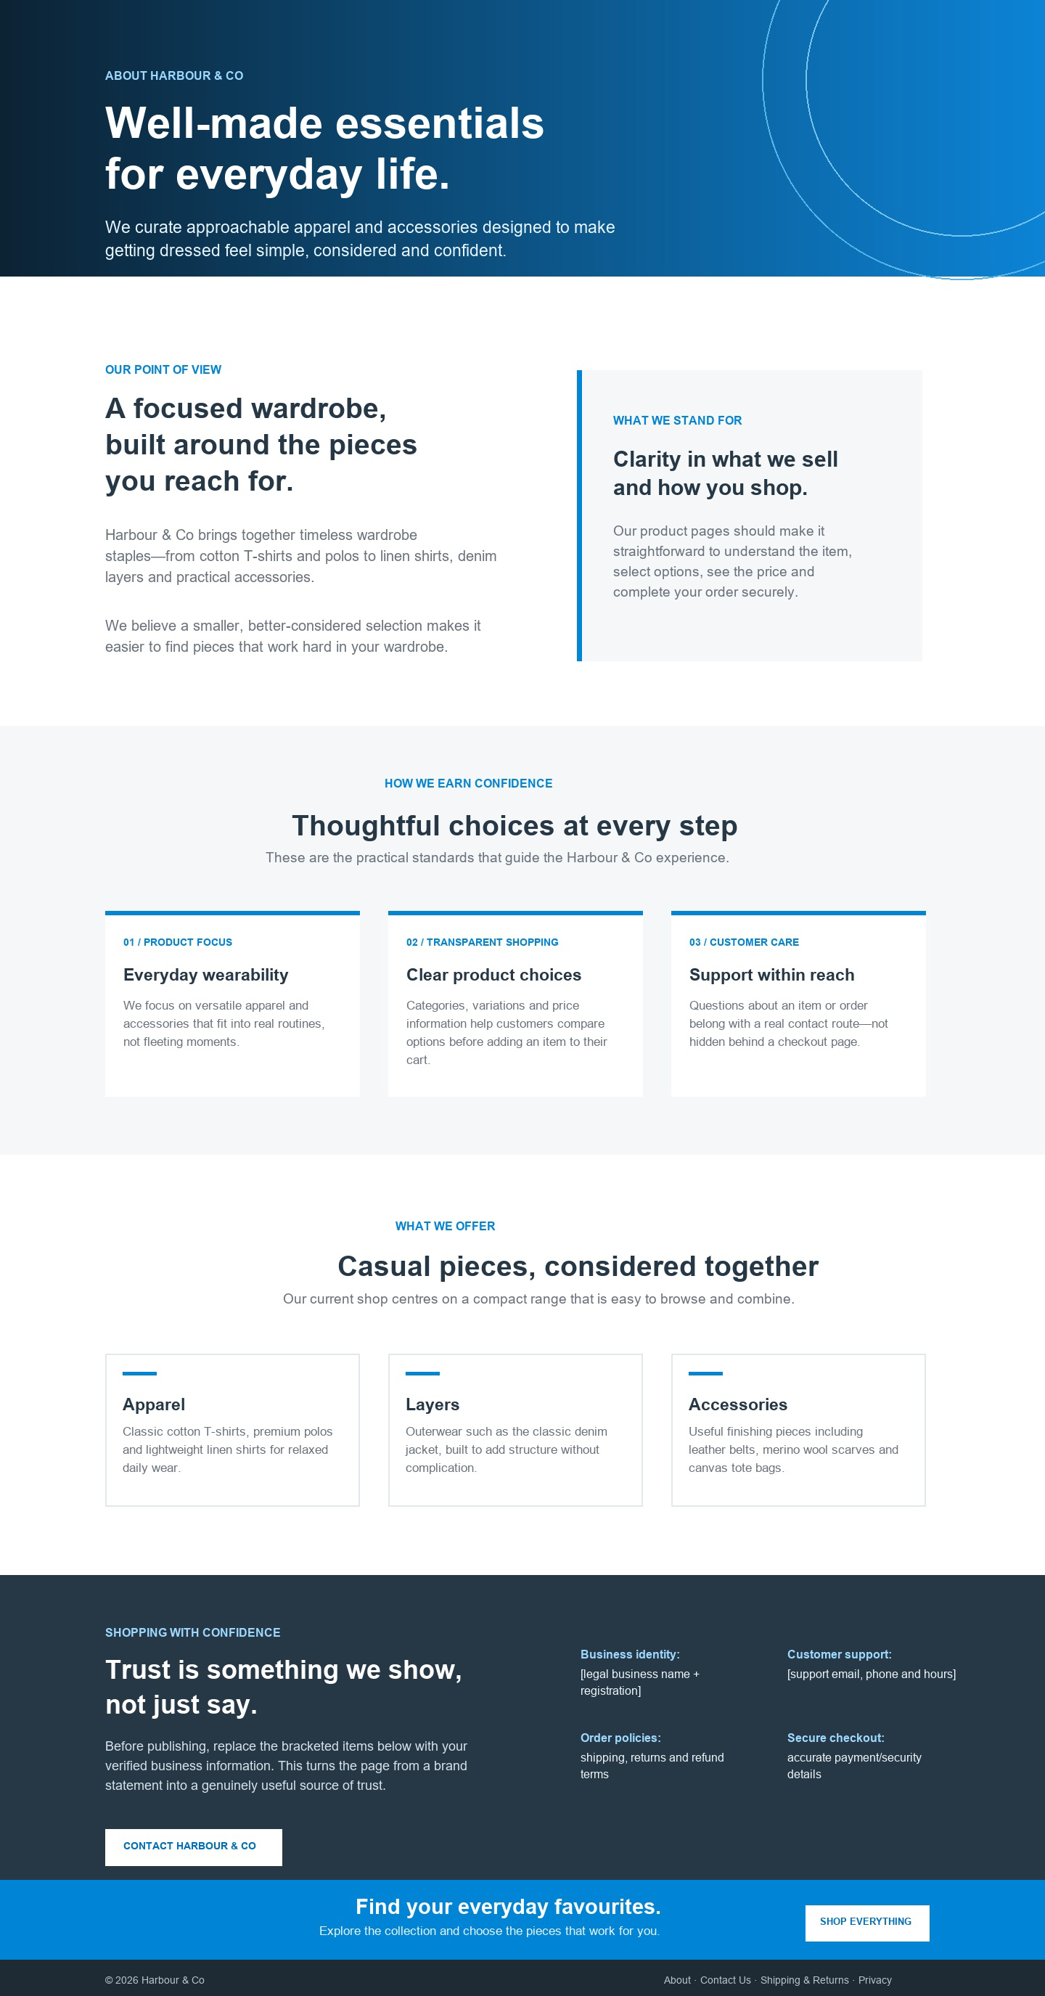
TOPIC 1 · PROMPTING IN PRACTICE
What the AI Produced
▸ The AI's About Us concept, built from the store's existing typeface, colours and catalogue.
© Tertiary Infotech Academy Pte Ltd
Build a Professional eCommerce Store with Generative AI · C6
22

Slide 23
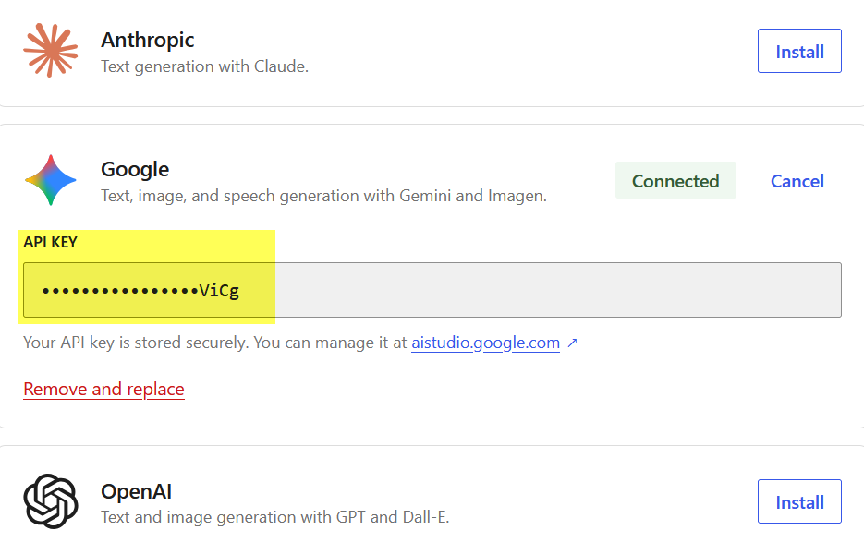



TOPIC 1 · WORDPRESS AI CONNECTORS
Using WordPress AI Connectors
Settings > Connectors
Core WordPress from version 7.0 — your API keys live here, shared across plugins.
Choose the provider
Anthropic (Claude), Google (Gemini, Imagen) or OpenAI (GPT, DALL·E).
Install the connector
Each provider installs as a small plugin.
Create an API key
From the AI platform — next two slides use Google AI Studio.
▸ Verified on WordPress 7.1.4: Settings > Connectors lists Anthropic, Google and OpenAI plus 'Install the AI plugin'.
© Tertiary Infotech Academy Pte Ltd
Build a Professional eCommerce Store with Generative AI · C6
23

Slide 24
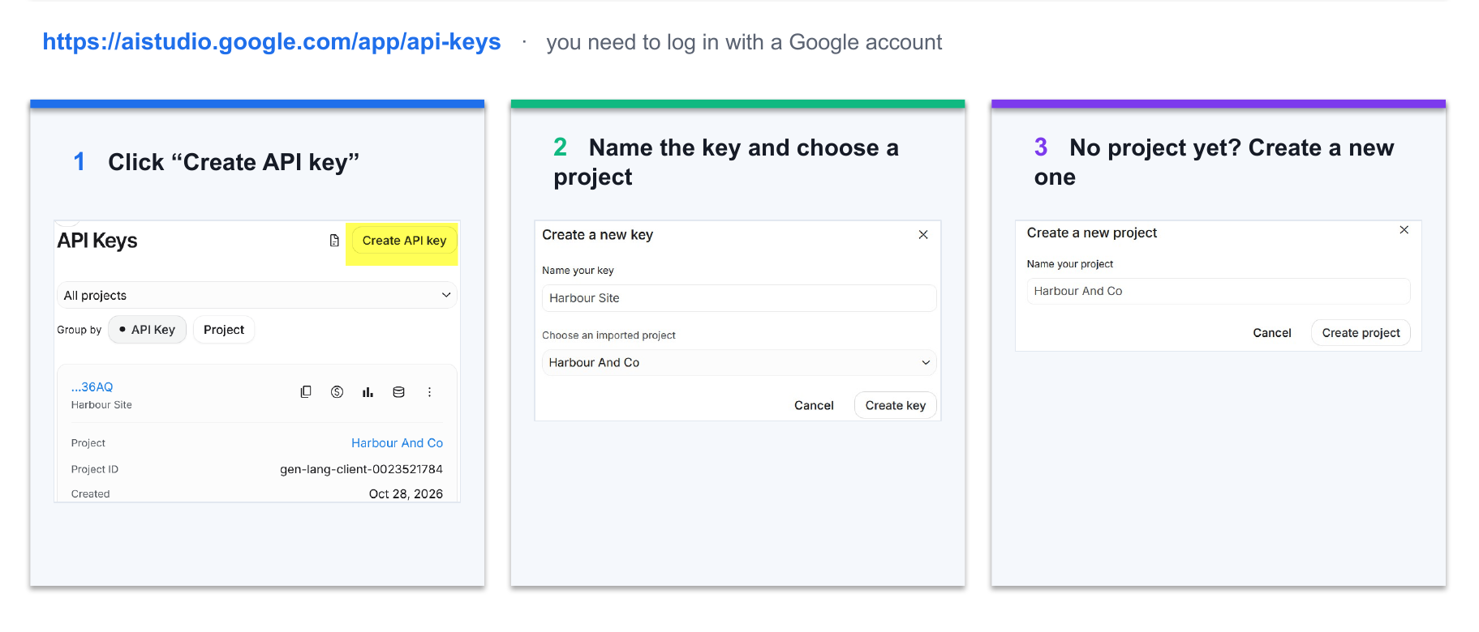
TOPIC 1 · WORDPRESS AI CONNECTORS
Create an API Key (Google) — Part 1
▸ https://aistudio.google.com/app/api-keys — log in with a Google account, Create API key, name it, pick or create a project.
© Tertiary Infotech Academy Pte Ltd
Build a Professional eCommerce Store with Generative AI · C6
24

Slide 25
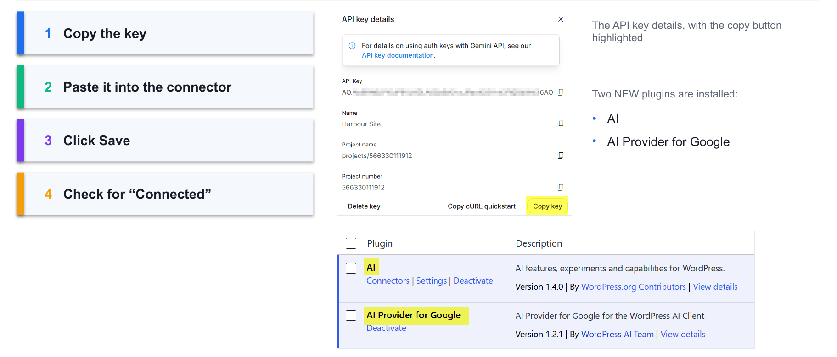
TOPIC 1 · WORDPRESS AI CONNECTORS
Create an API Key (Google) — Part 2
▸ Copy the key, paste it into the connector, Save, and check for 'Connected'. Two new plugins appear: AI and AI Provider for Google.
© Tertiary Infotech Academy Pte Ltd
Build a Professional eCommerce Store with Generative AI · C6
25

Slide 26
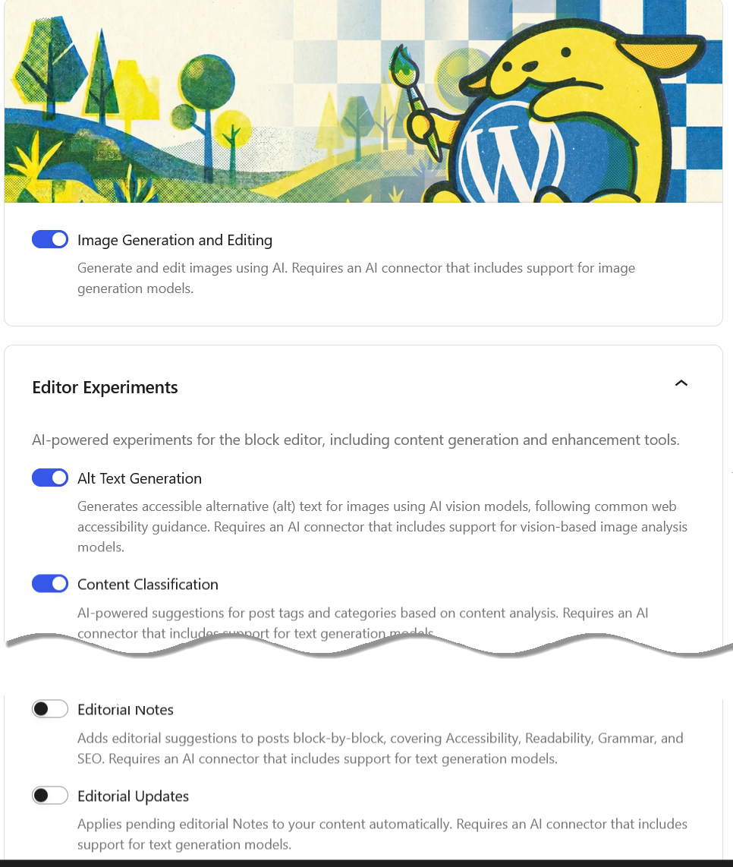

TOPIC 1 · AI FEATURES
Configure AI Features
Settings > AI
Turn features on or off for your site.
Image generation and editing
Create featured images from a prompt.
Editor experiments
Alt text generation, content classification.
Editorial notes
Suggested updates while you write.
© Tertiary Infotech Academy Pte Ltd
Build a Professional eCommerce Store with Generative AI · C6
26

Slide 27
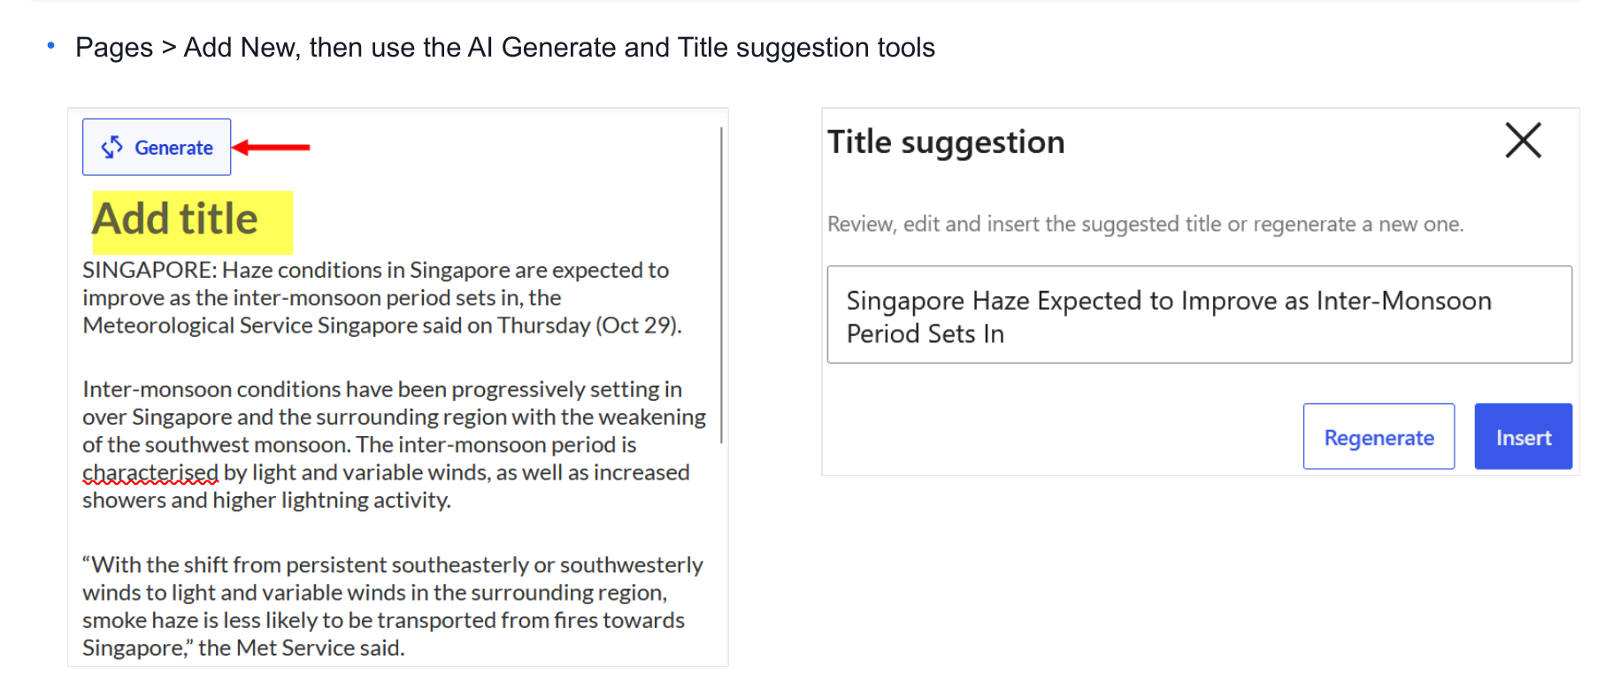
TOPIC 1 · AI FEATURES
Put It to the Test
▸ Pages > Add New, then try the AI Generate and Title suggestion tools.
© Tertiary Infotech Academy Pte Ltd
Build a Professional eCommerce Store with Generative AI · C6
27

Slide 28
TOPIC 1 · CHOOSING A TOOL
WordPress “AI Provider for Google” vs Google Gemini
Feature / Aspect | WordPress "AI Provider for Google" | Google Gemini (Standalone Ecosystem)
Primary Usefulness | Acts as a standardized bridge to connect your WordPress backend directly to Gemini models for automating site tasks (text, image generation, speech). | A versatile, standalone AI assistant and multimodal engine used for general research, coding, content creation, and data analysis.
Pros | Native Integration: Works smoothly with the PHP AI Client SDK inside modern WordPress environments. Flexibility: Allows different plugins to tap into Google AI smoothly through a unified layer. Direct Model Discovery: Automatically pulls available Gemini and Imagen models via API. | Massive Context Window: Exceptional at processing huge files, long videos, or entire codebases at once. Multimodal Excellence: Native understanding across text, code, audio, image, and video. Ready-to-Use UI: Accessible immediately via web or app without needing site configuration.
Cons | Dependent Infrastructure: Requires manual API key configuration and relies heavily on other plugins or core components to deliver user-facing features. Cost/Token Management: Unmonitored plugins can rack up unexpected API usage bills. | Disconnected Workflow: Content generated must be manually copied and pasted into WordPress (no automated native execution unless bridged by third-party tools). Prompt Dependency: Output quality varies heavily based on user prompt engineering skills.
© Tertiary Infotech Academy Pte Ltd
Build a Professional eCommerce Store with Generative AI · C6
28

Slide 29


TOPIC 1 · POINTS TO NOTE
WordPress.org's Official AI Plugin and WooCommerce
PHP · what the toolkit plugin switches on for you
The catch
// Enable Gutenberg / Block Editor for WooCommerce Products
add_filter( 'use_block_editor_for_post_type',
'enable_block_editor_for_woocommerce', 10, 2 );
function enable_block_editor_for_woocommerce( $can_edit, $post_type ) {
if ( 'product' === $post_type ) { $can_edit = true; }
return $can_edit;
}
The official AI plugin draws its toolbar in the block editor; WooCommerce products still default to the classic editor.
No code needed today
The Harbour & Co Toolkit plugin (Lab 1) has this as a tick box: Settings > Harbour & Co.
Trade-off
Product screens look different in the block editor — the labs use the classic product editor.
© Tertiary Infotech Academy Pte Ltd
Build a Professional eCommerce Store with Generative AI · C6
29

Slide 30
TOPIC 1 · YOUR AI CO-WORKER
The Brand Brief Goes Into Every Prompt
Attach it once per chat
Role + context + task
Constraints stop drift
You are the editor
labs/…/data/brand-brief.txt — voice, colours, promises, banned claims.
Every lab prompt names a role, gives the brief, and asks for one job.
British spelling, S$ incl. 9% GST, no invented reviews or sustainability claims.
AI drafts; you check every fact against the spec before it goes live.
TIP The single rule of this course: AI writes the first draft, a human approves anything public.
© Tertiary Infotech Academy Pte Ltd
Build a Professional eCommerce Store with Generative AI · C6
30

Slide 31
SECTION 2 · TOPICS 2–6
1
Store setup
WooCommerce
2
Products
3
Payments & shipping
4
Sales
5
Performance
© Tertiary Infotech Academy Pte Ltd · C6

Slide 32
TOPIC 2
1
What WooCommerce is
Overview of WooCommerce CMS
2
Installing it
3
Setup wizard
4
Themes & widgets
5
Settings, currency & tax
© Tertiary Infotech Academy Pte Ltd · C6

Slide 33

TOPIC 2 · CONTEXT
What is WooCommerce
▸ WooCommerce is an open-source, fully customisable eCommerce platform built on WordPress.
© Tertiary Infotech Academy Pte Ltd
Build a Professional eCommerce Store with Generative AI · C6
33

Slide 34

THE OPPORTUNITY
Why WooCommerce
Open source
Built on WordPress
Every product type
Free to use, fully customisable, and owned by you — not rented from a hosted platform.
Runs on the world's most widely used CMS, so your shop and your content live together.
Physical, digital, virtual, variable, subscription and bookable products.
Endlessly extensible
Hundreds of themes, payment gateways and extensions, plus a full developer API.
© Tertiary Infotech Academy Pte Ltd
Build a Professional eCommerce Store with Generative AI · C6
34

Slide 35



TOPIC 2 · WHAT YOU'LL LEARN
Key Concepts in This Topic
What WooCommerce is
Six steps to a store
System requirements
An open-source, fully customisable eCommerce platform built on WordPress, powering a large share of the world's online stores.
Choose hosting, install WordPress, pick a theme, activate WooCommerce, run the setup wizard, then extend with plugins.
PHP 7.2+, MySQL 5.6+ or MariaDB 10.0+, a 128 MB WordPress memory limit, and HTTPS support.
Taxonomies and post types
Themes and widgets
Settings, currency and tax
WooCommerce adds its own post types and taxonomies to WordPress to group and structure products.
The theme sets the storefront's look; widgets surface products, filters and categories in widgetised areas.
General, Products, Tax, Shipping, Payments and Privacy settings define how the store behaves and prices goods.
© Tertiary Infotech Academy Pte Ltd
Build a Professional eCommerce Store with Generative AI · C6
35

Slide 36
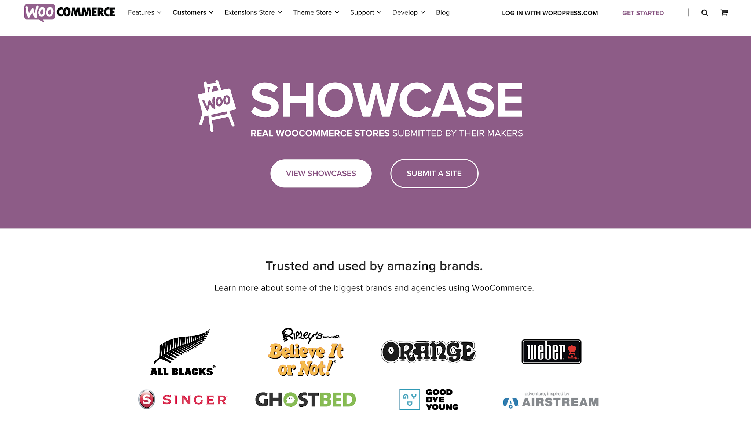
TOPIC 2 · INSPIRATION
WooCommerce Store Showcases
▸ Real stores built on WooCommerce — https://woocommerce.com/showcase/
© Tertiary Infotech Academy Pte Ltd
Build a Professional eCommerce Store with Generative AI · C6
36

Slide 37

TOPIC 2 · INSPIRATION
WooCommerce Demo Store
▸ The Storefront demo — https://themes.woocommerce.com/storefront/
© Tertiary Infotech Academy Pte Ltd
Build a Professional eCommerce Store with Generative AI · C6
37

Slide 38


TOPIC 2 · THE PATH
Start with WooCommerce in Six Steps
HOSTING
INSTALL WP
THEME
Meet the requirements
Set up WordPress
Pick Storefront
ACTIVATE
SET UP
EXTEND
Install the plugin
Run the wizard
Add plugins
© Tertiary Infotech Academy Pte Ltd
Build a Professional eCommerce Store with Generative AI · C6
38

Slide 39



TOPIC 2 · BEFORE YOU INSTALL
System Requirements
PHP 7.2 or greater
MySQL 5.6+ / MariaDB 10.0+
The server-side language WordPress and WooCommerce run on.
The database that stores products, orders and customers.
Memory limit 128 MB+
HTTPS support
WordPress needs headroom to process a catalogue and orders.
Essential — you are handling payment and customer data.
© Tertiary Infotech Academy Pte Ltd
Build a Professional eCommerce Store with Generative AI · C6
39

Slide 40

TOPIC 2 · INSTALL
Install WooCommerce on WordPress — Step by Step
Verified on WordPress 7.1.4 with WooCommerce 11.2.1.
STEP 1
STEP 2
STEP 3
STEP 4
STEP 5
Log in
Find the plugin
Install & activate
Run the wizard
Theme + settings
Your demo site /wp-admin with your training login.
Plugins > Add Plugin > search 'WooCommerce' — author Automattic.
Install Now, then Activate. The setup wizard opens.
Set up my store → describe yourself → store name, industry, location.
Storefront theme, then currency and tax settings.
TIP On 'Get a boost with our free features' click Skip this step — Harbour & Co adds its own plugins.
© Tertiary Infotech Academy Pte Ltd
Build a Professional eCommerce Store with Generative AI · C6
40

Slide 41
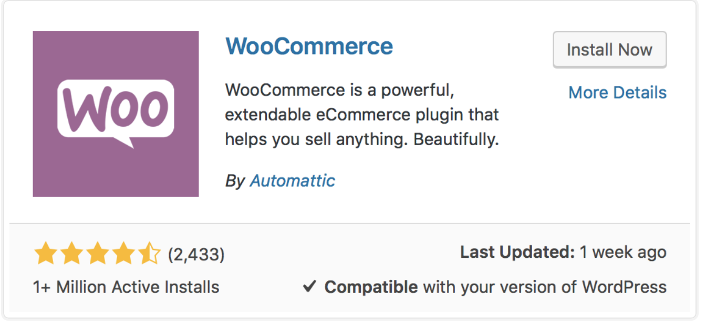
TOPIC 2 · INSTALL
Install WooCommerce
▸ Plugins > Add Plugin > search 'WooCommerce' by Automattic > Install Now > Activate.
© Tertiary Infotech Academy Pte Ltd
Build a Professional eCommerce Store with Generative AI · C6
41

Slide 42
TOPIC 2 · INSTALL
The Setup Wizard, Screen by Screen — for Harbour & Co
Screen | What it asks | Harbour & Co answer
Welcome to Woo! | Set up my store / Skip guided setup | Set up my store
Which one of these best describes you? | Just starting · Already selling · Setting up for a client | I'm already selling (in person, at the studio)
Tell us a bit about your store | Store name · Industry · Location · Email | Harbour & Co · Clothing and accessories · Singapore
Get a boost with our free features | PayPal, Jetpack, Pinterest, Klaviyo, Google, Snapchat, Reddit | Skip this step
WooCommerce > Home | Task list: products, payments, shipping, tax, appearance | Continue in Settings (Lab 1, steps 4–5)
© Tertiary Infotech Academy Pte Ltd
Build a Professional eCommerce Store with Generative AI · C6
42

Slide 43
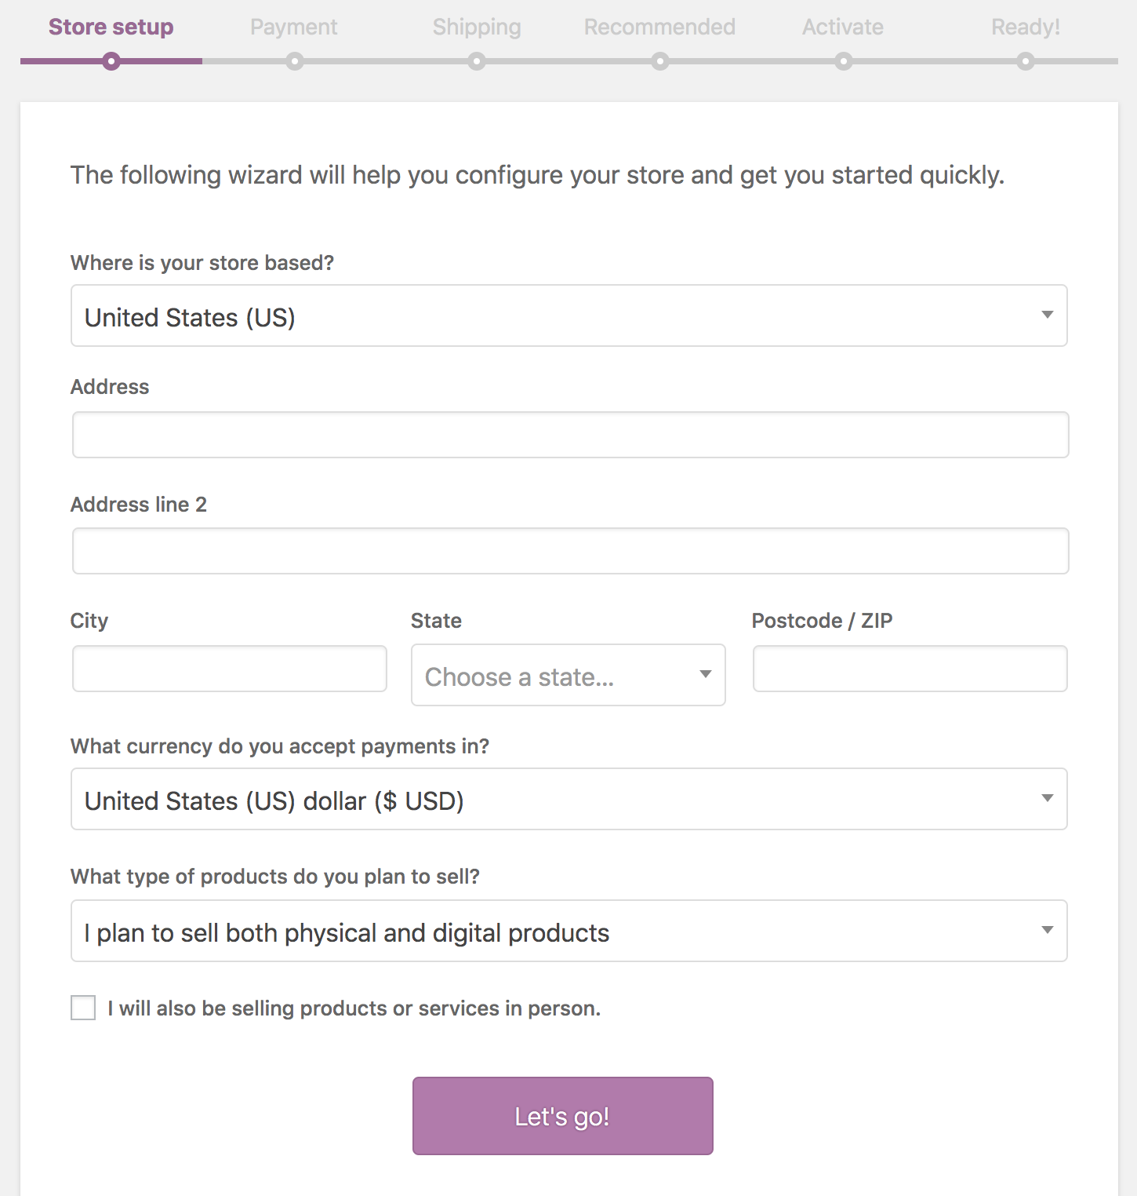
TOPIC 2 · INSTALL
The WooCommerce Setup Wizard
▸ On first activation the Setup Wizard configures the store for you.
© Tertiary Infotech Academy Pte Ltd
Build a Professional eCommerce Store with Generative AI · C6
43

Slide 44
TOPIC 2 · INSTALL
Store Setup
▸ Location and currency, the type of goods you sell, and whether you sell in person.
© Tertiary Infotech Academy Pte Ltd
Build a Professional eCommerce Store with Generative AI · C6
44

Slide 45
TOPIC 2 · HOW WOOCOMMERCE STRUCTURES CONTENT
Taxonomies and Post Types
Post types
Taxonomies
WordPress separates content into types — posts, pages, attachments. WooCommerce adds 'product'.
A grouping of post types — categories and tags. WooCommerce adds product categories, tags and attributes.
What it gives you
Created for you
This structure is what lets you filter, browse and curate a catalogue rather than a pile of pages.
The setup wizard registers these automatically when WooCommerce is activated.
© Tertiary Infotech Academy Pte Ltd
Build a Professional eCommerce Store with Generative AI · C6
45

Slide 46
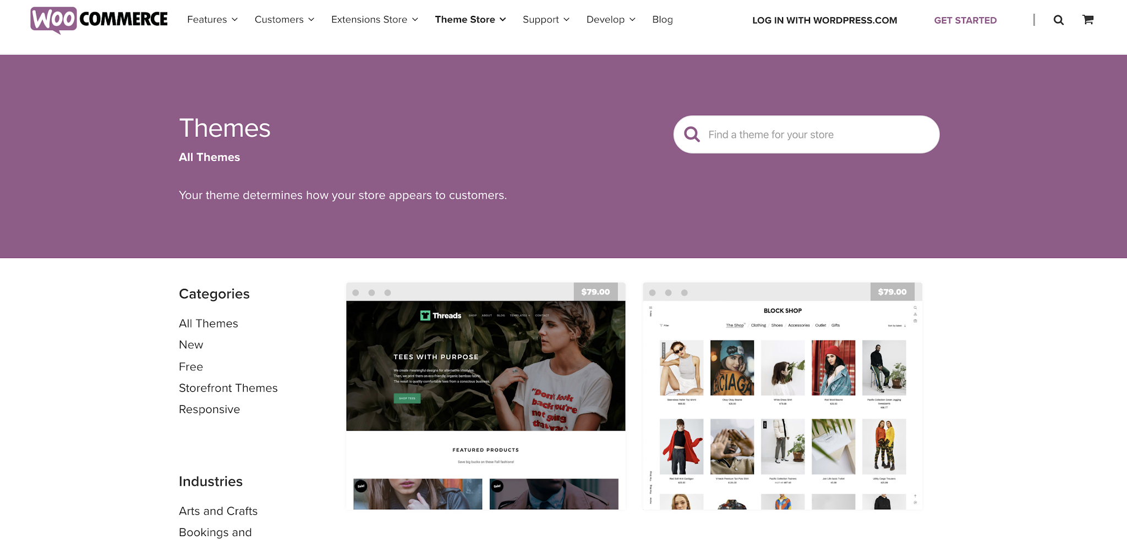
TOPIC 2 · THEMES
Professional WooCommerce Themes
▸ Official themes — https://woocommerce.com/product-category/themes
© Tertiary Infotech Academy Pte Ltd
Build a Professional eCommerce Store with Generative AI · C6
46

Slide 47
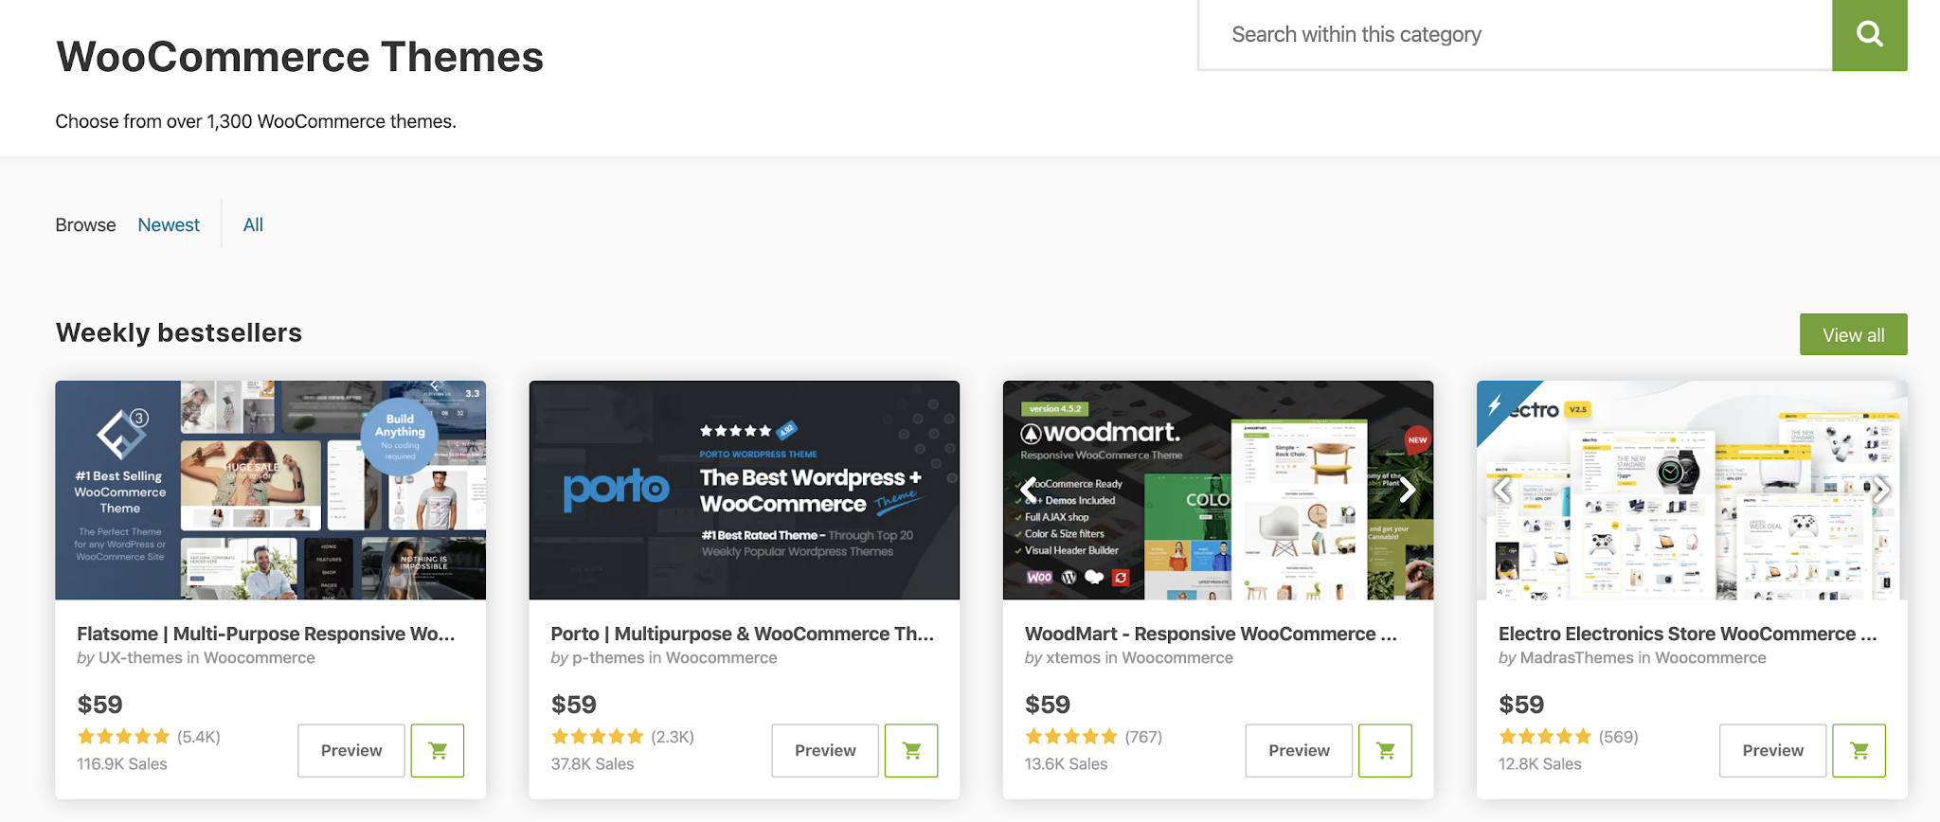
TOPIC 2 · THEMES
Third-Party WooCommerce Themes
▸ ThemeForest — https://themeforest.net/category/wordpress/ecommerce/woocommerce
© Tertiary Infotech Academy Pte Ltd
Build a Professional eCommerce Store with Generative AI · C6
47

Slide 48


TOPIC 2 · THEMES
Choosing the Right Theme
Aesthetic
Release frequency
Support
Does it suit your brand and the products you sell?
An actively maintained theme keeps pace with WooCommerce updates.
Is there documentation and a responsive support channel?
Custom functionality
Responsive
Compatibility
What does it add beyond styling — and will that lock you in?
It must work on a phone; most storefront traffic is mobile.
Confirm it declares WooCommerce support explicitly.
© Tertiary Infotech Academy Pte Ltd
Build a Professional eCommerce Store with Generative AI · C6
48

Slide 49
TOPIC 2 · WIDGETS
WooCommerce Widgets
Product widgets
Filter widgets
Products, Products by Rating, Recent Product Reviews, Recently Viewed Products.
Filter by Attribute, Filter by Price, Filter by Rating, plus Active Product Filters.
Navigation widgets
Utility widgets
Product Categories as a list or dropdown, and a Product Tag Cloud.
Cart and Product Search, so customers can buy and find from any page.
© Tertiary Infotech Academy Pte Ltd
Build a Professional eCommerce Store with Generative AI · C6
49

Slide 50
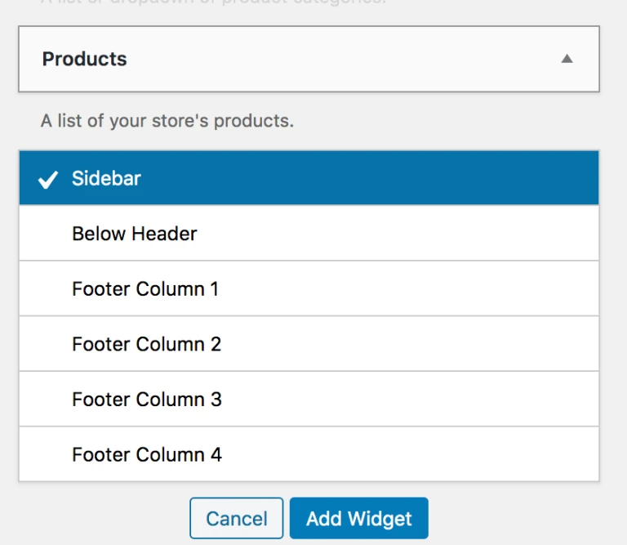
TOPIC 2 · WIDGETS
Adding a Widget
▸ Appearance > Widgets — choose a widget area, then Add Widget.
© Tertiary Infotech Academy Pte Ltd
Build a Professional eCommerce Store with Generative AI · C6
50

Slide 51
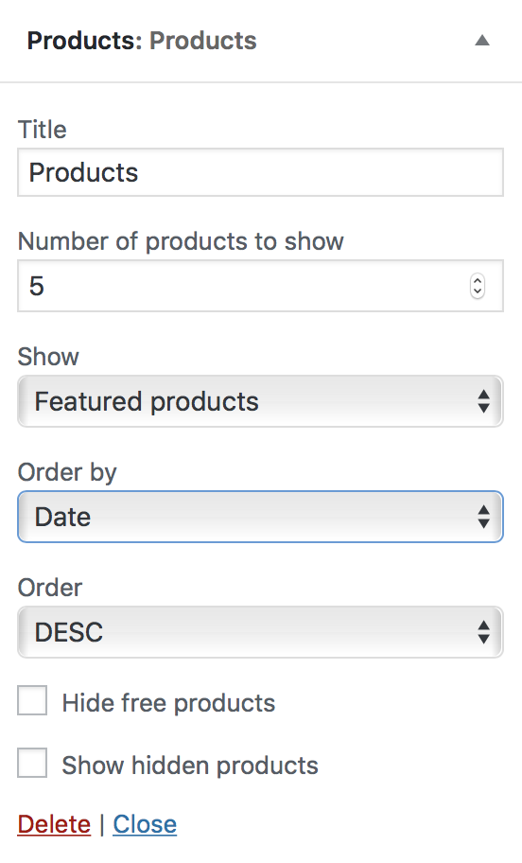
TOPIC 2 · WIDGETS
The Products Widget
▸ Show products by date, price, sales or randomly — all, featured only, or on sale.
© Tertiary Infotech Academy Pte Ltd
Build a Professional eCommerce Store with Generative AI · C6
51

Slide 52
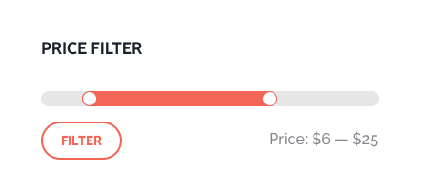
TOPIC 2 · WIDGETS
Filter Products by Price
▸ A slider that auto-detects the minimum and maximum prices on the page.
© Tertiary Infotech Academy Pte Ltd
Build a Professional eCommerce Store with Generative AI · C6
52

Slide 53
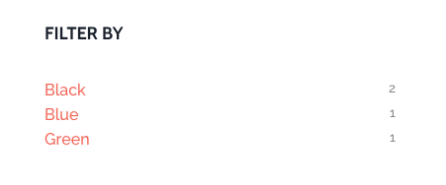
TOPIC 2 · WIDGETS
Filter Products by Attribute
▸ Layered navigation — AND returns products matching both terms, OR matches either.
© Tertiary Infotech Academy Pte Ltd
Build a Professional eCommerce Store with Generative AI · C6
53

Slide 54

TOPIC 2 · SHORTCODES — ADDED AUTOMATICALLY BY THE WIZARD
Shortcodes Included with WooCommerce
[woocommerce_cart]
[woocommerce_checkout]
Renders the cart page.
Renders the checkout page.
[woocommerce_my_account]
[woocommerce_order_tracking]
Renders the customer account page.
Renders the order tracking form.
© Tertiary Infotech Academy Pte Ltd
Build a Professional eCommerce Store with Generative AI · C6
54

Slide 55
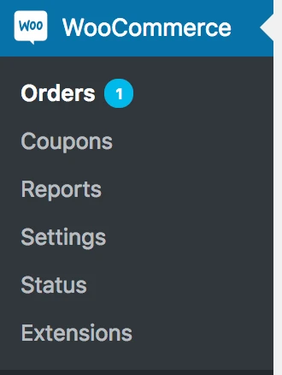
TOPIC 2 · THE ADMIN
WooCommerce Menu Items
▸ Orders, Coupons, Reports and Settings — the four places you work every day.
© Tertiary Infotech Academy Pte Ltd
Build a Professional eCommerce Store with Generative AI · C6
55

Slide 56


TOPIC 2 · WOOCOMMERCE > SETTINGS
Configuring WooCommerce Settings
General
Products
Tax
Store address, selling and shipping locations, taxes and currency options.
Shop pages, measurements, reviews, inventory and downloadable products.
Prices entered with tax, tax rates, and how tax is calculated and displayed.
Shipping
Payments
Accounts & Privacy
Shipping zones, methods, classes and shipping options.
Which gateways are enabled and the order they appear at checkout.
Guest checkout, account creation, and data retention policy.
© Tertiary Infotech Academy Pte Ltd
Build a Professional eCommerce Store with Generative AI · C6
56

Slide 57
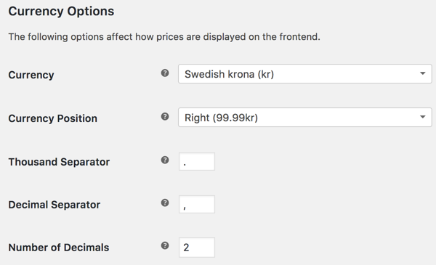
TOPIC 2 · SETTINGS
Shop Currency
▸ WooCommerce > Settings > General > Currency options.
© Tertiary Infotech Academy Pte Ltd
Build a Professional eCommerce Store with Generative AI · C6
57

Slide 58
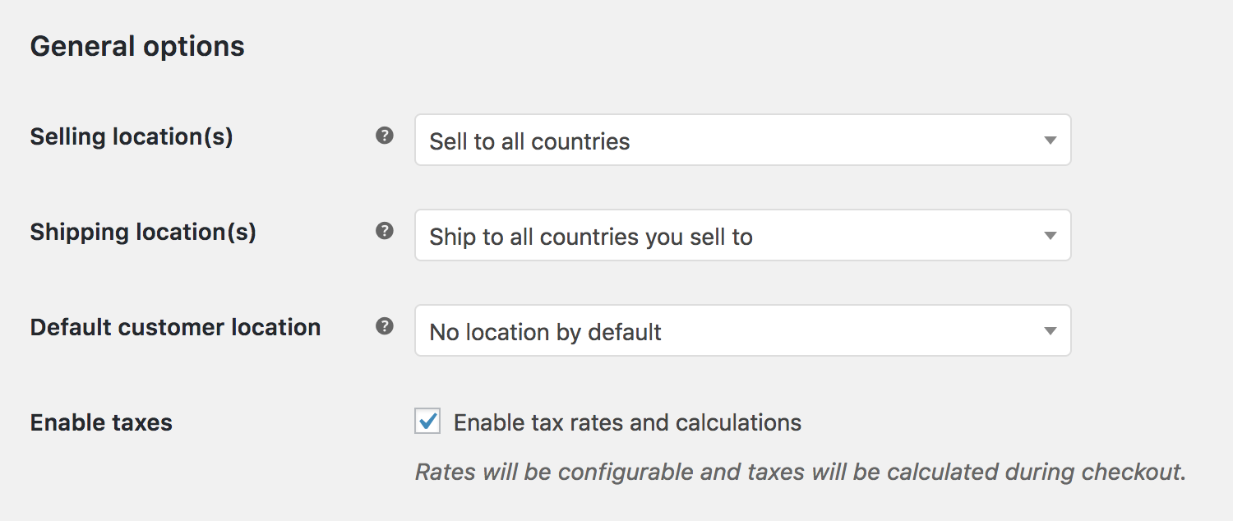
TOPIC 2 · TAX
Enabling Taxes
▸ Tick 'Enable taxes and tax calculations' — the Tax tab then appears.
© Tertiary Infotech Academy Pte Ltd
Build a Professional eCommerce Store with Generative AI · C6
58

Slide 59
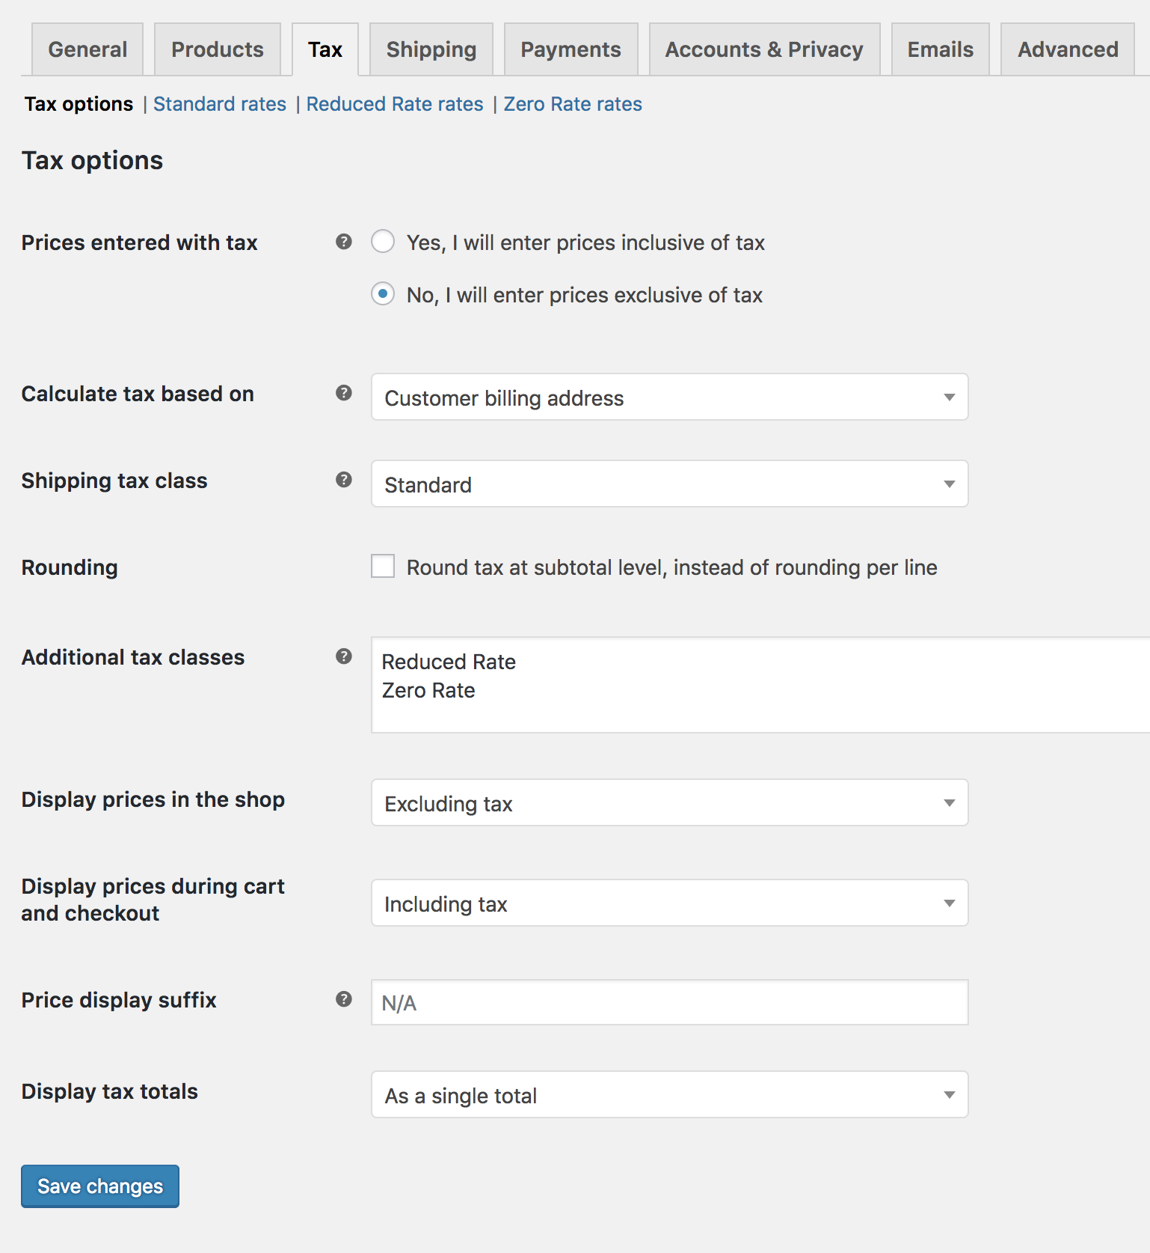
TOPIC 2 · TAX
Configuring Tax Options
▸ WooCommerce > Settings > Tax — visible only once taxes are enabled.
© Tertiary Infotech Academy Pte Ltd
Build a Professional eCommerce Store with Generative AI · C6
59

Slide 60
TOPIC 2 · THE MOST IMPORTANT TAX DECISION
Prices Entered With Tax
Inclusive
Exclusive
'Yes, I will enter prices inclusive of tax' — catalogue prices already contain the base tax rate.
'No, I will enter prices exclusive of tax' — tax is added on top at checkout.
Inclusive formula
Exclusive formula
tax_amount = price − ( price / ( ( tax_rate% / 100 ) + 1 ) )
tax_amount = price × ( tax_rate% / 100 )
© Tertiary Infotech Academy Pte Ltd
Build a Professional eCommerce Store with Generative AI · C6
60

Slide 61
TOPIC 2 · HARBOUR & CO SETTINGS
Singapore Dollars and 9% GST — the Settings That Matter
Setting | Where | Harbour & Co value | Why
Currency | Settings > General | Singapore dollar — shown as S$ by the toolkit | WooCommerce's SGD symbol is a plain $
Default customer location | Settings > General | Shop country/region | Unknown visitors otherwise see prices without GST
Prices entered with tax | Settings > Tax | Yes — inclusive | Every product price already contains GST
Standard rate | Tax > Standard rates | SG · 9% · GST | Singapore GST rate since 1 Jan 2024
Shipping cost | Shipping > zone > Flat rate | 4.59, taxable | Shipping costs are entered excluding tax: 4.59 + 9% = S$5.00
TIP Every row here was checked on a live WooCommerce 11 store before it went on this slide.
© Tertiary Infotech Academy Pte Ltd
Build a Professional eCommerce Store with Generative AI · C6
61

Slide 62
TOPIC 2 · WORDPRESS TEMPLATES WITH AI
Three Ways AI Output Becomes a WordPress Page
Custom HTML block
Block patterns
Paste Markdown
Paste the AI's HTML + CSS into one block. Fast, exact, but edited as code.
Reusable designed sections — the toolkit adds Hero, Collections, New arrivals, Trust bar, Policy links.
Paste AI Markdown into the editor: # headings and lists turn into real blocks.
TIP Lab 1 uses the first two: the AI-written homepage in a Custom HTML block, plus the live New arrivals pattern.
© Tertiary Infotech Academy Pte Ltd
Build a Professional eCommerce Store with Generative AI · C6
62

Slide 63
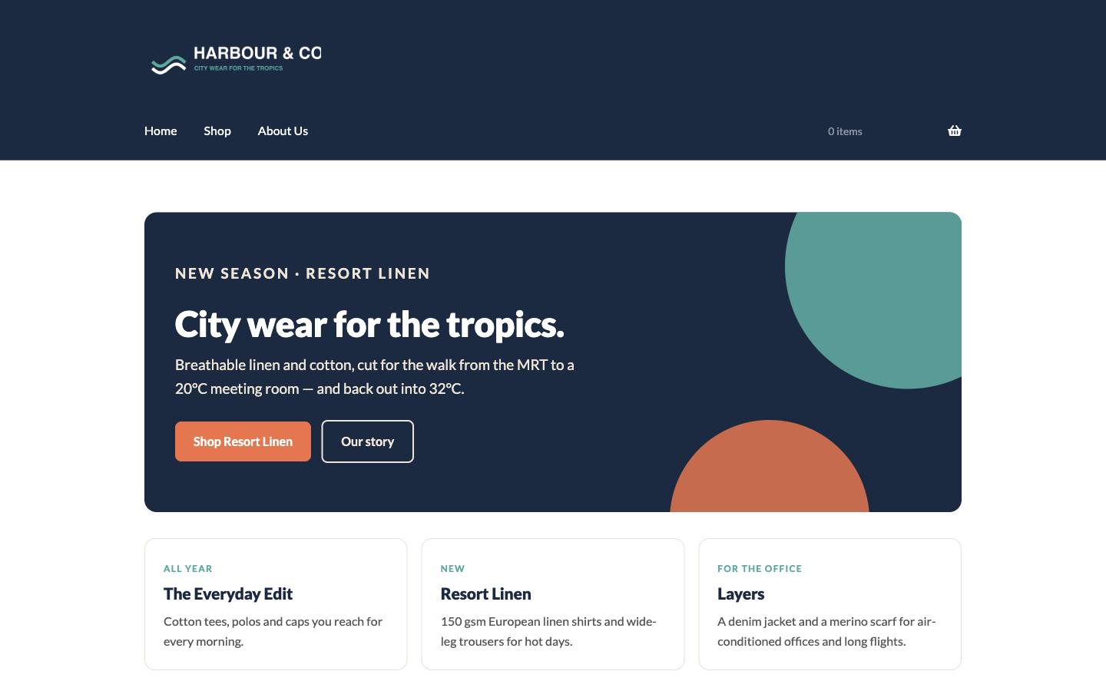
TOPIC 2 · WHAT YOU'LL BUILD
The Harbour & Co Homepage — AI-Designed, Live on WooCommerce
▸ Built in the docker test store from the Lab 1 template and the toolkit plugin — your version will differ.
© Tertiary Infotech Academy Pte Ltd
Build a Professional eCommerce Store with Generative AI · C6
63

Slide 64
TOPIC 2 · LAB 1 · PHASE 1
Lab 1 — Launch Harbour & Co — WooCommerce Plus an AI-Designed Homepage
Install WooCommerce, run the wizard, then let ChatGPT design the homepage you publish.
The business scenario
You will deliver
✓ WooCommerce installed and the setup wizard completed for Harbour & Co
✓ Store address, S$ currency and 9% GST (prices inclusive) saved
✓ Storefront theme and the Harbour & Co Toolkit plugin active
✓ An AI-designed homepage published and set as the front page
✓ A Shop manager user for Daniel Koh — the permissions policy in action
Rachel Lim has a WordPress site and a studio shop, but no online store. Today you install WooCommerce, set Singapore dollars and 9% GST the way her accountant wants, give her shop manager the right role, and publish a homepage that ChatGPT designs from the Harbour & Co brand brief.
AI does ChatGPT writes the homepage copy and the page layout as WordPress-ready HTML.
You decide You choose the layout, check every claim against the brand brief, and decide who may publish.
Time 25 min · LO1
© Tertiary Infotech Academy Pte Ltd
Build a Professional eCommerce Store with Generative AI · C6
64
Notes:
Lab 1 — Launch Harbour & Co — WooCommerce Plus an AI-Designed Homepage (25 min). Full steps: labs/lab-01-launch-harbour-and-co/LAB-01-Instructions.pdf
1. Log in to your demo site — Browser
2. Install and activate WooCommerce — Plugins > Add Plugin
3. Run the setup wizard for Harbour & Co — WooCommerce setup wizard
4. Set the address, selling location and currency — WooCommerce > Settings > General
5. Enter prices inclusive of 9% GST — WooCommerce > Settings > Tax
6. Apply the Storefront theme — Appearance > Themes > Add New Theme
7. Upload the Harbour & Co Toolkit plugin — Plugins > Add Plugin > Upload Plugin
8. Ask ChatGPT to design the homepage — ChatGPT (chatgpt.com) — a new chat
9. Publish the homepage — Pages > Add Page
10. Make it the front page — Settings > Reading
11. Add the logo and the main menu — Appearance > Customize > Site Identity · Appearance > Menus
12. Give the shop manager the right role — Users > Add User

Slide 65






TOPIC 2 · LAB 1 · PHASE 1
Lab 1 — How it runs
Orange cards are you; dark cards are the AI. Nothing goes live without you.
YOU · STEP 1
YOU · STEP 2
YOU · STEP 3
AI · STEP 4
YOU · STEP 5
YOU · STEP 6
Log in
Install WooCommerce
Set money rules
AI designs the homepage
You check and publish
Set permissions
Your demo site /wp-admin with your training login.
Plugins > Add Plugin, then run the setup wizard.
S$, 9% GST inclusive, Singapore selling location.
ChatGPT turns the brand brief into page HTML.
Fix any claim the brief does not support; publish.
Daniel Koh becomes Shop manager, not Administrator.
Checkpoint Your site's front page shows the Harbour & Co homepage, prices display in S$, and Users lists Daniel Koh as Shop manager.
© Tertiary Infotech Academy Pte Ltd
Build a Professional eCommerce Store with Generative AI · C6
65

Slide 66
TOPIC 2 · LAB 1 · PHASE 1
Lab 1 — The Steps
# | Step | Where
1 | Log in to your demo site | Browser
2 | Install and activate WooCommerce | Plugins > Add Plugin
3 | Run the setup wizard for Harbour & Co | WooCommerce setup wizard
4 | Set the address, selling location and currency | WooCommerce > Settings > General
5 | Enter prices inclusive of 9% GST | WooCommerce > Settings > Tax
6 | Apply the Storefront theme | Appearance > Themes > Add New Theme
7 | Upload the Harbour & Co Toolkit plugin | Plugins > Add Plugin > Upload Plugin
8 | Ask ChatGPT to design the homepage [AI prompt] | ChatGPT (chatgpt.com) — a new chat
9 | Publish the homepage | Pages > Add Page
10 | Make it the front page | Settings > Reading
11 | Add the logo and the main menu | Appearance > Customize > Site Identity · Appearance > Menus
12 | Give the shop manager the right role | Users > Add User
TIP Full instructions, values and the Prompt Playbook: labs/lab-01-launch-harbour-and-co/LAB-01-Instructions.pdf
© Tertiary Infotech Academy Pte Ltd
Build a Professional eCommerce Store with Generative AI · C6
66

Slide 67
TOPIC 2 · LAB 1 · PHASE 1
Step 8 · Ask ChatGPT to design the homepage
PROMPT · copy from labs/prompts/index.html or COPY-PROMPTS.txt
ROLE: You are a senior eCommerce web designer who builds WooCommerce storefronts.
CONTEXT: The attached brand brief describes Harbour & Co, a Singapore fashion label. The site runs WordPress with the Storefront theme. The page will go inside ONE WordPress 'Custom HTML' block.
TASK: Write the homepage as a single self-contained HTML snippet with these sections in order:
1. Hero — headline, one-line pitch, two buttons: 'Shop Resort Linen' (/product-category/apparel/) and 'Our story' (/about-us/)
2. Three collection cards — The Everyday Edit, Resort Linen, Layers — one sentence each
3. A trust bar — free delivery above S$100, 14-day returns, PayNow and card, studio pickup
4. A short founder note from Rachel Lim (3 sentences)
CONSTRAINTS: Use only inline CSS in a <style> block scoped to a .hc-home wrapper. Colours #1B2A41, #5FA8A0, #EFE6D8, #E4774F; font Lato. No JavaScript, no external images, no <html>/<head>/<body> tags. Mobile-friendly (stack cards under 700px). Use British spelling. Prices in S$ including 9% GST. Do not invent facts, reviews, awards or sustainability claims.
FORMAT: One HTML code block, then a 3-bullet list of any claim I should double-check.
© Tertiary Infotech Academy Pte Ltd
Build a Professional eCommerce Store with Generative AI · C6
67

Slide 68
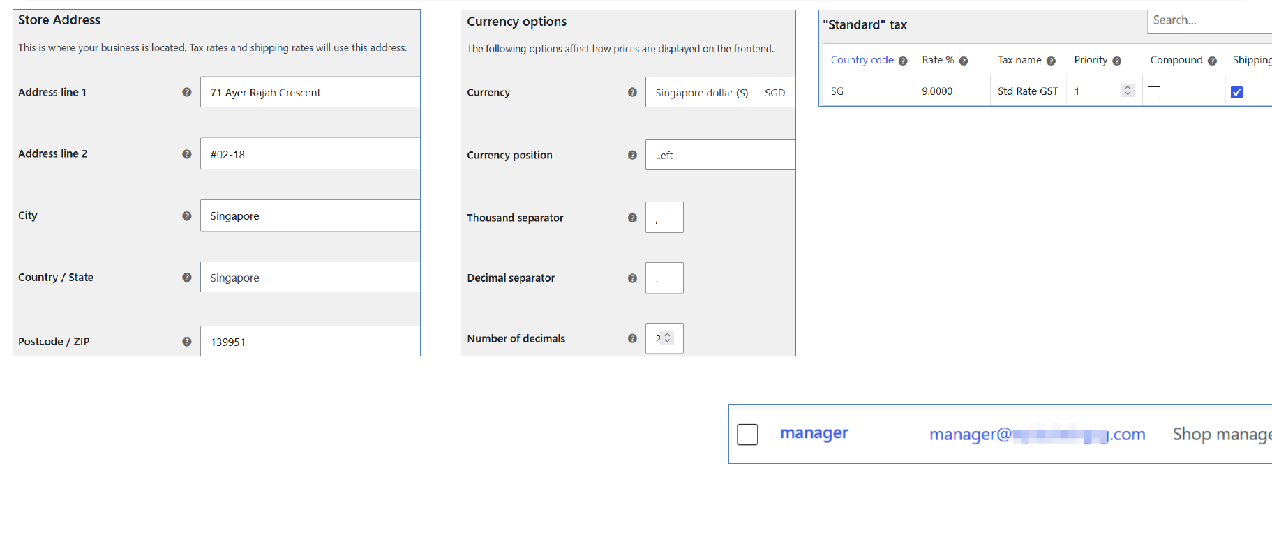
TOPIC 2 · LAB 1 · PHASE 1
What the Settings Look Like
▸ Store address, Singapore dollar currency and the GST standard rate; Daniel Koh as Shop manager.
© Tertiary Infotech Academy Pte Ltd
Build a Professional eCommerce Store with Generative AI · C6
68

Slide 69
TOPIC 2 · LAB 1 · PHASE 1
Lab 1 — Checkpoint
Verify
WooCommerce > Settings > General shows the Ayer Rajah address, Singapore dollar and shop-base customer location
Verify
Tax > Standard rates has SG · 9% · GST, and prices are entered inclusive of tax
Verify
Storefront and Harbour & Co Toolkit are active
Stretch challenge
Ask ChatGPT for an About Us page that meets E-E-A-T (founder byline, first-hand story, real address) and publish it at /about-us/.
© Tertiary Infotech Academy Pte Ltd
Build a Professional eCommerce Store with Generative AI · C6
69

Slide 70
TOPIC 2 · DISCUSSION · 15 MIN
Discussion — Content Management Policies for Your Store
In pairs, consider a store you would run. Decide what content management policies, guidelines and user permissions it needs, and how you would monitor that people actually follow them.
Question 1
Question 2
Who should be able to publish a product, and who should only be able to draft one?
Which WordPress/WooCommerce roles map to those responsibilities?
Question 3
Question 4
What product-content guidelines would you set — image size, description length, mandatory fields?
Who checks AI-written copy before it goes live, and against which brand rules?
TIP Produce: A short policy statement: the roles, the content guidelines, and how adherence is monitored.
© Tertiary Infotech Academy Pte Ltd
Build a Professional eCommerce Store with Generative AI · C6
70

Slide 71
TOPIC 3
1
Product types
Manage Products on WooCommerce Store
2
AI product photos & copy
3
Variations
4
Categories, tags & attributes
5
Up-sells & CSV import
© Tertiary Infotech Academy Pte Ltd · C6

Slide 72

TOPIC 3 · WHAT YOU'LL LEARN
Key Concepts in This Topic
Product types
The Product Data panel
Images and galleries
Simple, Grouped, Virtual, Downloadable, External/Affiliate and Variable each model a different kind of offer.
General, Inventory, Shipping, Linked Products and Attributes — where the substance of a product is defined.
A featured image plus a gallery, with catalogue visibility controlling where the product appears.
Categories, tags, attributes
Up-sells and cross-sells
CSV import and export
Categories are hierarchical, tags are flat, and attributes drive filtering and product variations.
Up-sells appear on the product page; cross-sells appear in the cart; related products are automatic.
Create or update hundreds of products in one pass, including variations, from a single CSV file.
© Tertiary Infotech Academy Pte Ltd
Build a Professional eCommerce Store with Generative AI · C6
72

Slide 73

TOPIC 3 · SIX CORE TYPES
Product Types
Simple
Grouped
Virtual
The majority of products — shipped, with no options. For example, a book.
A collection of related simple products bought individually, e.g. a set of six glasses.
Needs no shipping — a service. Disables all shipping fields and the cart calculator.
Downloadable
External / Affiliate
Variable
The customer receives a file after purchase — an album, PDF or photo.
Listed and described on your site, but sold elsewhere.
Variations with their own SKU, price and stock — e.g. a t-shirt in sizes and colours.
© Tertiary Infotech Academy Pte Ltd
Build a Professional eCommerce Store with Generative AI · C6
73

Slide 74
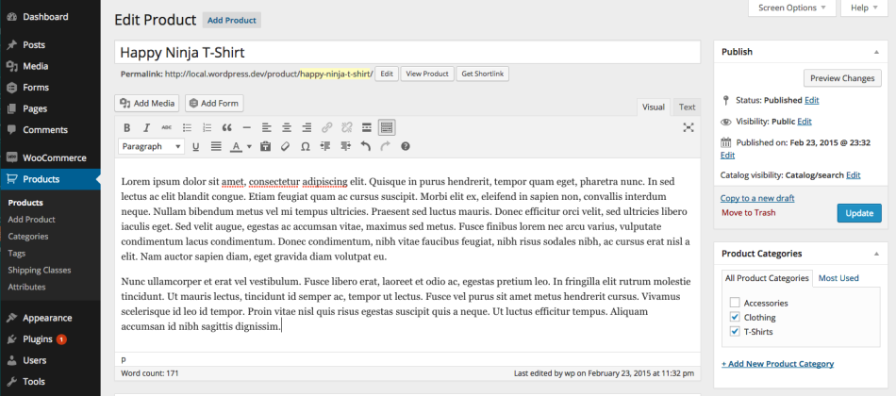
TOPIC 3 · PRODUCTS
Adding a Simple Product
▸ Products > Add New — a familiar WordPress editing interface.
© Tertiary Infotech Academy Pte Ltd
Build a Professional eCommerce Store with Generative AI · C6
74

Slide 75
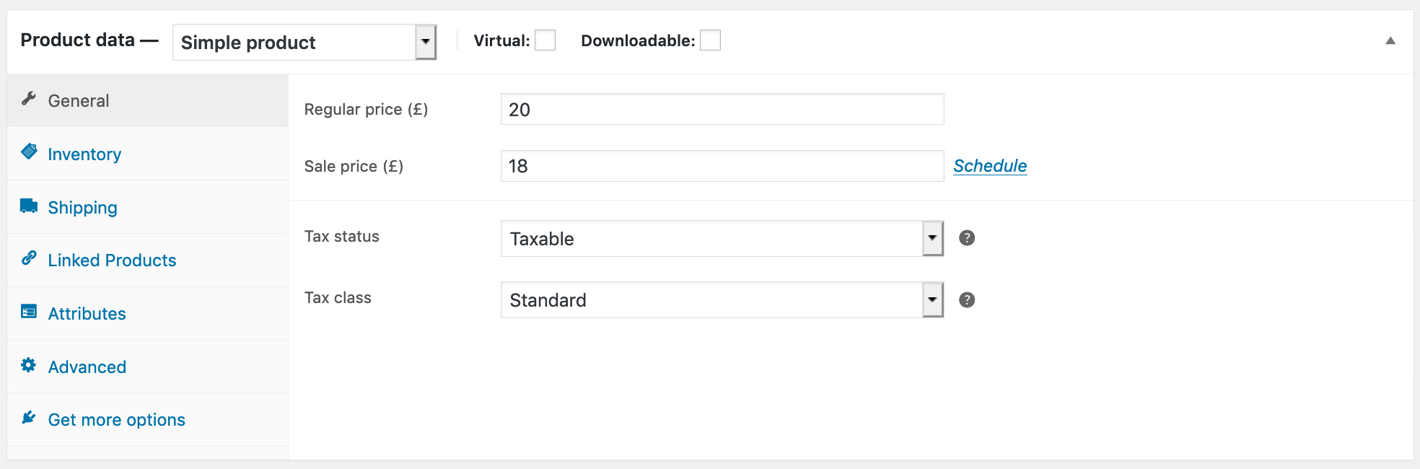
TOPIC 3 · PRODUCTS
The Product Data Panel
▸ General, Inventory, Shipping, Linked Products, Attributes and Advanced.
© Tertiary Infotech Academy Pte Ltd
Build a Professional eCommerce Store with Generative AI · C6
75

Slide 76
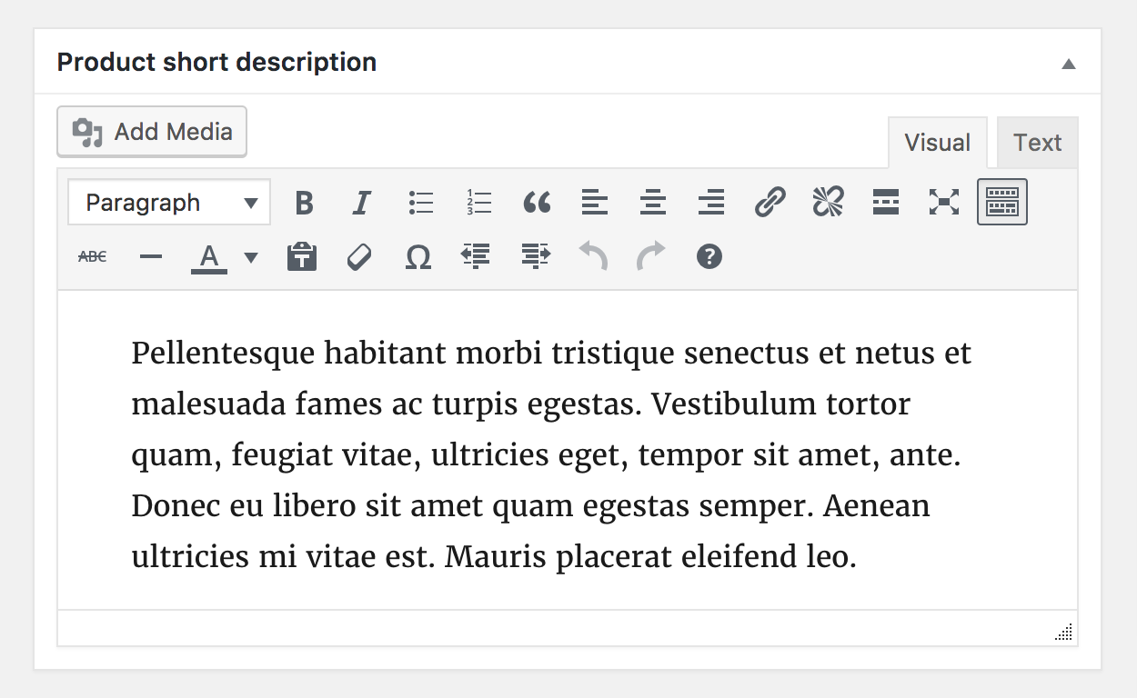
TOPIC 3 · CONTENT
Product Short Description
▸ The excerpt beside the product image; the long description fills the Description tab.
© Tertiary Infotech Academy Pte Ltd
Build a Professional eCommerce Store with Generative AI · C6
76

Slide 77
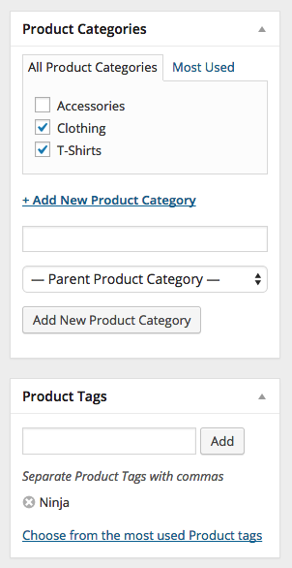
TOPIC 3 · TAXONOMIES
Product Categories and Tags
▸ Assigned from the right-hand column, exactly like a WordPress post.
© Tertiary Infotech Academy Pte Ltd
Build a Professional eCommerce Store with Generative AI · C6
77

Slide 78
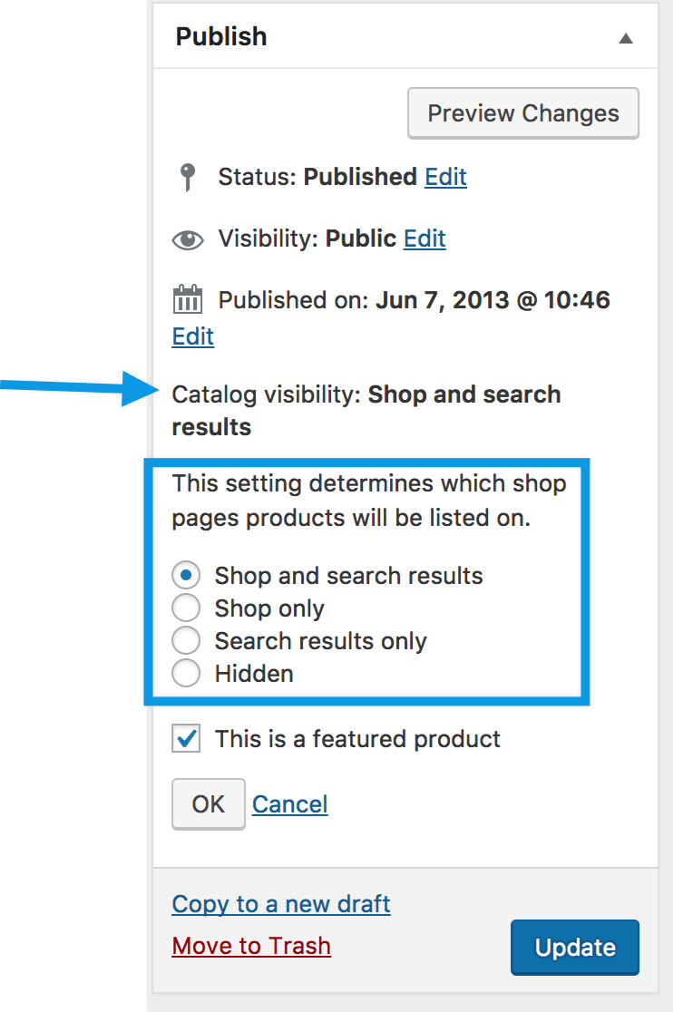
TOPIC 3 · MEDIA
Product Images and Galleries
▸ A featured image plus a gallery — and catalogue visibility controls where it appears.
© Tertiary Infotech Academy Pte Ltd
Build a Professional eCommerce Store with Generative AI · C6
78

Slide 79
TOPIC 3 · WHERE A PRODUCT APPEARS
Catalog Visibility Options
Shop and search
Shop only
Visible everywhere — shop pages, category pages and search results.
Visible in shop and category pages, but not in search results.
Search only
Hidden
Visible in search results, but not in the shop or category pages.
Only reachable on its own product page — useful for unlisted or bundled items.
© Tertiary Infotech Academy Pte Ltd
Build a Professional eCommerce Store with Generative AI · C6
79

Slide 80
TOPIC 3 · AI PRODUCT CONTENT
Prompt the Photo, Then Fact-Check the Copy
Photo prompt
Copy prompt
Fact-check
Alt text
Square 1:1 · flat lay from above · sand linen background · soft daylight · no text, no logos, no people.
Only facts from the spec sheet · short ≤ 30 words · long: hook, Fabric & fit, Size guide, Care.
Delete 'cooling', 'eco-friendly', 'luxurious' — anything the spec cannot prove.
Plain description for screen readers and image search: colour + product + setting.
TIP A product shoot costs time and money; an AI flat lay takes a minute. The facts still come from you.
© Tertiary Infotech Academy Pte Ltd
Build a Professional eCommerce Store with Generative AI · C6
80

Slide 81
TOPIC 3 · LAB 2 · PHASE 1
Lab 2 — Shoot and Write a Product with AI
ChatGPT makes the product photo and writes the copy. You publish the Classic Cotton T-Shirt.
The business scenario
You will deliver
✓ An AI-generated product photo that follows the brand photography rules
✓ A short description (under 30 words) and a long description written by AI, checked by you
✓ The Classic Cotton T-Shirt published: S$29.90, sale S$24.90, SKU, stock 50, category, tags, image, alt text
Harbour & Co's best-seller, the Classic Cotton T-Shirt, has no photo and no copy. A photo shoot costs S$800 and takes a week. You have nine minutes and ChatGPT. Generate an on-brand product photo, write the description from the spec sheet, and publish the product.
AI does ChatGPT generates the product photo and drafts the short and long descriptions.
You decide You reject any photo or sentence that breaks the brand brief, and you enter the facts (price, SKU, stock) yourself.
Time 10 min · LO2
© Tertiary Infotech Academy Pte Ltd
Build a Professional eCommerce Store with Generative AI · C6
81
Notes:
Lab 2 — Shoot and Write a Product with AI (10 min). Full steps: labs/lab-02-ai-product-photos-and-copy/LAB-02-Instructions.pdf
1. Generate the product photo — ChatGPT (chatgpt.com) — a new chat
2. Write the descriptions from the facts — Same ChatGPT chat
3. Fact-check before you paste — You
4. Create the product — Products > Add new product
5. Price, SKU and stock — Product data > General / Inventory / Shipping
6. Category and tags — Product categories / Product tags (right sidebar)
7. Product image and alt text — Product image > Set product image
8. Publish and view it as a customer — Publish > View product

Slide 82


TOPIC 3 · LAB 2 · PHASE 1
Lab 2 — How it runs
Orange cards are you; dark cards are the AI. Nothing goes live without you.
YOU · STEP 1
AI · STEP 2
AI · STEP 3
YOU · STEP 4
YOU · STEP 5
Spec sheet in
AI shoots the photo
AI writes the copy
You fact-check
Publish
Attach the brand brief and product spec.
ChatGPT generates a 1:1 flat-lay on sand.
Short and long description from facts only.
Delete anything the spec does not say.
Products > Add new product with every field filled.
Checkpoint The product page shows your AI photo, the short description beside it, S$24.90 sale price and the Apparel > Shirts category.
© Tertiary Infotech Academy Pte Ltd
Build a Professional eCommerce Store with Generative AI · C6
82

Slide 83
TOPIC 3 · LAB 2 · PHASE 1
Lab 2 — The Steps
# | Step | Where
1 | Generate the product photo [AI prompt] | ChatGPT (chatgpt.com) — a new chat
2 | Write the descriptions from the facts [AI prompt] | Same ChatGPT chat
3 | Fact-check before you paste | You
4 | Create the product | Products > Add new product
5 | Price, SKU and stock | Product data > General / Inventory / Shipping
6 | Category and tags | Product categories / Product tags (right sidebar)
7 | Product image and alt text | Product image > Set product image
8 | Publish and view it as a customer | Publish > View product
TIP Full instructions, values and the Prompt Playbook: labs/lab-02-ai-product-photos-and-copy/LAB-02-Instructions.pdf
© Tertiary Infotech Academy Pte Ltd
Build a Professional eCommerce Store with Generative AI · C6
83

Slide 84

TOPIC 3 · LAB 2 · PHASE 1
Step 1 · Generate the product photo
PROMPT · copy from labs/prompts/index.html or COPY-PROMPTS.txt
Paste into
ROLE: You are a fashion product photographer.
CONTEXT: Harbour & Co (brand brief attached) sells the Classic Cotton T-Shirt (spec attached): a white, relaxed-fit 180 gsm combed-cotton tee.
TASK: Create ONE square (1:1) product photo for the online store.
CONSTRAINTS: Flat lay, viewed from directly above, on a warm sand (#EFE6D8) linen background. Soft daylight from the left, gentle shadow, no harsh flash. The tee is neatly folded at the sleeves. No people, no text, no logos, no props except one small sprig of green leaves in a corner.
FORMAT: Generate the image.
ChatGPT — attach data/brand-brief.txt first
Expect
A square, on-brand flat-lay photo. If it takes too long, use assets/images/TSHIRT-CLASSIC-001.jpg.
You decide
You reject any photo or sentence that breaks the brand brief, and you enter the facts (price, SKU, stock) yourself.
© Tertiary Infotech Academy Pte Ltd
Build a Professional eCommerce Store with Generative AI · C6
84

Slide 85
TOPIC 3 · LAB 2 · PHASE 1
Step 2 · Write the descriptions from the facts
PROMPT · copy from labs/prompts/index.html or COPY-PROMPTS.txt
Paste into
ROLE: You are Harbour & Co's copywriter.
CONTEXT: Use ONLY the facts in the attached product spec and the voice rules in the brand brief.
TASK: Write (a) a product SHORT description of at most 30 words, and (b) a LONG description that follows this structure: a 2-sentence hook; 'Fabric & fit'; 'Size guide' as a small table S–XL with chest width in cm from the spec; 'Care'.
CONSTRAINTS: Use British spelling. Prices in S$ including 9% GST. Do not invent facts, reviews, awards or sustainability claims. No claims about cooling, sweat or sustainability.
FORMAT: Two headed sections: SHORT DESCRIPTION and LONG DESCRIPTION (Markdown).
ChatGPT — attach data/brand-brief.txt first
Expect
Copy that only uses spec facts. Compare with assets/descriptions/TSHIRT-CLASSIC-001.txt.
You decide
You reject any photo or sentence that breaks the brand brief, and you enter the facts (price, SKU, stock) yourself.
© Tertiary Infotech Academy Pte Ltd
Build a Professional eCommerce Store with Generative AI · C6
85

Slide 86
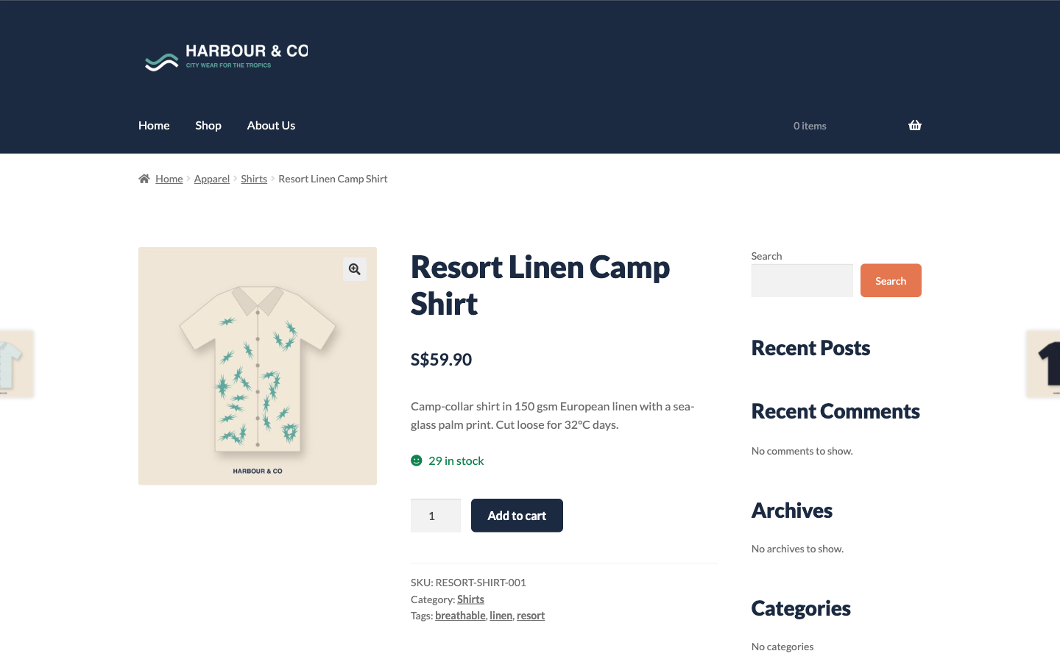
TOPIC 3 · LAB 2 · PHASE 1
What Done Looks Like
▸ Product photo, short description, S$ price, stock and the Apparel > Shirts breadcrumb.
© Tertiary Infotech Academy Pte Ltd
Build a Professional eCommerce Store with Generative AI · C6
86

Slide 87
TOPIC 3 · LAB 2 · PHASE 1
Lab 2 — Checkpoint
Verify
The product photo is AI-generated (or the starter image) and follows the brand photo rules
Verify
Short description ≤ 30 words; long description uses only spec facts
Verify
Regular S$29.90, sale S$24.90, SKU TSHIRT-CLASSIC-001, stock 50
Stretch challenge
Repeat for the Cotton Cap (CAP-COTTON-001, S$19.90, Accessories) and ask ChatGPT for three photo variations — pick the one that best matches the brief.
© Tertiary Infotech Academy Pte Ltd
Build a Professional eCommerce Store with Generative AI · C6
87

Slide 88
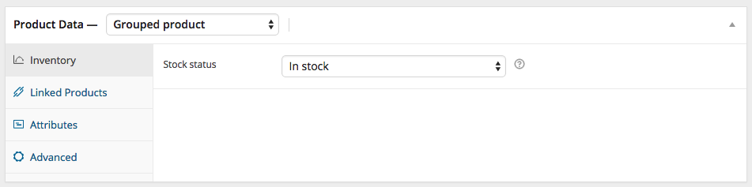
TOPIC 3 · GROUPED
Adding a Grouped Product
▸ Select Grouped from the Product data dropdown — price fields disappear.
© Tertiary Infotech Academy Pte Ltd
Build a Professional eCommerce Store with Generative AI · C6
88

Slide 89
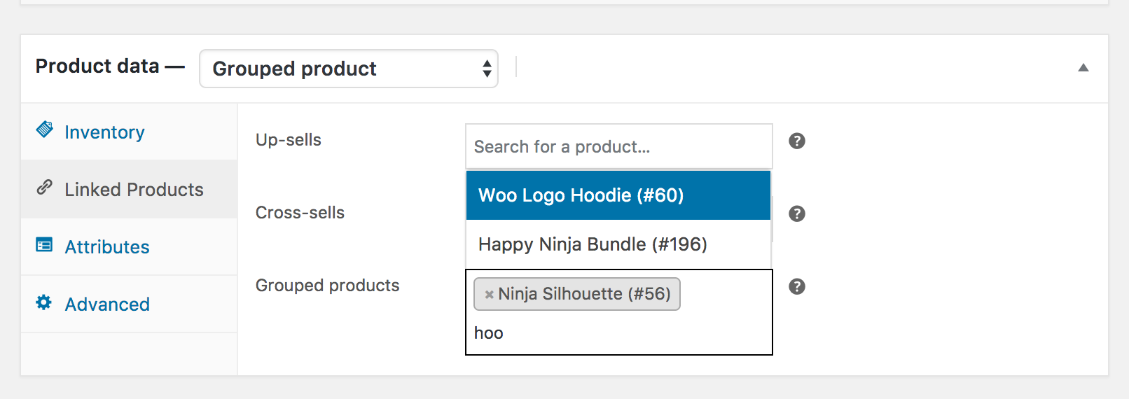
TOPIC 3 · GROUPED
Populating a Grouped Product
▸ Add child products from Linked Products > Grouped products, then reorder by dragging.
© Tertiary Infotech Academy Pte Ltd
Build a Professional eCommerce Store with Generative AI · C6
89

Slide 90
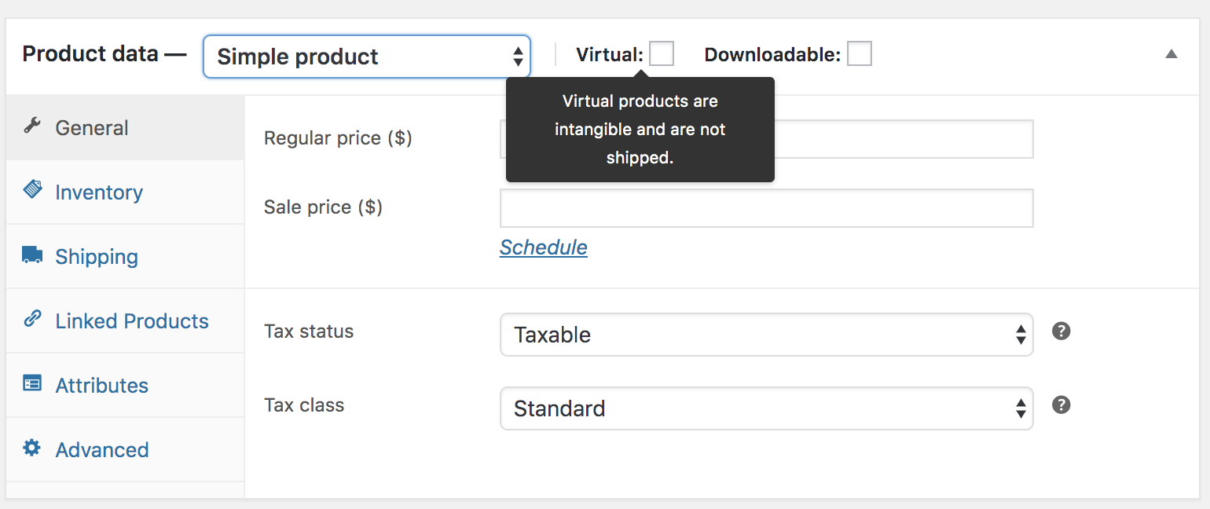
TOPIC 3 · VIRTUAL
Virtual and Downloadable Products
▸ Tick Virtual to remove shipping; tick Downloadable to add a file path and download limit.
© Tertiary Infotech Academy Pte Ltd
Build a Professional eCommerce Store with Generative AI · C6
90

Slide 91

TOPIC 3 · VARIABLE PRODUCTS
Creating a Variable Product
ADD ATTRIBUTE
ENTER VALUES
USE FOR VARIATIONS
e.g. Size, Colour
Small | Medium | Large
Tick the box, save
GENERATE VARIATIONS
SET PRICE & STOCK
All combinations at once
Per variation
© Tertiary Infotech Academy Pte Ltd
Build a Professional eCommerce Store with Generative AI · C6
91

Slide 92

TOPIC 3 · ORGANISING THE CATALOGUE
Categories, Tags and Attributes
Product categories
Product tags
Hierarchical — parents and subcategories, with a slug, description, display type and image.
Flat, with no hierarchy. Use them for cross-cutting themes such as 'cat print' or 'summer'.
Product attributes
The default category
Per-product or global. Global attributes power layered navigation and variations.
Every product must have a category; unassigned products fall into 'Uncategorized'.
© Tertiary Infotech Academy Pte Ltd
Build a Professional eCommerce Store with Generative AI · C6
92

Slide 93
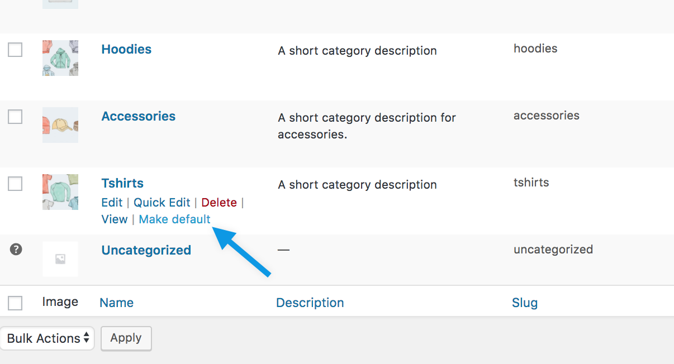
TOPIC 3 · CATEGORIES
The Default Category
▸ 'Uncategorized' cannot be deleted while it is the default — but it can be renamed or switched.
© Tertiary Infotech Academy Pte Ltd
Build a Professional eCommerce Store with Generative AI · C6
93

Slide 94
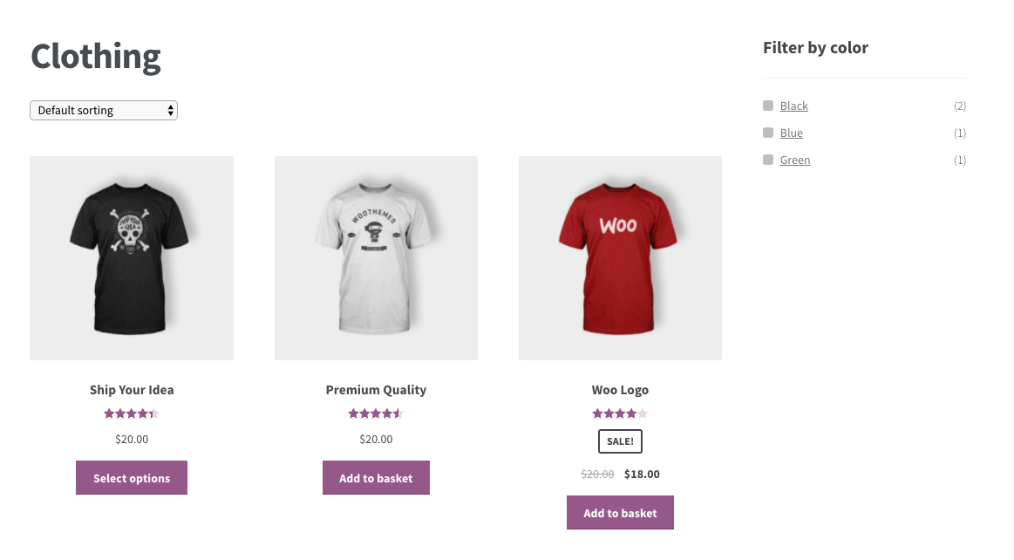
TOPIC 3 · ATTRIBUTES
Product Attributes
▸ Attributes drive the Filter by Attribute widget and are required for variations.
© Tertiary Infotech Academy Pte Ltd
Build a Professional eCommerce Store with Generative AI · C6
94

Slide 95
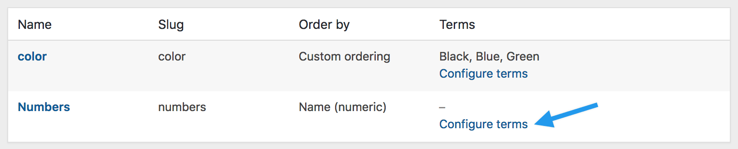
TOPIC 3 · ATTRIBUTES
Managing Global Attributes
▸ Products > Attributes — add a name, slug, archives option and default sort order.
© Tertiary Infotech Academy Pte Ltd
Build a Professional eCommerce Store with Generative AI · C6
95

Slide 96
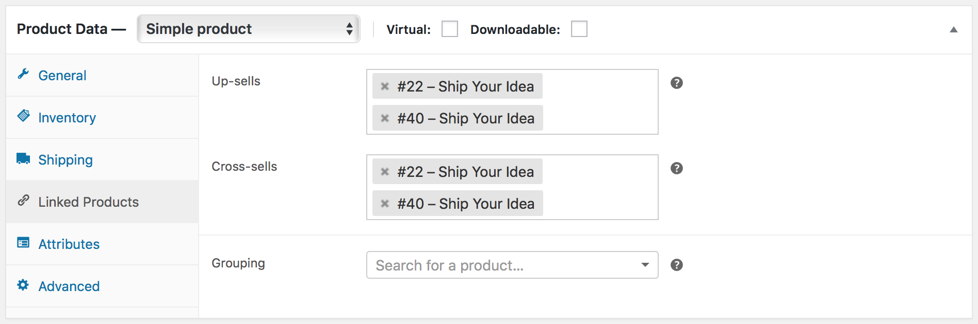
TOPIC 3 · LINKED PRODUCTS
Linked Products
▸ Product data > Linked Products — search for the product you want to link.
© Tertiary Infotech Academy Pte Ltd
Build a Professional eCommerce Store with Generative AI · C6
96

Slide 97
TOPIC 3 · RAISING ORDER VALUE
Up-Sells, Cross-Sells and Related Products
Up-sells & cross-sells — you choose
Related products — automatic
• Up-sells: on the PRODUCT page, recommended INSTEAD of this item, usually higher value
• Cross-sells: in the CART, complementary to what's being bought
• Harbour & Co: T-shirt up-sells the polo; cross-sells the cap and tote
• Shown on the PRODUCT page
• Chosen AUTOMATICALLY from shared categories or tags
• You influence them by how you categorise and tag
© Tertiary Infotech Academy Pte Ltd
Build a Professional eCommerce Store with Generative AI · C6
97

Slide 98
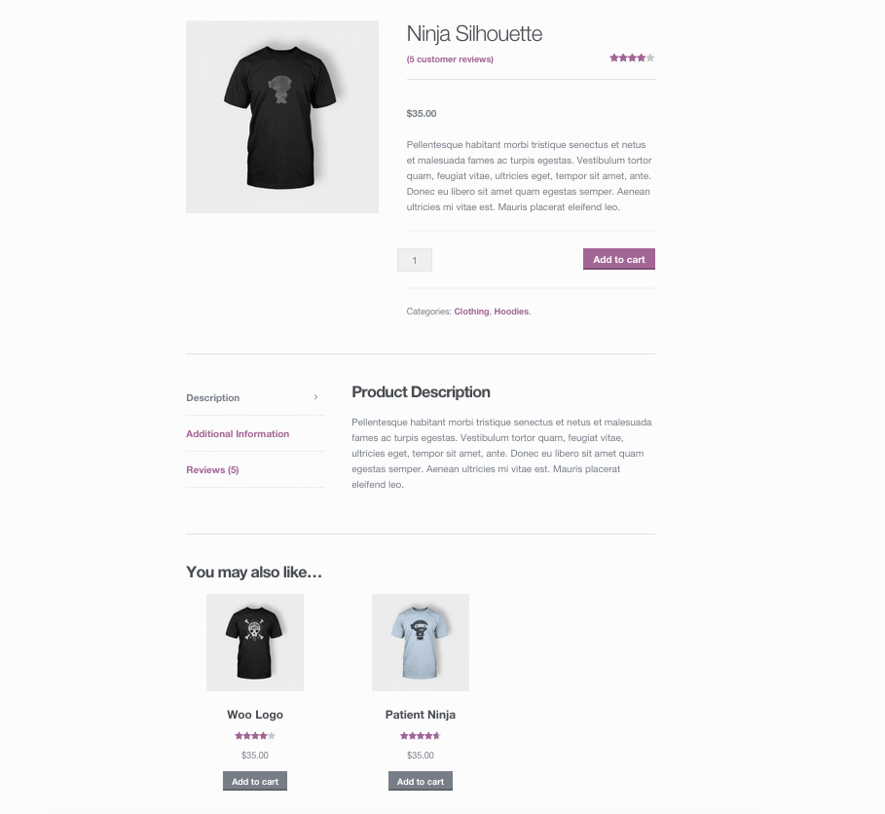
TOPIC 3 · UP-SELLS
Up-Sells on the Product Page
▸ Up-sells display beneath the product description.
© Tertiary Infotech Academy Pte Ltd
Build a Professional eCommerce Store with Generative AI · C6
98

Slide 99
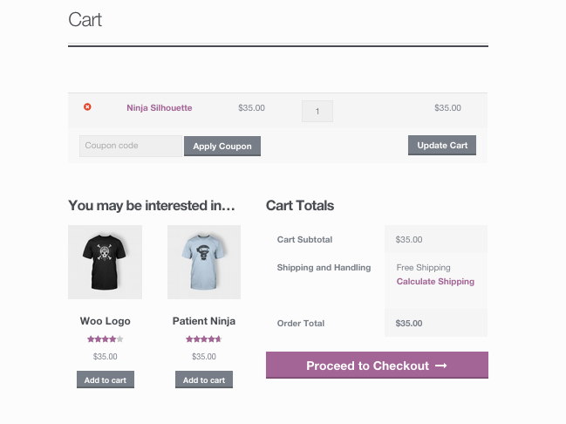
TOPIC 3 · CROSS-SELLS
Cross-Sells in the Cart
▸ Cross-sells are promoted on the cart page, based on what is already in it.
© Tertiary Infotech Academy Pte Ltd
Build a Professional eCommerce Store with Generative AI · C6
99

Slide 100
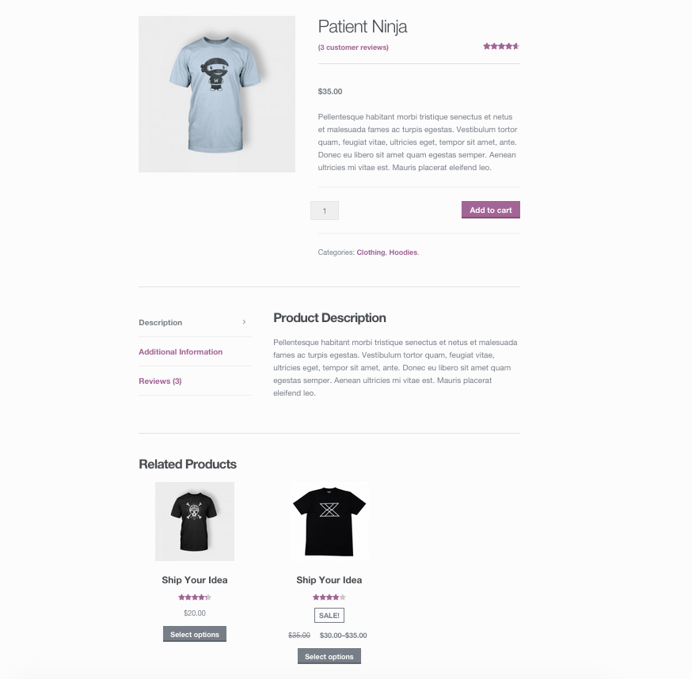
TOPIC 3 · RELATED
Related Products
▸ Automatic — pulled from products sharing the same categories or tags.
© Tertiary Infotech Academy Pte Ltd
Build a Professional eCommerce Store with Generative AI · C6
100

Slide 101
TOPIC 3 · BULK MAINTENANCE
Product CSV Importer and Exporter
Built in
Every product type
Included since WooCommerce 3.1 — no plugin required.
Supports simple, grouped, external and variable products, including variations.
For new stores
For existing stores
Export a template, fill it in, and launch a whole catalogue in one pass.
Update hundreds of products, run a sale, or sync multiple storefronts.
© Tertiary Infotech Academy Pte Ltd
Build a Professional eCommerce Store with Generative AI · C6
101

Slide 102
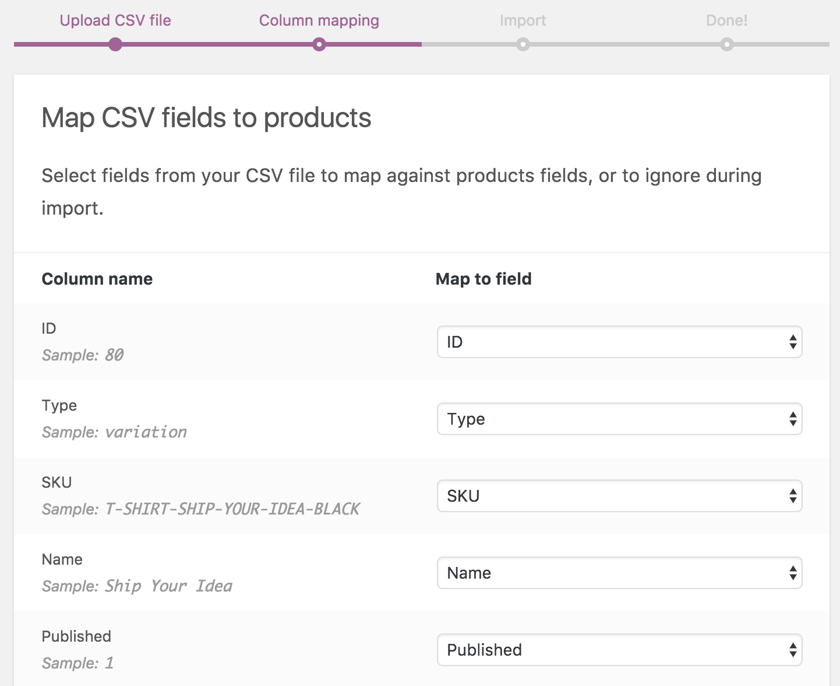
TOPIC 3 · CSV IMPORT
Importing Products
▸ Products > Import > choose your CSV > Continue > map columns > Run the importer.
© Tertiary Infotech Academy Pte Ltd
Build a Professional eCommerce Store with Generative AI · C6
102

Slide 103
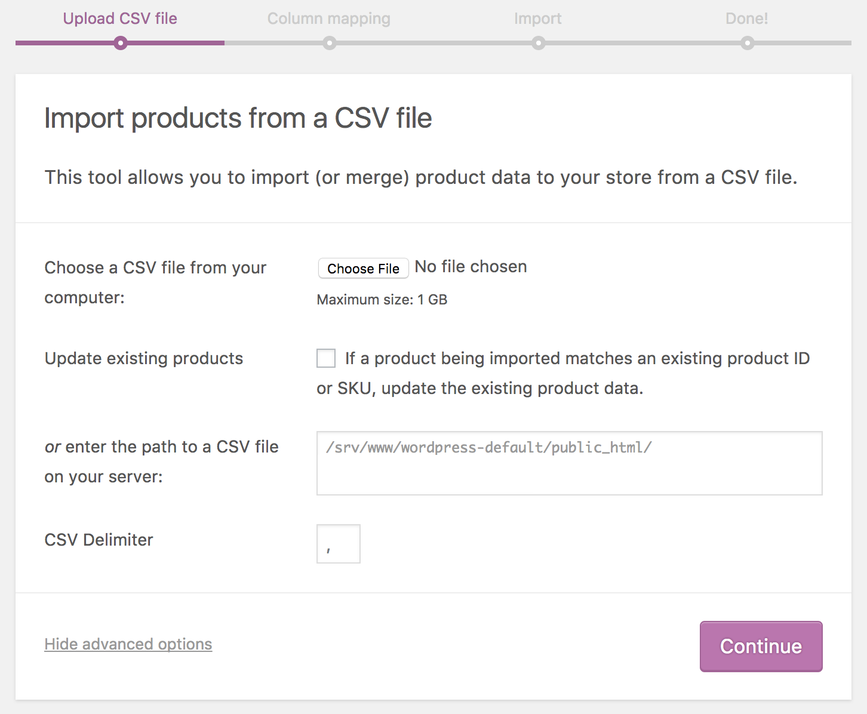
TOPIC 3 · CSV IMPORT
Mapping CSV Columns
▸ WooCommerce proposes a column mapping — review it before running the importer.
© Tertiary Infotech Academy Pte Ltd
Build a Professional eCommerce Store with Generative AI · C6
103

Slide 104
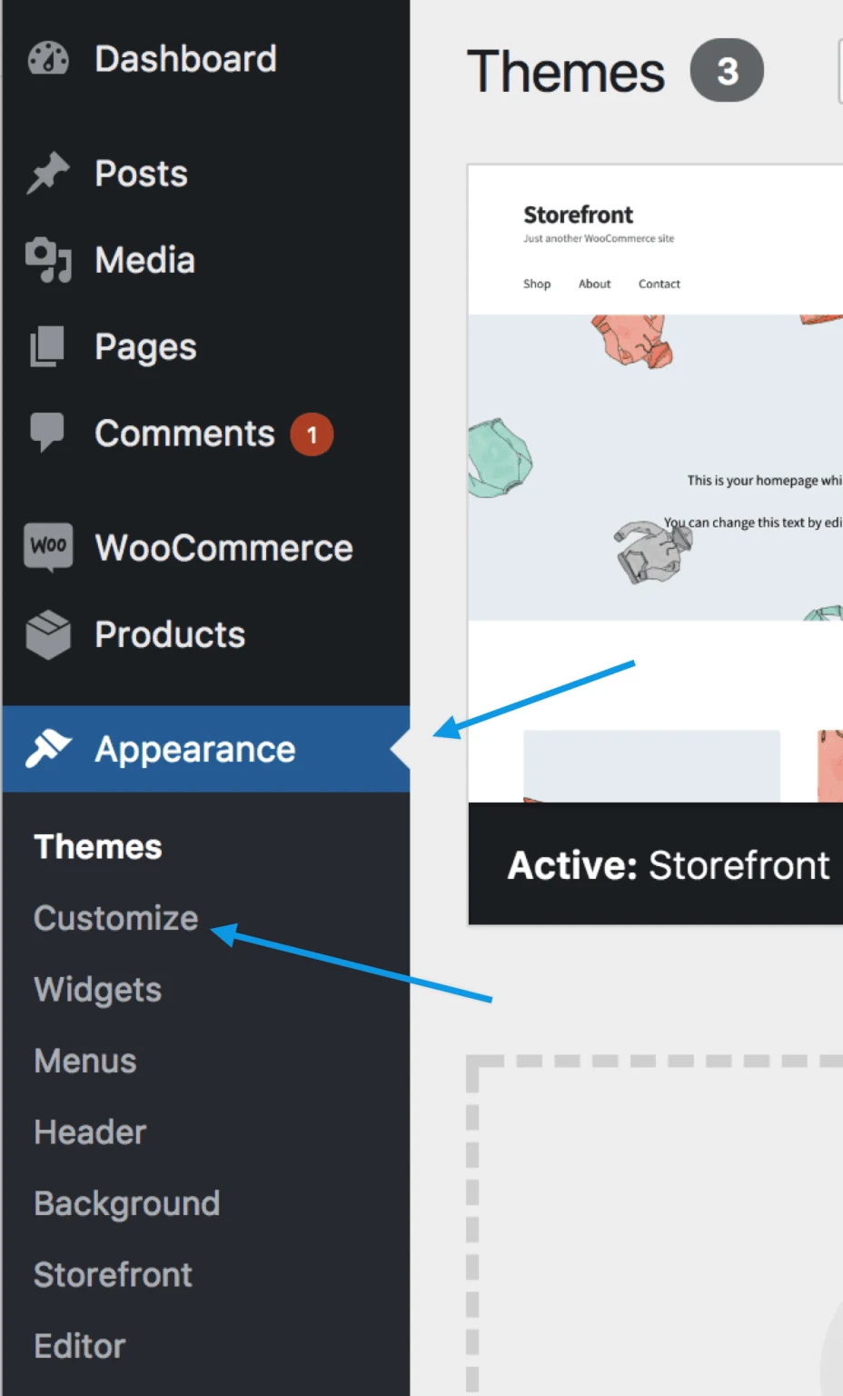
TOPIC 3 · CUSTOMIZER
The WooCommerce Customizer
▸ Appearance > Customize > WooCommerce — Store Notice, Product Catalog and Product Images.
© Tertiary Infotech Academy Pte Ltd
Build a Professional eCommerce Store with Generative AI · C6
104

Slide 105
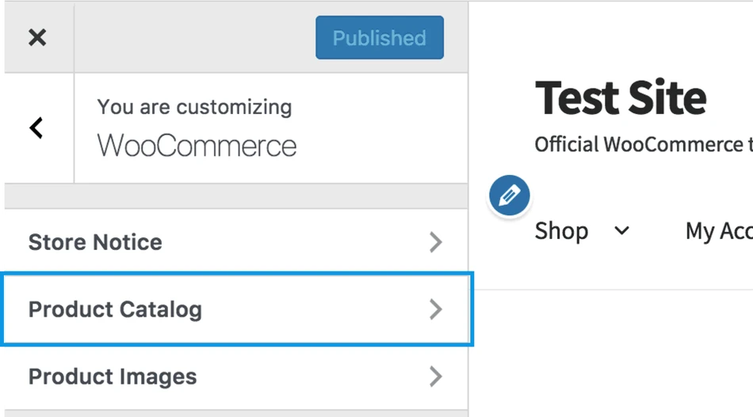
TOPIC 3 · CUSTOMIZER
Product Catalog Options
▸ Appearance > Customize > WooCommerce > Product Catalog.
© Tertiary Infotech Academy Pte Ltd
Build a Professional eCommerce Store with Generative AI · C6
105

Slide 106
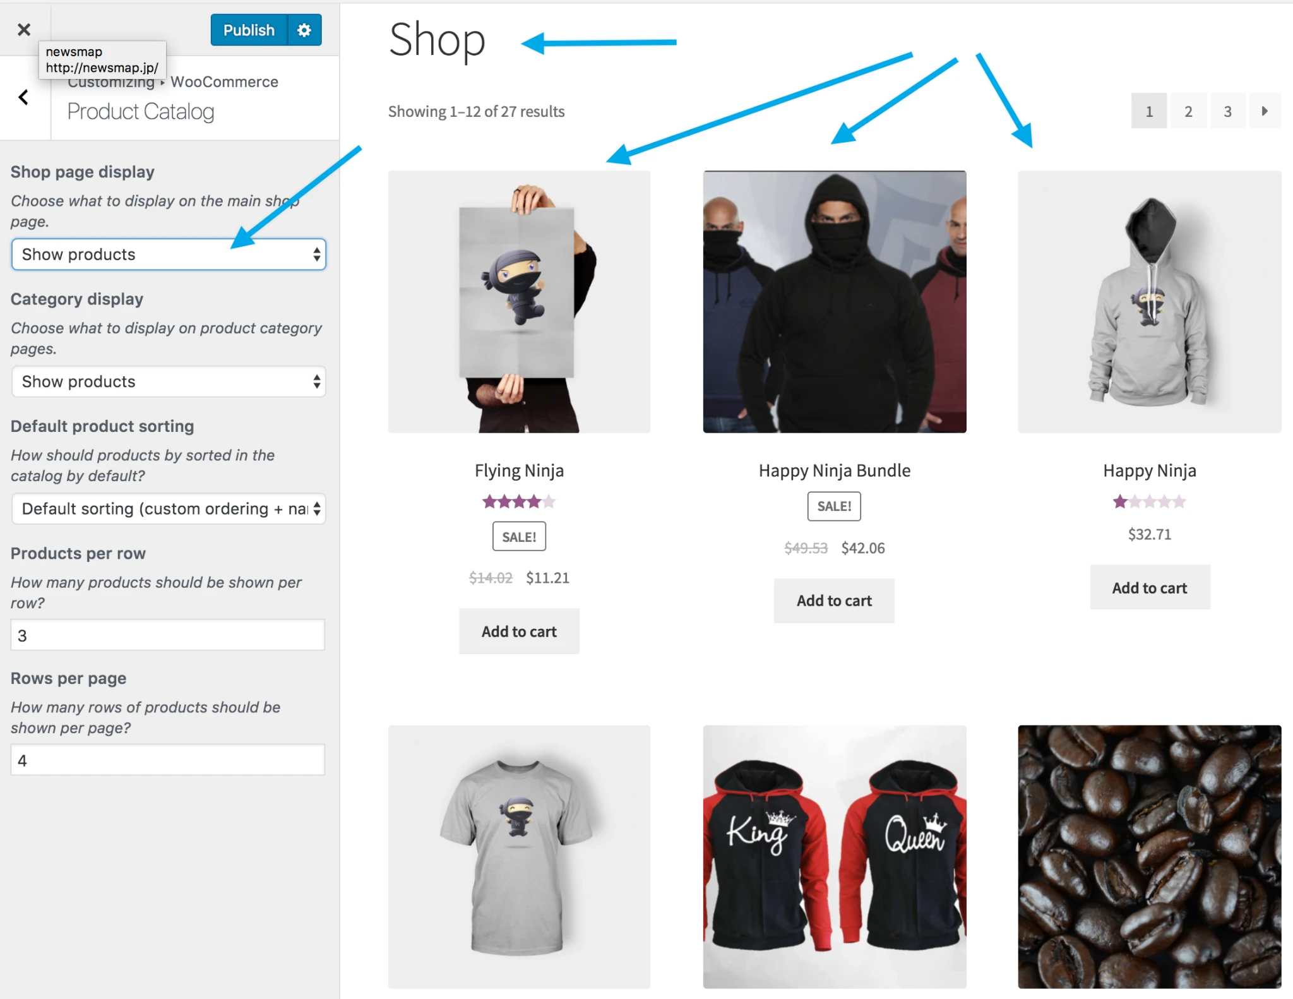
TOPIC 3 · CUSTOMIZER
The Shop Page
▸ Display Products, Categories, or both — one choice gives the cleanest look.
© Tertiary Infotech Academy Pte Ltd
Build a Professional eCommerce Store with Generative AI · C6
106

Slide 107
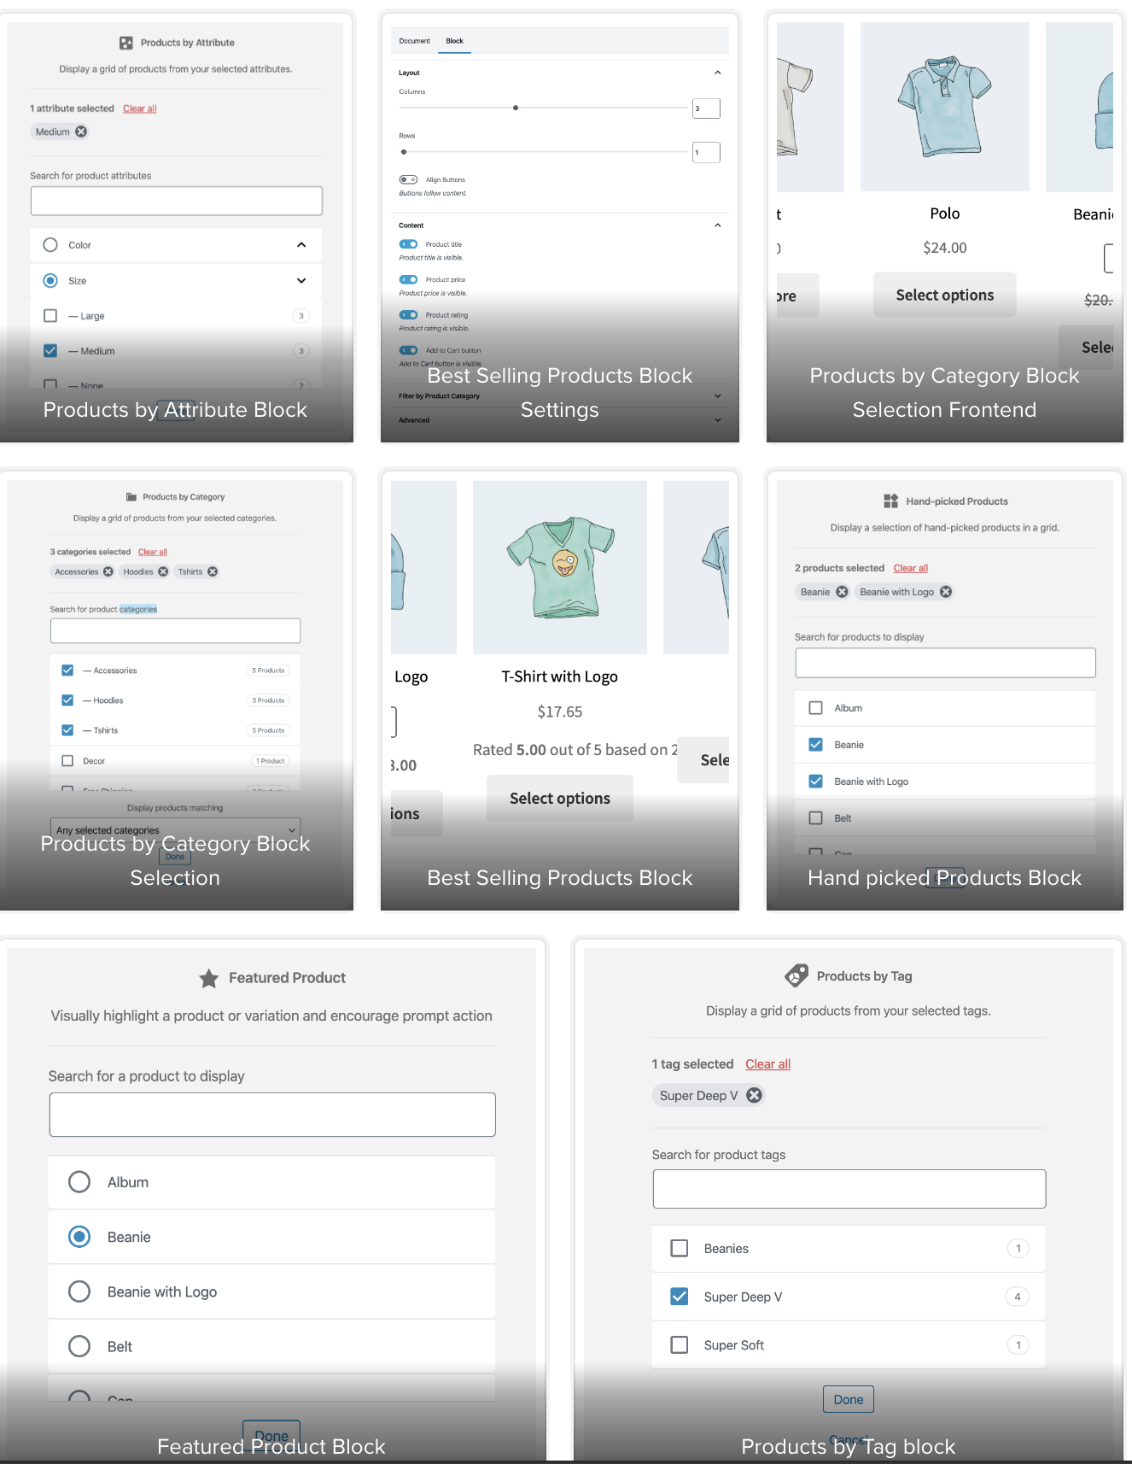
TOPIC 3 · BLOCKS
WooCommerce Blocks
▸ Product blocks for any post or page — by tag, category, attribute, best selling, on sale and more.
© Tertiary Infotech Academy Pte Ltd
Build a Professional eCommerce Store with Generative AI · C6
107

Slide 108

TOPIC 3 · AI CATALOGUE
From WhatsApp Notes to an Import-Ready CSV
Give the exact headers
Spell out the rules
Check before import
First import: create
Type, SKU, Name, Published, Short description, Regular price, Sale price, Categories, Tags, In stock?, Stock, Weight (kg).
Categories with ' > ' · weight in kg · no S$ sign · quote fields with commas.
SKU, price, sale price and stock against the notes — the importer will not.
Leave 'Update existing products' unticked — that option skips SKUs not yet in the store.
© Tertiary Infotech Academy Pte Ltd
Build a Professional eCommerce Store with Generative AI · C6
108

Slide 109
TOPIC 3 · LAB 3 · PHASE 1
Lab 3 — Let AI Build the New-Season Catalogue
Rachel's WhatsApp notes become a WooCommerce CSV. Import it, add the polo's six variations, link the up-sells.
The business scenario
You will deliver
✓ harbour-co-new-season.csv generated by AI from the supplier notes and checked by you
✓ Nine products imported by CSV into Apparel > Shirts, Apparel > Bottoms, Apparel > Outerwear and Accessories
✓ The Premium Polo Shirt as a variable product: 3 sizes × 2 colours = 6 priced, stocked variations
✓ Up-sell and cross-sell links on the Classic Cotton T-Shirt
The Resort Linen pieces arrive next week. Rachel's product details are scattered WhatsApp messages. Typing four products by hand invites typos in SKUs and prices. ChatGPT turns her notes into an import-ready CSV; you import it with the core range, build the Premium Polo's size and colour variations, and link up-sells so customers see the next-best item.
AI does ChatGPT converts messy notes into a CSV with WooCommerce's exact column headers.
You decide You check SKUs, prices and stock against the notes before importing — the importer will not.
Time 10 min · LO3
© Tertiary Infotech Academy Pte Ltd
Build a Professional eCommerce Store with Generative AI · C6
109
Notes:
Lab 3 — Let AI Build the New-Season Catalogue (10 min). Full steps: labs/lab-03-ai-builds-the-catalogue/LAB-03-Instructions.pdf
1. Turn the supplier notes into a CSV — ChatGPT (chatgpt.com) — a new chat
2. Check the CSV against the notes — You (a spreadsheet or text editor)
3. Import the core range — Products > All Products > Import
4. Import your AI-generated CSV — Products > All Products > Import
5. Create the variable polo — Products > Add new product
6. Add Size and Colour attributes — Product data > Attributes
7. Generate and price the six variations — Product data > Variations
8. Link up-sells and cross-sells — Classic Cotton T-Shirt > Product data > Linked Products
9. Ask AI for a catalogue audit — Same ChatGPT chat

Slide 110


TOPIC 3 · LAB 3 · PHASE 1
Lab 3 — How it runs
Orange cards are you; dark cards are the AI. Nothing goes live without you.
YOU · STEP 1
AI · STEP 2
YOU · STEP 3
YOU · STEP 4
YOU · STEP 5
YOU · STEP 6
Notes in
AI writes the CSV
You check it
Import
Variations
Link products
Attach supplier-notes.txt.
Exact WooCommerce headers, one row per product.
SKU, price, sale price, stock, category against the notes.
Core CSV + AI CSV through the importer.
Polo: Size × Colour, generated and priced.
Up-sells and cross-sells.
Checkpoint All Products lists 11 products, the polo shows S$39.90 – S$41.90, and Apparel has Shirts, Bottoms and Outerwear under it.
© Tertiary Infotech Academy Pte Ltd
Build a Professional eCommerce Store with Generative AI · C6
110

Slide 111
TOPIC 3 · LAB 3 · PHASE 1
Lab 3 — The Steps
# | Step | Where
1 | Turn the supplier notes into a CSV [AI prompt] | ChatGPT (chatgpt.com) — a new chat
2 | Check the CSV against the notes | You (a spreadsheet or text editor)
3 | Import the core range | Products > All Products > Import
4 | Import your AI-generated CSV | Products > All Products > Import
5 | Create the variable polo | Products > Add new product
6 | Add Size and Colour attributes | Product data > Attributes
7 | Generate and price the six variations | Product data > Variations
8 | Link up-sells and cross-sells | Classic Cotton T-Shirt > Product data > Linked Products
9 | Ask AI for a catalogue audit [AI prompt] | Same ChatGPT chat
TIP Full instructions, values and the Prompt Playbook: labs/lab-03-ai-builds-the-catalogue/LAB-03-Instructions.pdf
© Tertiary Infotech Academy Pte Ltd
Build a Professional eCommerce Store with Generative AI · C6
111

Slide 112
TOPIC 3 · LAB 3 · PHASE 1
Step 1 · Turn the supplier notes into a CSV
PROMPT · copy from labs/prompts/index.html or COPY-PROMPTS.txt
ROLE: You are an eCommerce catalogue manager who prepares WooCommerce imports.
CONTEXT: The attached supplier notes list four new Harbour & Co products. The brand brief sets the voice.
TASK: Produce a CSV for the WooCommerce product importer, one row per product.
CONSTRAINTS: Use exactly these headers in this order: Type,SKU,Name,Published,Short description,Regular price,Sale price,Categories,Tags,In stock?,Stock,Weight (kg)
Type = simple. Published = 1. In stock? = 1. Categories use ' > ' for hierarchy, e.g. Apparel > Bottoms. Weight in kg (250g = 0.25). Prices are numbers with no S$ sign. Leave Sale price empty when there is no promo. Short description ≤ 25 words in the brand voice, built only from the notes. Wrap any field containing a comma in double quotes. Tag every linen or resort item with 'resort'.
FORMAT: One CSV code block only, then a table listing each SKU with its price and stock so I can check them.
© Tertiary Infotech Academy Pte Ltd
Build a Professional eCommerce Store with Generative AI · C6
112

Slide 113
TOPIC 3 · LAB 3 · PHASE 1
Step 9 · Ask AI for a catalogue audit
PROMPT · copy from labs/prompts/index.html or COPY-PROMPTS.txt
Paste into
ROLE: You are a catalogue QA analyst.
CONTEXT: The attached file is Harbour & Co's full product export.
TASK: Find maintenance problems: missing images, missing short descriptions, duplicate or malformed SKUs, products with no category or still in 'Uncategorized', sale prices higher than regular prices, stock of 0.
FORMAT: A table: SKU · problem · fix. Then the three fixes that matter most for customers.
ChatGPT — attach data/brand-brief.txt first
Expect
A short fix list — most rows will say 'no image' until you add the starter images.
You decide
You check SKUs, prices and stock against the notes before importing — the importer will not.
© Tertiary Infotech Academy Pte Ltd
Build a Professional eCommerce Store with Generative AI · C6
113

Slide 114
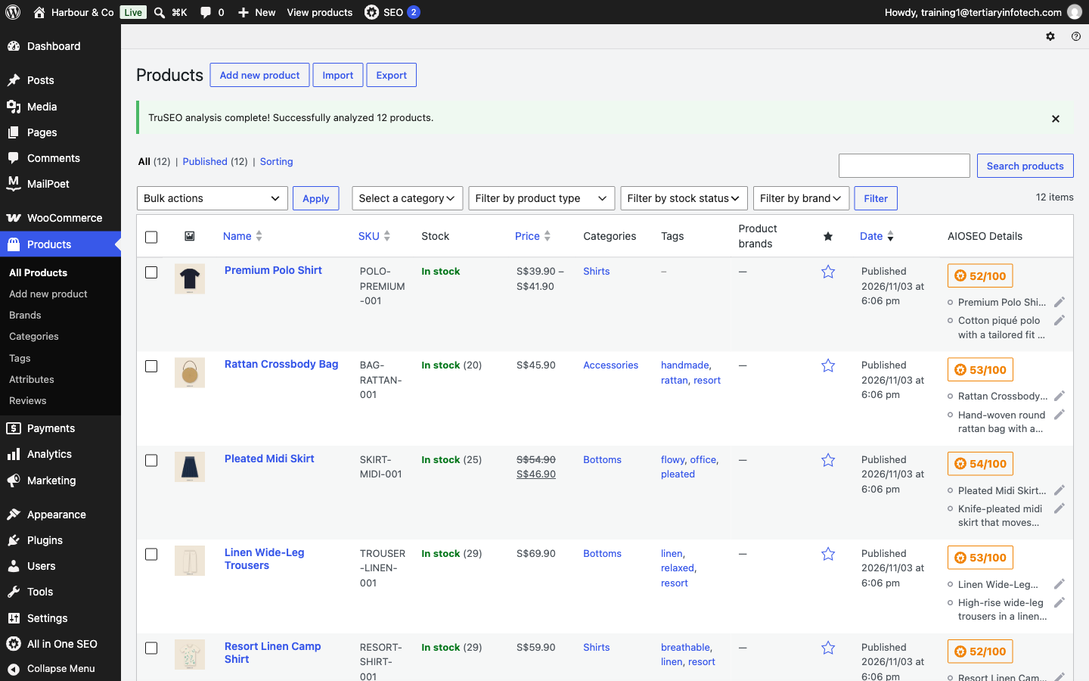
TOPIC 3 · LAB 3 · PHASE 1
What Done Looks Like
▸ CSV-imported products, the polo's S$39.90 – S$41.90 range, and Apparel > Shirts / Bottoms / Outerwear.
© Tertiary Infotech Academy Pte Ltd
Build a Professional eCommerce Store with Generative AI · C6
114

Slide 115
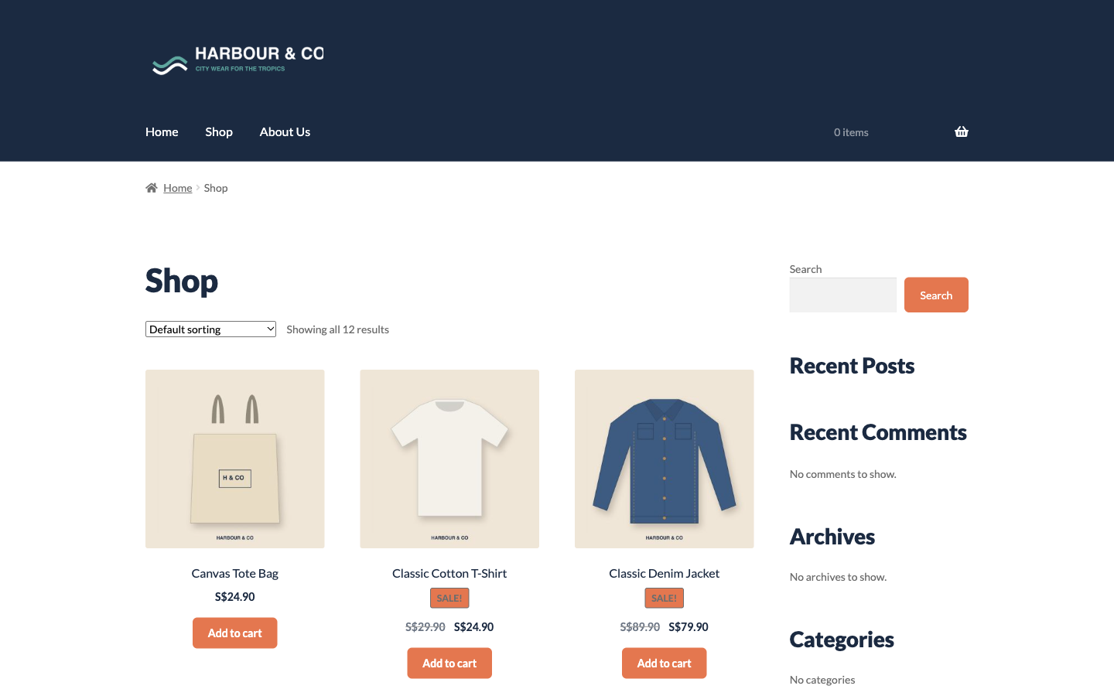
TOPIC 3 · LAB 3 · PHASE 1
The Catalogue on the Storefront
▸ Twelve products with starter images — replace them with your AI photos.
© Tertiary Infotech Academy Pte Ltd
Build a Professional eCommerce Store with Generative AI · C6
115

Slide 116
TOPIC 3 · LAB 3 · PHASE 1
Lab 3 — Checkpoint
Verify
Nine CSV-imported products plus the T-shirt and polo appear in All Products
Verify
Categories: Apparel > Shirts, Apparel > Bottoms, Apparel > Outerwear and Accessories
Verify
The polo has six variations, each with SKU, price and stock
Stretch challenge
Add the starter images to the nine imported products and ask ChatGPT to write a 2-line category description for Apparel > Bottoms.
© Tertiary Infotech Academy Pte Ltd
Build a Professional eCommerce Store with Generative AI · C6
116

Slide 117
TOPIC 4
1
Store policies
Manage Payments and Shipping
2
Payment methods
3
Gateways
4
Shipping zones
5
Flat rate, free & pickup
© Tertiary Infotech Academy Pte Ltd · C6

Slide 118
TOPIC 4 · WHAT YOU'LL LEARN
Key Concepts in This Topic
Payment methods
Choosing a gateway
Shipping zones
Online gateways such as Stripe and PayPal, plus offline options like bank transfer, cheque and cash on delivery.
Location, fees, supported currencies and whether the customer stays on your site all shape the decision.
A zone is a geographic region; each zone carries its own shipping methods and rates.
Flat rate shipping
Free shipping
Local pickup
A standard cost per order, per item or per shipping class, defined inside a shipping zone.
A powerful incentive — commonly gated behind a minimum order amount or a valid coupon.
Lets the customer collect the order themselves, with optional cost and tax status.
© Tertiary Infotech Academy Pte Ltd
Build a Professional eCommerce Store with Generative AI · C6
118

Slide 119
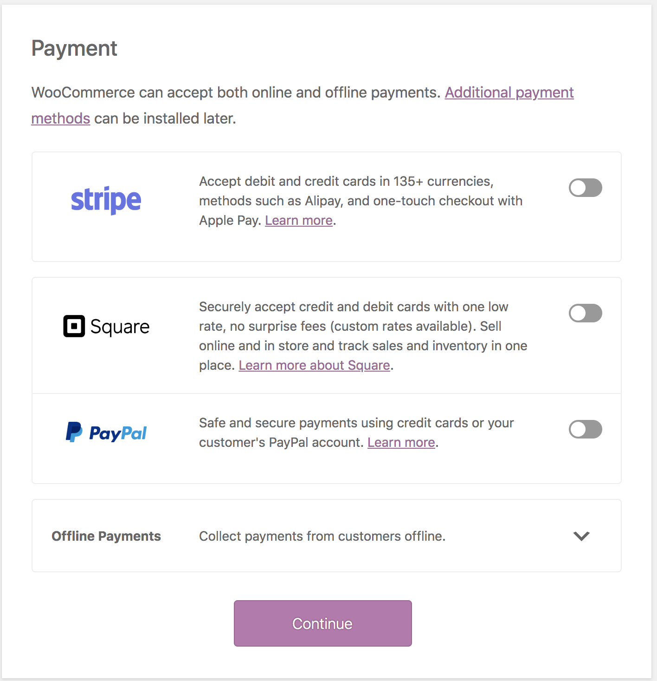
TOPIC 4 · PAYMENTS
Online Payment Methods
▸ Card and wallet gateways that take payment at checkout.
© Tertiary Infotech Academy Pte Ltd
Build a Professional eCommerce Store with Generative AI · C6
119

Slide 120
TOPIC 4 · ONLINE GATEWAYS
Choosing a Payment Gateway
Stripe
PayPal
Square
Supports 25+ countries and recurring payments; the customer stays on your site.
Active in 200+ countries, with PayPal Credit available for US stores.
Suits merchants who also sell in person, in a physical store.
eWAY
Klarna
Payfast
Takes card payments directly on your store without redirecting the customer.
Buy-now-pay-later across Europe, the UK and the US.
A popular South African gateway for card and EFT, with no monthly cost.
© Tertiary Infotech Academy Pte Ltd
Build a Professional eCommerce Store with Generative AI · C6
120

Slide 121
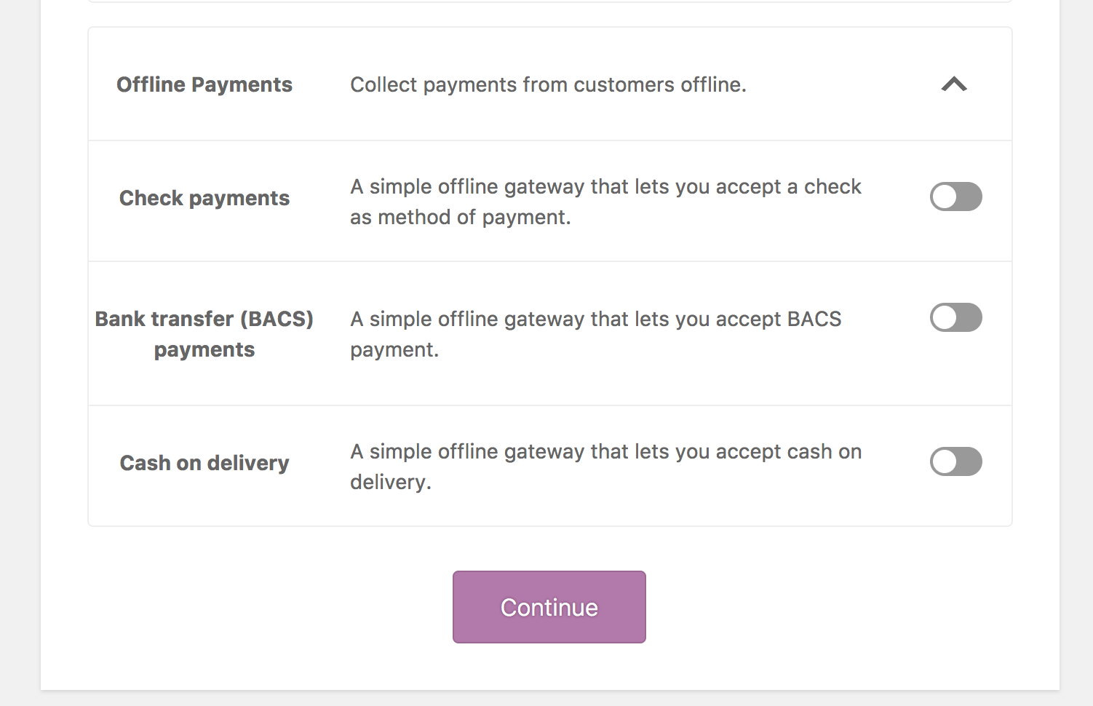
TOPIC 4 · PAYMENTS
Offline Payment Methods
▸ Direct bank transfer, cheque and cash on delivery — the order is held until you confirm payment.
© Tertiary Infotech Academy Pte Ltd
Build a Professional eCommerce Store with Generative AI · C6
121

Slide 122
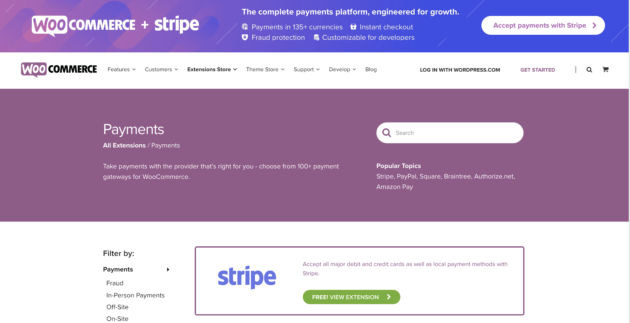
TOPIC 4 · PAYMENTS
Additional Payment Gateways
▸ https://woocommerce.com/product-category/woocommerce-extensions/payment-gateways
© Tertiary Infotech Academy Pte Ltd
Build a Professional eCommerce Store with Generative AI · C6
122

Slide 123

TOPIC 4 · SHIPPING
Shipping Options
▸ Set the unit of measurement for weight and dimensions before configuring rates.
© Tertiary Infotech Academy Pte Ltd
Build a Professional eCommerce Store with Generative AI · C6
123

Slide 124
TOPIC 4 · SHIPPING ZONES
How Shipping Is Structured
SHIPPING ZONE
SHIPPING METHOD
METHOD SETTINGS
A geographic region
Flat rate, free, pickup
Title, tax status, cost
SHIPPING CLASS
CHECKOUT
Optional per-product rate
Customer picks an option
© Tertiary Infotech Academy Pte Ltd
Build a Professional eCommerce Store with Generative AI · C6
124

Slide 125

TOPIC 4 · WHAT'S BUILT IN
Core Shipping Options
Flat rate
Free shipping
A standard cost per order, per item or per shipping class.
Optionally gated behind a minimum order amount or a valid coupon.
Local pickup
Shipping classes
The customer collects the order themselves, with optional cost.
Group products that cost more to ship — bulky, fragile or heavy items.
© Tertiary Infotech Academy Pte Ltd
Build a Professional eCommerce Store with Generative AI · C6
125

Slide 126

TOPIC 4 · SHIPPING
Flat Rate Shipping
▸ Added to a shipping zone, with a title, tax status and cost applied to the cart.
© Tertiary Infotech Academy Pte Ltd
Build a Professional eCommerce Store with Generative AI · C6
126

Slide 127

TOPIC 4 · SHIPPING
Free Shipping
▸ 'Free shipping requires…' — commonly a minimum order amount, to lift average order value.
© Tertiary Infotech Academy Pte Ltd
Build a Professional eCommerce Store with Generative AI · C6
127

Slide 128

TOPIC 4 · SHIPPING
Local Pickup
▸ Let customers collect the order — some stores retitle this 'Collect in store'.
© Tertiary Infotech Academy Pte Ltd
Build a Professional eCommerce Store with Generative AI · C6
128

Slide 129

TOPIC 4 · STORE POLICIES
Four Pages Customers Read Before They Pay
Privacy Policy
Returns & Refunds
Shipping & Delivery
Payment Methods
Singapore PDPA 2012: what you collect, why, who it goes to, retention, access & correction, DPO contact.
Days, condition, sale items, faulty items, refund timing.
Where, cost, free threshold, days, pickup hours.
PayNow / bank transfer, pay at pickup, cards — and what happens to unpaid orders.
TIP AI drafts are not legal advice. Every number must match the checkout, and the owner signs off.
© Tertiary Infotech Academy Pte Ltd
Build a Professional eCommerce Store with Generative AI · C6
129

Slide 130
TOPIC 4 · LAB 4 · PHASE 1
Lab 4 — AI Drafts the Policies, You Switch On Payments and Shipping
ChatGPT drafts the privacy, returns, shipping and payment pages. You make the checkout keep every promise.
The business scenario
You will deliver
✓ Four AI-drafted policy pages, checked against the brand promises and published
✓ Privacy and Terms pages linked in Settings so checkout shows them
✓ Payments: Direct bank transfer (PayNow) and Pay at pickup enabled
✓ Shipping zone Singapore: flat rate S$5, free shipping from S$100, local pickup
✓ A 'Customer care' footer menu linking the four policies
Customers will not pay a store that hides its rules. Harbour & Co needs four pages before launch — Privacy Policy (Singapore PDPA), Returns & Refunds, Shipping & Delivery and Payment Methods — and a checkout that matches them: PayNow or bank transfer, pay at pickup, S$5 delivery, free above S$100, free studio pickup.
AI does ChatGPT drafts every policy page from the brand promises in the brief.
You decide You check every promise matches the settings you configure — and you flag the drafts for the owner's legal review.
Time 25 min · LO4
© Tertiary Infotech Academy Pte Ltd
Build a Professional eCommerce Store with Generative AI · C6
130
Notes:
Lab 4 — AI Drafts the Policies, You Switch On Payments and Shipping (25 min). Full steps: labs/lab-04-ai-policies-payments-shipping/LAB-04-Instructions.pdf
1. Draft the four policy pages — ChatGPT (chatgpt.com) — a new chat
2. Check every promise — You
3. Publish the four pages — Pages > Add Page
4. Link privacy and terms to checkout — Settings > Privacy · WooCommerce > Settings > Advanced
5. Switch on PayNow / bank transfer — WooCommerce > Settings > Payments > Take offline payments
6. Switch on pay at pickup — WooCommerce > Settings > Payments > Take offline payments
7. Build the Singapore shipping zone — WooCommerce > Settings > Shipping > Add zone
8. Add the Customer care footer menu — Appearance > Menus
9. Test the checkout as a customer — Private browser window

Slide 131



TOPIC 4 · LAB 4 · PHASE 1
Lab 4 — How it runs
Orange cards are you; dark cards are the AI. Nothing goes live without you.
YOU · STEP 1
AI · STEP 2
YOU · STEP 3
YOU · STEP 4
YOU · STEP 5
YOU · STEP 6
Facts in
AI drafts 4 policies
You check promises
Payments
Shipping zone
Test checkout
Attach brand brief + policy facts.
Privacy (PDPA), returns, shipping, payments.
Fees, days and methods must match settings.
PayNow / bank transfer + pay at pickup.
S$5 flat · free ≥ S$100 · pickup.
See every option and policy link.
Checkpoint Checkout shows three delivery options, two payment methods, and links to the Privacy Policy and Terms.
© Tertiary Infotech Academy Pte Ltd
Build a Professional eCommerce Store with Generative AI · C6
131

Slide 132
TOPIC 4 · LAB 4 · PHASE 1
Lab 4 — The Steps
# | Step | Where
1 | Draft the four policy pages [AI prompt] | ChatGPT (chatgpt.com) — a new chat
2 | Check every promise | You
3 | Publish the four pages | Pages > Add Page
4 | Link privacy and terms to checkout | Settings > Privacy · WooCommerce > Settings > Advanced
5 | Switch on PayNow / bank transfer | WooCommerce > Settings > Payments > Take offline payments
6 | Switch on pay at pickup | WooCommerce > Settings > Payments > Take offline payments
7 | Build the Singapore shipping zone | WooCommerce > Settings > Shipping > Add zone
8 | Add the Customer care footer menu | Appearance > Menus
9 | Test the checkout as a customer | Private browser window
TIP Full instructions, values and the Prompt Playbook: labs/lab-04-ai-policies-payments-shipping/LAB-04-Instructions.pdf
© Tertiary Infotech Academy Pte Ltd
Build a Professional eCommerce Store with Generative AI · C6
132

Slide 133
TOPIC 4 · LAB 4 · PHASE 1
Step 1 · Draft the four policy pages
PROMPT · copy from labs/prompts/index.html or COPY-PROMPTS.txt
ROLE: You are an eCommerce operations writer for small Singapore retailers.
CONTEXT: Harbour & Co (brief attached). The attached policy facts are the ONLY source of fees, days and contacts.
TASK: Draft four customer-facing pages: 1) Privacy Policy aligned to Singapore's Personal Data Protection Act 2012 (PDPA) — what we collect at checkout, why, who we share it with (payment and delivery partners), retention, the customer's access and correction rights, our Data Protection Officer contact; 2) Returns & Refunds; 3) Shipping & Delivery; 4) Payment Methods.
CONSTRAINTS: Plain English, short headed sections, under 350 words per page. Use only the facts given — if a fact is missing write [TO CONFIRM]. Use British spelling. Prices in S$ including 9% GST. Do not invent facts, reviews, awards or sustainability claims.
FORMAT: Four Markdown sections, each starting with the page title as a # heading.
© Tertiary Infotech Academy Pte Ltd
Build a Professional eCommerce Store with Generative AI · C6
133

Slide 134

TOPIC 4 · LAB 4 · PHASE 1
What Done Looks Like
▸ Flat rate S$5.00, studio pickup, PayNow or bank transfer, and the Terms / Privacy notice at checkout.
© Tertiary Infotech Academy Pte Ltd
Build a Professional eCommerce Store with Generative AI · C6
134

Slide 135
TOPIC 4 · LAB 4 · PHASE 1
Lab 4 — Checkpoint
Verify
Four policy pages are published and in the Customer care footer menu
Verify
Privacy page is set in Settings > Privacy; a Terms page is set in WooCommerce > Advanced
Verify
Two payment methods are enabled with customer-friendly titles
Stretch challenge
Ask ChatGPT for Terms and Conditions using the same facts, publish it, and point WooCommerce > Advanced > Terms and conditions at it.
© Tertiary Infotech Academy Pte Ltd
Build a Professional eCommerce Store with Generative AI · C6
135

Slide 136
TOPIC 4 · DISCUSSION · 15 MIN
Discussion — Recommend Payment and Shipping for Customer Experience
Working from the store you have built, recommend the payment and shipping mix that would give your customers the best experience — and justify the trade-offs.
Question 1
Question 2
Which payment methods do your customers expect, and what does each one cost you?
Does the customer stay on your site, or get redirected? Why does that matter for conversion?
Question 3
Question 4
Would free shipping above a threshold raise your average order value or erode your margin?
Which shipping zones do you actually serve, and what happens to orders outside them?
TIP Produce: A recommended payment and shipping configuration with the customer-experience reason for each choice.
© Tertiary Infotech Academy Pte Ltd
Build a Professional eCommerce Store with Generative AI · C6
136

Slide 137
TOPIC 5
1
Orders & statuses
Manage Sales on WooCommerce Store
2
Editing orders
3
Refunds & restocking
4
Coupons
5
AI customer replies
© Tertiary Infotech Academy Pte Ltd · C6

Slide 138

TOPIC 5 · WHAT YOU'LL LEARN
Key Concepts in This Topic
Orders and statuses
Managing orders
Adding orders manually
Pending, Processing, Completed, On-Hold, Cancelled, Refunded and Failed track an order's life.
View, filter and edit orders; change status, edit line items, add fees and apply coupons.
Phone and offline sales can be entered by hand and emailed to the customer for payment.
Refunds
Stock issues
Coupons and promotions
Refund manually or through the gateway, with the option to restock the returned items.
Stock management, low-stock thresholds and out-of-stock handling prevent overselling.
Percentage, fixed cart and fixed product discounts, with usage limits and expiry dates.
© Tertiary Infotech Academy Pte Ltd
Build a Professional eCommerce Store with Generative AI · C6
138

Slide 139

TOPIC 5 · ORDERS
Managing Orders
▸ An order is created at checkout, gets a unique ID, and carries a status through its life.
© Tertiary Infotech Academy Pte Ltd
Build a Professional eCommerce Store with Generative AI · C6
139

Slide 140


TOPIC 5 · THE LIFE OF AN ORDER
Order Statuses
Pending payment
Processing
Completed
On hold
Order received, no payment initiated — unpaid.
Payment received and stock reduced; awaiting fulfilment.
Order fulfilled — no further action required.
Stock is reduced, but you must confirm payment yourself.
Cancelled
Refunded / Failed
Cancelled by admin or customer — stock is increased back.
Refunded by an admin, or payment declined or requiring authentication.
© Tertiary Infotech Academy Pte Ltd
Build a Professional eCommerce Store with Generative AI · C6
140

Slide 141

TOPIC 5 · ORDERS
Viewing Orders
▸ WooCommerce > Orders — number, customer, date, status, address and total.
© Tertiary Infotech Academy Pte Ltd
Build a Professional eCommerce Store with Generative AI · C6
141

Slide 142

TOPIC 5 · ORDERS
Screen Options and Filtering
▸ Choose columns and rows, filter by date, search customers, and preview with the 'eye'.
© Tertiary Infotech Academy Pte Ltd
Build a Professional eCommerce Store with Generative AI · C6
142

Slide 143

TOPIC 5 · ORDERS
The Single Order Page
▸ View and edit everything — status, line items, taxes, coupons, fees and notes.
© Tertiary Infotech Academy Pte Ltd
Build a Professional eCommerce Store with Generative AI · C6
143

Slide 144

TOPIC 5 · ORDERS
Order Data Panel
▸ Modify the status, the customer note, and which user the order is assigned to.
© Tertiary Infotech Academy Pte Ltd
Build a Professional eCommerce Store with Generative AI · C6
144

Slide 145
TOPIC 5 · WHAT YOU CAN CHANGE
Editing a Single Order
Change status
Edit order items
Stock
Move the order through its lifecycle and trigger the customer emails.
Modify products, quantities, prices and taxes on an unpaid order.
Reduce or restore stock for the order directly from Order actions.
Apply coupons
Add a fee
Order actions
Enter a known coupon code — the order must be unpaid for it to take effect.
Enter an amount or a percentage; negative fees apportion tax across items.
Email order details to the customer, or regenerate download permissions.
© Tertiary Infotech Academy Pte Ltd
Build a Professional eCommerce Store with Generative AI · C6
145

Slide 146

TOPIC 5 · ORDERS
Adding an Order Manually
▸ WooCommerce > Orders > Add order — for phone and offline sales.
© Tertiary Infotech Academy Pte Ltd
Build a Professional eCommerce Store with Generative AI · C6
146

Slide 147

TOPIC 5 · REFUNDS
Refunding an Order
▸ Open the order, click Refund, enter the amount and a reason, then Refund manually.
© Tertiary Infotech Academy Pte Ltd
Build a Professional eCommerce Store with Generative AI · C6
147

Slide 148

TOPIC 5 · REFUNDS
Restocking Refunded Items
▸ Tick 'Restock refunded items' so returned stock goes back into inventory.
© Tertiary Infotech Academy Pte Ltd
Build a Professional eCommerce Store with Generative AI · C6
148

Slide 149

TOPIC 5 · COUPONS
Adding a Coupon
▸ Marketing > Coupons > Add coupon — enter or generate a unique code.
© Tertiary Infotech Academy Pte Ltd
Build a Professional eCommerce Store with Generative AI · C6
149

Slide 150

TOPIC 5 · COUPONS
Coupon Discount Settings
▸ Discount type and amount, free shipping, and an expiry date.
© Tertiary Infotech Academy Pte Ltd
Build a Professional eCommerce Store with Generative AI · C6
150

Slide 151
TOPIC 5 · GET THE ARITHMETIC RIGHT
The Three Discount Types
Percentage discount
Fixed cart discount
A share off the qualifying items. 3 shirts at $20 = $60; 10% off gives $6.
A flat sum off the whole cart. 3 shirts at $20 = $60; $10 off gives $10.
Fixed product discount
Restrictions & limits
A set amount off EACH qualifying item. 3 shirts, $10 off each, gives $30.
Minimum spend, product and category limits, usage limit per coupon and per user.
© Tertiary Infotech Academy Pte Ltd
Build a Professional eCommerce Store with Generative AI · C6
151

Slide 152

TOPIC 5 · AI CUSTOMER CARE
AI Drafts the Reply. You Check the Number and Press Send.
Give it the facts
Constrain the tone
Check the maths
Send from the order
The order, the complaint, the decision you have already made.
Apologise once, exact refund figure, timing, no bribes, under 120 words.
Tote S$24.90 less its share of WELCOME10 = S$22.41 — WooCommerce shows the same.
Order notes → Note to customer: emailed and kept on the record.
© Tertiary Infotech Academy Pte Ltd
Build a Professional eCommerce Store with Generative AI · C6
152

Slide 153
TOPIC 5 · LAB 5 · PHASE 1
Lab 5 — Run a Day of Orders — Refund, Restock, Reply with AI
Take an order with WELCOME10, refund a damaged item with restocking, and send a reply ChatGPT drafted.
The business scenario
You will deliver
✓ WELCOME10 coupon: 10% off, minimum spend S$50, one use per customer
✓ A test order placed at checkout with WELCOME10 and moved from Processing to Completed
✓ The tote refunded with 'Restock refunded items' ticked
✓ An AI-drafted, human-approved note to the customer on the order
✓ A manual phone order created for a walk-in customer
Launch morning. Tan Wei Ling orders a polo and a tote using the welcome coupon, then emails: the tote's strap stitching came loose. Daniel is off sick, so you run the shop: process the order, refund the tote and put it back in stock, and send her a reply that sounds like Harbour & Co — drafted by AI, approved by you.
AI does ChatGPT drafts the customer reply and an out-of-stock message.
You decide You decide the refund, check the amount, edit the reply and press send.
Time 25 min · LO5
© Tertiary Infotech Academy Pte Ltd
Build a Professional eCommerce Store with Generative AI · C6
153
Notes:
Lab 5 — Run a Day of Orders — Refund, Restock, Reply with AI (25 min). Full steps: labs/lab-05-orders-refunds-ai-replies/LAB-05-Instructions.pdf
1. Create the WELCOME10 coupon — Marketing > Coupons > Add coupon
2. Place the test order — Private browser window (as the customer)
3. Move the order through its statuses — WooCommerce > Orders > the order
4. Draft the reply with AI — ChatGPT (chatgpt.com) — a new chat
5. Refund the tote and restock it — WooCommerce > Orders > the order > Refund
6. Send your approved reply — Order notes (right sidebar)
7. Enter a phone order by hand — WooCommerce > Orders > Add order
8. Triage the rest of the inbox with AI — Same ChatGPT chat

Slide 154




TOPIC 5 · LAB 5 · PHASE 1
Lab 5 — How it runs
Orange cards are you; dark cards are the AI. Nothing goes live without you.
YOU · STEP 1
YOU · STEP 2
YOU · STEP 3
YOU · STEP 4
AI · STEP 5
YOU · STEP 6
Coupon
Test order
Issue arrives
Refund + restock
AI drafts the reply
You approve & send
WELCOME10 with rules.
Checkout as Tan Wei Ling.
Damaged tote strap.
Refund the tote, stock goes back up.
Apology, refund amount, timing.
Order note → Note to customer.
Checkpoint The order shows WELCOME10, a refund for the tote, a stock-increase order note, and your note to the customer.
© Tertiary Infotech Academy Pte Ltd
Build a Professional eCommerce Store with Generative AI · C6
154

Slide 155
TOPIC 5 · LAB 5 · PHASE 1
Lab 5 — The Steps
# | Step | Where
1 | Create the WELCOME10 coupon | Marketing > Coupons > Add coupon
2 | Place the test order | Private browser window (as the customer)
3 | Move the order through its statuses | WooCommerce > Orders > the order
4 | Draft the reply with AI [AI prompt] | ChatGPT (chatgpt.com) — a new chat
5 | Refund the tote and restock it | WooCommerce > Orders > the order > Refund
6 | Send your approved reply | Order notes (right sidebar)
7 | Enter a phone order by hand | WooCommerce > Orders > Add order
8 | Triage the rest of the inbox with AI [AI prompt] | Same ChatGPT chat
TIP Full instructions, values and the Prompt Playbook: labs/lab-05-orders-refunds-ai-replies/LAB-05-Instructions.pdf
© Tertiary Infotech Academy Pte Ltd
Build a Professional eCommerce Store with Generative AI · C6
155

Slide 156
TOPIC 5 · LAB 5 · PHASE 1
Step 4 · Draft the reply with AI
PROMPT · copy from labs/prompts/index.html or COPY-PROMPTS.txt
Paste into
ROLE: You are Harbour & Co's customer-care lead.
CONTEXT: Tan Wei Ling's email and order are attached. We will refund the Canvas Tote Bag in full to her original payment method within 5–7 working days and she does not need to post it back.
TASK: Draft a reply to her.
CONSTRAINTS: Under 120 words. Apologise once, state the refund amount (S$24.90 less her share of the 10% coupon = S$22.41) and timing, thank her for the photo, no discount bribes, sign off as Harbour & Co Customer Care. Use British spelling. Prices in S$ including 9% GST. Do not invent facts, reviews, awards or sustainability claims.
FORMAT: Plain text, ready to paste.
ChatGPT — attach data/brand-brief.txt first
Expect
A short, warm reply with the exact refund figure. Edit anything that over-promises.
You decide
You decide the refund, check the amount, edit the reply and press send.
© Tertiary Infotech Academy Pte Ltd
Build a Professional eCommerce Store with Generative AI · C6
156

Slide 157
TOPIC 5 · LAB 5 · PHASE 1
Step 8 · Triage the rest of the inbox with AI
PROMPT · copy from labs/prompts/index.html or COPY-PROMPTS.txt
Paste into
ROLE: You are a WooCommerce store manager.
CONTEXT: The attached CSV lists five customer issues.
TASK: For each, give the order status to set, the WooCommerce action (refund, restock, edit order, coupon, note) and a one-line customer reply.
FORMAT: A table: issue · status · action · reply.
ChatGPT — attach data/brand-brief.txt first
Expect
A triage table you can act on — check each action is possible in WooCommerce.
You decide
You decide the refund, check the amount, edit the reply and press send.
© Tertiary Infotech Academy Pte Ltd
Build a Professional eCommerce Store with Generative AI · C6
157

Slide 158

TOPIC 5 · LAB 5 · PHASE 1
What Done Looks Like
▸ WELCOME10 applied, the tote refunded with restock, and the note to the customer on the order.
© Tertiary Infotech Academy Pte Ltd
Build a Professional eCommerce Store with Generative AI · C6
158

Slide 159
TOPIC 5 · LAB 5 · PHASE 1
Lab 5 — Checkpoint
Verify
WELCOME10 exists with minimum spend S$50 and one use per customer
Verify
The test order used WELCOME10 and reached Completed
Verify
The tote is refunded and its stock went back up
Stretch challenge
Ask ChatGPT for a polite 'back in stock soon' message, then set the Classic Denim Jacket stock to 0 and check how the product page reports it.
© Tertiary Infotech Academy Pte Ltd
Build a Professional eCommerce Store with Generative AI · C6
159

Slide 160
TOPIC 6
1
Reports & Analytics
Manage WooCommerce Performance
2
Customer & stock reports
3
Dashboard widgets
4
eCommerce metrics
5
Google Analytics
© Tertiary Infotech Academy Pte Ltd · C6

Slide 161

TOPIC 6 · WHAT YOU'LL LEARN
Key Concepts in This Topic
WooCommerce Reports
Sales reports
Customer and stock reports
Orders, Customers, Stock and Taxes — the built-in view of how the store is performing.
Gross and net sales by date, product and category, plus top sellers, top earners and coupon usage.
Customers versus guests, and low-stock, out-of-stock and on-backorder items.
Dashboard widgets
eCommerce metrics
Google Analytics
At-a-glance store status on the WordPress dashboard, configurable through Screen Options.
Conversion rate, traffic, revenue by source, retention, repeat purchase and refund rate.
Integrating analytics attributes revenue to channels and shows where customers drop off.
© Tertiary Infotech Academy Pte Ltd
Build a Professional eCommerce Store with Generative AI · C6
161

Slide 162

TOPIC 6 · REPORTS
WooCommerce Reports
▸ WooCommerce > Reports — Orders, Customers, Stock and Taxes.
© Tertiary Infotech Academy Pte Ltd
Build a Professional eCommerce Store with Generative AI · C6
162

Slide 163

TOPIC 6 · REPORTS
Order Reports
▸ Sales by date, by product, by category, coupons by date and customer downloads.
© Tertiary Infotech Academy Pte Ltd
Build a Professional eCommerce Store with Generative AI · C6
163

Slide 164

TOPIC 6 · REPORTS
Customer Reports
▸ Customers vs. Guests, and the customer list — sortable across time periods.
© Tertiary Infotech Academy Pte Ltd
Build a Professional eCommerce Store with Generative AI · C6
164

Slide 165

TOPIC 6 · REPORTS
Stock Reports
▸ Low in stock, out of stock, and most stocked — lost revenue you can prevent.
© Tertiary Infotech Academy Pte Ltd
Build a Professional eCommerce Store with Generative AI · C6
165

Slide 166

TOPIC 6 · DASHBOARD
Dashboard Widgets
▸ WooCommerce adds status widgets to the WordPress dashboard; tune them via Screen Options.
© Tertiary Infotech Academy Pte Ltd
Build a Professional eCommerce Store with Generative AI · C6
166

Slide 167
TOPIC 6 · WHAT TO MEASURE
Metrics for a Successful Store
Sales & revenue
Conversion
Traffic
Gross and net sales, revenue by traffic source, and average order value.
Sales conversion rate — the share of visitors who actually buy.
Website traffic and organic acquisition traffic.
Engagement
Loyalty
Problems
Email click-through rate, email subscription rate and social media engagement.
Customer retention rate and repeat customer rate.
Refund and return rate, and customer enquiries.
© Tertiary Infotech Academy Pte Ltd
Build a Professional eCommerce Store with Generative AI · C6
167

Slide 168

TOPIC 6 · CHOOSING WHAT TO TRACK
Criteria for Evaluating a Metric
Actionable
Comparable
Does a change in this number tell somebody to do something differently?
Can you track it consistently over time and against a target?
Attributable
Owned
Can you tell which channel, campaign or product caused the movement?
Is there a person responsible for it, and a threshold that triggers a response?
© Tertiary Infotech Academy Pte Ltd
Build a Professional eCommerce Store with Generative AI · C6
168

Slide 169

TOPIC 6 · EXTENDING
WooCommerce Extensions
▸ https://woocommerce.com/product-category/woocommerce-extensions/
© Tertiary Infotech Academy Pte Ltd
Build a Professional eCommerce Store with Generative AI · C6
169

Slide 170

TOPIC 6 · EXTENDING
Recommended Free Plugins
▸ WooCommerce Admin, Mailchimp for WooCommerce, Facebook for WooCommerce and Automated Taxes.
© Tertiary Infotech Academy Pte Ltd
Build a Professional eCommerce Store with Generative AI · C6
170

Slide 171

TOPIC 6 · ANALYTICS
Google Analytics Integration
▸ https://wordpress.org/plugins/woocommerce-google-analytics-integration/
© Tertiary Infotech Academy Pte Ltd
Build a Professional eCommerce Store with Generative AI · C6
171

Slide 172

TOPIC 6 · EXTENDING
Subscriptions
▸ Recurring revenue — https://woocommerce.com/products/woocommerce-subscriptions/
© Tertiary Infotech Academy Pte Ltd
Build a Professional eCommerce Store with Generative AI · C6
172

Slide 173

TOPIC 6 · EXTENDING
Bookings
▸ Sell time and appointments — https://woocommerce.com/products/woocommerce-bookings/
© Tertiary Infotech Academy Pte Ltd
Build a Professional eCommerce Store with Generative AI · C6
173

Slide 174

TOPIC 6 · EXTENDING
Memberships
▸ Gate content and offers — https://woocommerce.com/products/woocommerce-memberships/
© Tertiary Infotech Academy Pte Ltd
Build a Professional eCommerce Store with Generative AI · C6
174

Slide 175
TOPIC 6 · DISCUSSION · 15 MIN
Discussion — Metrics to Measure Store Performance
Decide which metrics you would use to judge whether the store is succeeding, and what criteria make a metric worth tracking at all.
Question 1
Question 2
Which three metrics would you put in front of the business owner every week?
What makes a metric useful — is it actionable, comparable, and tied to a decision?
Question 3
Question 4
What does a rising refund rate or a falling repeat-customer rate actually tell you?
Which report or tool produces each metric — WooCommerce Analytics or Google Analytics?
TIP Produce: A shortlist of performance metrics with the criteria used to select them and their data source.
© Tertiary Infotech Academy Pte Ltd
Build a Professional eCommerce Store with Generative AI · C6
175

Slide 176
SECTION 3 · TOPIC 7
1
How search works
SEO in the Age of AI Search
2
SEO, AEO & GEO
3
E-E-A-T
4
AI for SEO
5
On-page SEO
Then the payoff: a campaign that measures itself.
© Tertiary Infotech Academy Pte Ltd · C6

Slide 177
TOPIC 7 · WHAT YOU'LL LEARN
Key Concepts in This Topic
How search works
SEO, AEO and GEO
E-E-A-T
Crawl, index, rank and serve — and what a modern results page looks like.
Rich snippets, featured snippets and AI Overviews, and how the three disciplines connect.
Experience, Expertise, Authoritativeness and Trustworthiness.
AI tools for SEO
Titles, descriptions and URLs
Sitemaps and images
Write prompts around objective, keywords, intent, structure and on-page needs.
The on-page elements that shape how a page appears in search.
Help crawlers find your pages, and optimise images with alt text.
© Tertiary Infotech Academy Pte Ltd
Build a Professional eCommerce Store with Generative AI · C6
177

Slide 178


TOPIC 7 · SEARCH LANDSCAPE
How a Search Engine Works
Crawling
Discovering and scanning websites
Indexing
Analysing and storing information
Ranking
Evaluating and ranking content
Serving
Delivering results to users
© Tertiary Infotech Academy Pte Ltd
Build a Professional eCommerce Store with Generative AI · C6
178

Slide 179

TOPIC 7 · SEARCH LANDSCAPE
Modern Search Engine Results Page
© Tertiary Infotech Academy Pte Ltd
Build a Professional eCommerce Store with Generative AI · C6
179

Slide 180
TOPIC 7 · SEARCH LANDSCAPE
AI Overview, AI Mode and Position Zero
AI Overview
AI Mode
Position Zero
An AI-composed answer at the top of results, citing only a handful of selected sources.
A fully conversational search experience that replaces the results list entirely.
Winning a citation inside AI Overviews is the new position zero — the highest-value placement on the page.
© Tertiary Infotech Academy Pte Ltd
Build a Professional eCommerce Store with Generative AI · C6
180

Slide 181
TOPIC 7 · SEARCH LANDSCAPE
What is Search Engine Optimization?
Rank higher
Be well indexed
SEO uses technical and creative strategies to get your site to rank higher in search engines.
Following SEO best practice keeps your website well indexed and high in the rankings.
Target the right words
Use white-hat tactics
By targeting certain words through search marketing techniques, site owners improve their chances of showing for a particular search.
When people look for information on a keyword, a variety of white-hat tactics help your site get returned in the results.
© Tertiary Infotech Academy Pte Ltd
Build a Professional eCommerce Store with Generative AI · C6
181

Slide 182
TOPIC 7 · SEARCH LANDSCAPE
How SEO, AEO and GEO Interact
The foundation discipline: it starts with SEO, and everything else builds on it.
SEO
AEO
GEO
Earns crawlability, indexation and authority: the raw material AI systems draw from.
Structures content so machines can efficiently extract and display direct answers.
Builds the reputation signals that make AI recommend you by name.
TIP One integrated effort. Three visibility outcomes.
© Tertiary Infotech Academy Pte Ltd
Build a Professional eCommerce Store with Generative AI · C6
182

Slide 183


TOPIC 7 · SEARCH LANDSCAPE
Beyond the Results Page — Rich Snippets
They stand out
Some results look different and catch the eye more than the plain blue line.
More information
Rich snippets take more space and show extra helpful details.
Example
Extra links, address and opening hours.
© Tertiary Infotech Academy Pte Ltd
Build a Professional eCommerce Store with Generative AI · C6
183

Slide 184

TOPIC 7 · SEARCH LANDSCAPE
AEO — Answer Engine Optimization
New searches seek answers to problems — 'How to …?'
Benefits
Disadvantage
• Massive visibility and more brand awareness
• Positions you as an authority on the subject
• Google shows the featured snippet above the #1 listing (Position #0)
• The question is answered directly on the results page
• No need to click the blue link — click-through falls
• Optimise anyway: answer clearly, in bullets, under clear headings, on content that already ranks
TIP This strategy is called AEO — Answer Engine Optimization.
© Tertiary Infotech Academy Pte Ltd
Build a Professional eCommerce Store with Generative AI · C6
184

Slide 185

TOPIC 7 · SEARCH LANDSCAPE
GEO — Generative Engine Optimization
AI Overview
Google's AI synthesises several web sources into one conversational answer at the top.
The impact
Fewer clicks for everyone not cited — being one of the cited sources is what counts.
© Tertiary Infotech Academy Pte Ltd
Build a Professional eCommerce Store with Generative AI · C6
185

Slide 186

TOPIC 7 · SEARCH LANDSCAPE
AI Overview vs AI Mode
© Tertiary Infotech Academy Pte Ltd
Build a Professional eCommerce Store with Generative AI · C6
186

Slide 187


TOPIC 7 · SEARCH LANDSCAPE
GEO — Adapting to AI Search
In-depth, helpful content
Answer the whole question, not a keyword.
First-hand experience
Complex topics that need a unique perspective.
Strong E-E-A-T
Show who wrote it and why they know.
▸ Adapting means doubling down on SEO fundamentals — this is Generative Engine Optimization (GEO).
© Tertiary Infotech Academy Pte Ltd
Build a Professional eCommerce Store with Generative AI · C6
187

Slide 188
TOPIC 7 · E-E-A-T
Experience, Expertise, Authoritativeness, Trustworthiness
Feature real people
A visible author byline with a photo and a short bio on advice-driven content.
Show first-hand experience
Original images, case studies and testimonials — not generic stock content.
▸ E-E-A-T is the framework Google's human Search Quality Raters use to judge a site's quality and credibility.
© Tertiary Infotech Academy Pte Ltd
Build a Professional eCommerce Store with Generative AI · C6
188

Slide 189

TOPIC 7 · E-E-A-T
Building Authoritativeness and Trustworthiness
Authoritativeness
Trustworthiness
• Earn quality backlinks with unique, high-value content
• Highlight mentions: an 'As Seen On' section
• Consistent public profiles: LinkedIn, Google Business Profile, directories
• Secure the site with HTTPS
• Make About Us, Contact and Policies easy to find (Lab 4)
• Show genuine Google reviews and testimonials
© Tertiary Infotech Academy Pte Ltd
Build a Professional eCommerce Store with Generative AI · C6
189

Slide 190
TOPIC 7 · AI FOR SEO
Using AI Tools for SEO — Part 1
Guide the model towards search intent, ranking factors and your business goals.
Define the OBJECTIVE
Specify TARGET KEYWORDS
Identify INTENT and AUDIENCE
Informational (posts) · Transactional (products, services) · Navigational (brand, location).
Example: a landing page for linen shirts to rank for Harbour & Co in Singapore.
Short-tail buying keywords · search volume · high relevance, low competition.
Consumers, B2B or SMEs — and the problem they are trying to solve.
Example: busy office workers who commute in the heat.
© Tertiary Infotech Academy Pte Ltd
Build a Professional eCommerce Store with Generative AI · C6
190

Slide 191
TOPIC 7 · AI FOR SEO
Using AI Tools for SEO — Part 2
Define CONTENT TYPE and STRUCTURE
Optimise ON-PAGE requirements
Include E-E-A-T factors
Meta titles and descriptions, image alt text, URL and internal links.
Improves credibility and ranking potential.
Search engines favour structure.
Example: 1,000 words with H1, H2, H3 headings and an FAQ.
© Tertiary Infotech Academy Pte Ltd
Build a Professional eCommerce Store with Generative AI · C6
191

Slide 192
TOPIC 7 · AI FOR SEO
Using Gemini to Find Keywords
I am optimizing a yoga studio in Singapore. Give me a list of 8 buying keywords related to yoga studio that have a high informational search intent, low competition and high relevance. Format the output as a bulleted list.
Best beginner yoga classes Singapore reviews
Compare yoga studio membership prices Singapore
High intent to join, seeking validation / social proof
Actively comparing options and close to purchasing
What to look for in a hot yoga studio Singapore
Trial class package [Your Neighbourhood] yoga
Seeking detailed information to make a final decision
Very high intent, location-specific, low competition
Prenatal yoga classes Singapore cost and schedule
Which yoga style is best for stress relief Singapore
Specific need, looking for practical buying details
Informational research leading to class enrolment
Affordable private yoga lessons Singapore rates
How to choose a yoga studio for back pain Singapore
A specific, high-value service with a cost query
Problem-solving intent, looking for a specialised service
© Tertiary Infotech Academy Pte Ltd
Build a Professional eCommerce Store with Generative AI · C6
192

Slide 193

TOPIC 7 · ON-PAGE SEO
Page Title / Meta Title
The <title> tag
Tells users and search engines what the page is about; sits in the <head>.
The most important meta tag
It is your tagline on the results page — unique for every page.
Length
Roughly 50–60 characters — AIOSEO measures it in pixels (600).
© Tertiary Infotech Academy Pte Ltd
Build a Professional eCommerce Store with Generative AI · C6
193

Slide 194

TOPIC 7 · ON-PAGE SEO
Meta Titles: Your First Impression Everywhere
Seen first
Example
The rules
The clickable headline in search results is also the first label AI systems read.
Linen Summer Shirt Singapore | Harbour & Co — keyword first, brand second, under 60 characters.
Lead with the primary keyword · ~60 characters · every page unique.
© Tertiary Infotech Academy Pte Ltd
Build a Professional eCommerce Store with Generative AI · C6
194

Slide 195

TOPIC 7 · ON-PAGE SEO
Example: Asking AI for a Page Title
Primary keyword
'Hatha Yoga Classes' is the core service searched; 'Singapore' is essential for local SEO.
User intent and appeal
'Beginner Friendly & All Levels' answers 'Is Hatha yoga good for beginners?'
Length
Kept close to the 60-character limit.
▸ PROMPT Please provide a keyworded SEO title for a Hatha yoga class and justify the result
© Tertiary Infotech Academy Pte Ltd
Build a Professional eCommerce Store with Generative AI · C6
195

Slide 196

TOPIC 7 · ON-PAGE SEO
Example: Page Title in All in One SEO
▸ Check the counter: keep titles at roughly 50–60 characters.
© Tertiary Infotech Academy Pte Ltd
Build a Professional eCommerce Store with Generative AI · C6
196

Slide 197

TOPIC 7 · ON-PAGE SEO
Meta Description
A summary of the page
A sentence or two — Google may use it as the snippet.
Where it lives
Like <title>, inside the page's <head>.
Length
Roughly 155–160 characters.
© Tertiary Infotech Academy Pte Ltd
Build a Professional eCommerce Store with Generative AI · C6
197

Slide 198
TOPIC 7 · ON-PAGE SEO
Meta Descriptions: The Pitch Below the Title
The format
Click-through, not ranking
AI reads it too
~155 characters. State the value, include the keyword naturally, end with a reason to act.
Not a ranking factor, but a click-through factor — it earns the click from a lower position.
AI systems read descriptions when summarising what a page offers.
© Tertiary Infotech Academy Pte Ltd
Build a Professional eCommerce Store with Generative AI · C6
198

Slide 199

TOPIC 7 · ON-PAGE SEO
Example: Meta Description in All in One SEO
▸ AIOSEO 5.0.4 on the Harbour & Co test store: SERP Preview, Product Title (pixels) and Meta Description (characters).
© Tertiary Infotech Academy Pte Ltd
Build a Professional eCommerce Store with Generative AI · C6
199

Slide 200
TOPIC 7 · ON-PAGE SEO
Page URL
▸ Each piece of content needs its own unique URL — the URL appears below the page title.
© Tertiary Infotech Academy Pte Ltd
Build a Professional eCommerce Store with Generative AI · C6
200

Slide 201
TOPIC 7 · ON-PAGE SEO
Sitemap
What it is
Why it helps
A sitemap is a file listing the web pages of your site, telling Google and other search engines about the organisation of your site content.
Search engine web crawlers like Googlebot read this file to crawl your site more intelligently.
© Tertiary Infotech Academy Pte Ltd
Build a Professional eCommerce Store with Generative AI · C6
201

Slide 202

TOPIC 7 · ON-PAGE SEO
AI and XML Sitemap
▸ AI cannot crawl your site — use your SEO plugin's sitemap (AIOSEO: /sitemap.xml), then submit it in Search Console.
© Tertiary Infotech Academy Pte Ltd
Build a Professional eCommerce Store with Generative AI · C6
202

Slide 203
TOPIC 7 · ON-PAGE SEO
Optimize Your Images
Use HTML image elements
Use the alt attribute
Use supported file types
Use the <img> or <picture> elements. Semantic markup helps crawlers find and process images. Avoid using CSS to display images that you want indexed.
Provide a descriptive filename and alt text. The alt attribute gives alternative text for the image if it cannot be displayed.
Most browsers support JPEG, GIF, PNG, BMP and WebP image formats.
© Tertiary Infotech Academy Pte Ltd
Build a Professional eCommerce Store with Generative AI · C6
203

Slide 204

TOPIC 7 · ON-PAGE SEO
Optimize Your Images — Alt Text in WordPress
© Tertiary Infotech Academy Pte Ltd
Build a Professional eCommerce Store with Generative AI · C6
204

Slide 205
TOPIC 7 · LAB 6 SETUP
Keyword → Page → Meta → Alt Text
One keyword per page
AI estimates, you decide
Apply in AIOSEO
Alt text everywhere
Two pages chasing the same phrase compete with each other.
ChatGPT cannot see live search volumes — treat its numbers as guesses.
Appearance tab: Product Title + Meta Description · Optimization tab: Focus Keyphrase.
Describe colour, product and setting in ≤ 125 characters.
© Tertiary Infotech Academy Pte Ltd
Build a Professional eCommerce Store with Generative AI · C6
205

Slide 206
TOPIC 7 · LAB 6 · PHASE 2
Lab 6 — Get Found — AI Writes the SEO, You Approve It
Keywords from ChatGPT, meta titles under 60 characters, descriptions under 155, alt text on every image.
The business scenario
You will deliver
✓ A keyword map: one primary keyword per page, from AI research checked by you
✓ Meta title (≤ 60 characters) and meta description (≤ 155 characters) on the home page and three products
✓ Alt text on every product image
✓ The XML sitemap live at /sitemap.xml
The store works, but nobody can find it. 'Linen shirt singapore' should land on Harbour & Co, not a marketplace. You ask ChatGPT for buyer keywords, map one keyword to each page, write meta titles and descriptions in All in One SEO, fill the alt text, and check the sitemap Google will crawl.
AI does ChatGPT researches buyer keywords and writes titles, descriptions and alt text to the character limits.
You decide You choose the keyword for each page and approve the wording — AI cannot see your rankings.
Time 10 min · LO6
© Tertiary Infotech Academy Pte Ltd
Build a Professional eCommerce Store with Generative AI · C6
206
Notes:
Lab 6 — Get Found — AI Writes the SEO, You Approve It (10 min). Full steps: labs/lab-06-ai-seo/LAB-06-Instructions.pdf
1. Install All in One SEO — Plugins > Add Plugin
2. Research buyer keywords — ChatGPT (chatgpt.com) — a new chat
3. Write the meta titles and descriptions — Same ChatGPT chat
4. Apply them to the products — Products > edit product > AIOSEO Settings (below the editor)
5. Set the home page meta — All in One SEO > Search Appearance > Global Settings
6. Write alt text for every image — Same ChatGPT chat, then Media > Library
7. Check the sitemap — All in One SEO > Sitemaps

Slide 207



TOPIC 7 · LAB 6 · PHASE 2
Lab 6 — How it runs
Orange cards are you; dark cards are the AI. Nothing goes live without you.
AI · STEP 1
YOU · STEP 2
AI · STEP 3
YOU · STEP 4
YOU · STEP 5
YOU · STEP 6
AI finds keywords
You map them
AI writes the meta
Apply in AIOSEO
Alt text
Sitemap
Buyer-intent terms for Singapore.
One keyword per page — no two pages compete.
Titles ≤ 60, descriptions ≤ 155.
Post title, meta description, focus keyphrase.
Describe every product image.
Check /sitemap.xml is live.
Checkpoint The AIOSEO snippet preview for the Resort Linen Camp Shirt shows a keyword-led title under 60 characters and a description under 155.
© Tertiary Infotech Academy Pte Ltd
Build a Professional eCommerce Store with Generative AI · C6
207

Slide 208
TOPIC 7 · LAB 6 · PHASE 2
Lab 6 — The Steps
# | Step | Where
1 | Install All in One SEO | Plugins > Add Plugin
2 | Research buyer keywords [AI prompt] | ChatGPT (chatgpt.com) — a new chat
3 | Write the meta titles and descriptions [AI prompt] | Same ChatGPT chat
4 | Apply them to the products | Products > edit product > AIOSEO Settings (below the editor)
5 | Set the home page meta | All in One SEO > Search Appearance > Global Settings
6 | Write alt text for every image [AI prompt] | Same ChatGPT chat, then Media > Library
7 | Check the sitemap | All in One SEO > Sitemaps
TIP Full instructions, values and the Prompt Playbook: labs/lab-06-ai-seo/LAB-06-Instructions.pdf
© Tertiary Infotech Academy Pte Ltd
Build a Professional eCommerce Store with Generative AI · C6
208

Slide 209
TOPIC 7 · LAB 6 · PHASE 2
Step 2 · Research buyer keywords
PROMPT · copy from labs/prompts/index.html or COPY-PROMPTS.txt
Paste into
ROLE: You are an SEO strategist for Singapore fashion retailers.
CONTEXT: Keyword seeds and the brand brief are attached. Pages to rank: Home, Resort Linen Camp Shirt, Linen Wide-Leg Trousers, Classic Cotton T-Shirt.
TASK: Suggest 12 buyer-intent keywords and assign ONE primary keyword to each page so no two pages compete.
CONSTRAINTS: Singapore searchers, English. Prefer specific, high-relevance, lower-competition phrases. Mark each as transactional or commercial. Do not include competitor brand names. You cannot see live search volumes — say so and rate volume as an estimate only.
FORMAT: Table 1: keyword · intent · estimated volume (low/med/high) · why. Table 2: page · primary keyword.
ChatGPT — attach data/brand-brief.txt first
Expect
A keyword table and a page map. Copy the map into data/keyword-map-template.csv.
You decide
You choose the keyword for each page and approve the wording — AI cannot see your rankings.
© Tertiary Infotech Academy Pte Ltd
Build a Professional eCommerce Store with Generative AI · C6
209

Slide 210
TOPIC 7 · LAB 6 · PHASE 2
Step 3 · Write the meta titles and descriptions
PROMPT · copy from labs/prompts/index.html or COPY-PROMPTS.txt
Paste into
TASK: For each page in your map, write a meta title and a meta description.
CONSTRAINTS: Title ≤ 60 characters, primary keyword first, then '| Harbour & Co'. Description ≤ 155 characters, includes the keyword naturally, states one concrete fact (fabric, price or delivery) and ends with a reason to click. Count the characters and show the count. Use British spelling. Prices in S$ including 9% GST. Do not invent facts, reviews, awards or sustainability claims.
FORMAT: Table: page · meta title · chars · meta description · chars.
ChatGPT — attach data/brand-brief.txt first
Expect
Every title ≤ 60 and description ≤ 155 — check the counts yourself.
You decide
You choose the keyword for each page and approve the wording — AI cannot see your rankings.
© Tertiary Infotech Academy Pte Ltd
Build a Professional eCommerce Store with Generative AI · C6
210

Slide 211
TOPIC 7 · LAB 6 · PHASE 2
Step 6 · Write alt text for every image
PROMPT · copy from labs/prompts/index.html or COPY-PROMPTS.txt
Paste into
TASK: Write alt text for each Harbour & Co product image: what the image shows, colour, product name.
CONSTRAINTS: ≤ 125 characters, no 'image of', no keyword stuffing.
FORMAT: Table: SKU · alt text.
ChatGPT — attach data/brand-brief.txt first
Expect
Every product image has alt text.
You decide
You choose the keyword for each page and approve the wording — AI cannot see your rankings.
© Tertiary Infotech Academy Pte Ltd
Build a Professional eCommerce Store with Generative AI · C6
211

Slide 212
TOPIC 7 · LAB 6 · PHASE 2
What Done Looks Like
▸ A keyword-led title and description in the SERP Preview, inside the length guides.
© Tertiary Infotech Academy Pte Ltd
Build a Professional eCommerce Store with Generative AI · C6
212

Slide 213
TOPIC 7 · LAB 6 · PHASE 2
Lab 6 — Checkpoint
Verify
AIOSEO is active
Verify
Home page and three products carry keyword-led titles ≤ 60 characters and descriptions ≤ 155
Verify
Each of the four pages targets a different primary keyword
Stretch challenge
Ask ChatGPT for an FAQ block for the Resort Linen Camp Shirt (AEO) and add it to the long description.
© Tertiary Infotech Academy Pte Ltd
Build a Professional eCommerce Store with Generative AI · C6
213

Slide 214
PHASE 3 · DIGITAL MARKETING
1
Social posts
One Campaign, Three Channels, Measured
2
Newsletter
3
Campaign coupon
4
UTM links
5
Analytics
The Resort Linen Drop: AI writes, you approve, the numbers decide.
© Tertiary Infotech Academy Pte Ltd · C6

Slide 215
DIGITAL MARKETING WITH GENAI
What Each Channel Needs from the AI
Instagram
Facebook
Newsletter (MailPoet)
No tricks
Product first, ≤ 150 words, 5 hashtags incl. #HarbourResortLinen, a 1080 × 1080 image with clear space.
≤ 90 words, the offer once, the tracked link.
Subject ≤ 45 characters, preheader ≤ 90, four products, one button.
No fake scarcity, no invented reviews, no claims the brief cannot prove.
© Tertiary Infotech Academy Pte Ltd
Build a Professional eCommerce Store with Generative AI · C6
215

Slide 216
DIGITAL MARKETING WITH GENAI
UTM Tags + a Coupon = Proof of What Sold
Piece | Value | Shows up in
utm_source | instagram · facebook · newsletter | Order > Order attribution: Source
utm_medium | social · email | Order attribution: medium
utm_campaign | resort-linen | Order attribution: campaign
Coupon | RESORT15 — 15% off four pieces, 14 days, one per customer | Analytics > Coupons
Test order | Open the tagged link in a NEW private window, then buy | Analytics > Orders, the order screen
TIP Verified on WooCommerce 11: an order placed via the tagged link stored utm_source = instagram.
© Tertiary Infotech Academy Pte Ltd
Build a Professional eCommerce Store with Generative AI · C6
216

Slide 217
TOPIC 7 · LAB 7 · PHASE 3
Lab 7 — Launch the Resort Linen Drop — Social, Newsletter, Results
AI writes the posts and the newsletter; RESORT15 and UTM tags prove which one sold.
The business scenario
You will deliver
✓ RESORT15: 15% off the four Resort Linen pieces, 14 days, one use per customer
✓ An Instagram post and a Facebook post (caption, hashtags, image) drafted by AI and approved by you
✓ A MailPoet newsletter with UTM-tagged links
✓ A test order through the Instagram link showing its source in the order
✓ A one-page results review: three metrics, what they mean, what to change
The Resort Linen Drop goes live today. Rachel wants an Instagram post, a Facebook post and a newsletter — and proof of what worked. You create the RESORT15 coupon, ask ChatGPT for the posts, the post image and the newsletter, tag every link, place a test order through the Instagram link, and read the results.
AI does ChatGPT writes the captions, generates the post image, drafts the newsletter and analyses week-1 results.
You decide You approve every word before it is public and decide what to change from the numbers.
Time 10 min · LO6
© Tertiary Infotech Academy Pte Ltd
Build a Professional eCommerce Store with Generative AI · C6
217
Notes:
Lab 7 — Launch the Resort Linen Drop — Social, Newsletter, Results (10 min). Full steps: labs/lab-07-ai-digital-marketing/LAB-07-Instructions.pdf
1. Create the RESORT15 coupon — Marketing > Coupons > Add coupon
2. Write the social posts — ChatGPT (chatgpt.com) — a new chat
3. Generate the post image — Same ChatGPT chat
4. Mock up the post for approval — templates/social-post-mockup.html (browser)
5. Draft the newsletter in MailPoet — MailPoet > Emails > Create > Newsletter
6. Place a test order through the Instagram link — Private browser window
7. Read the campaign numbers — Analytics > Coupons · Analytics > Orders
8. Ask AI to evaluate week 1 — Same ChatGPT chat

Slide 218

TOPIC 7 · LAB 7 · PHASE 3
Lab 7 — How it runs
Orange cards are you; dark cards are the AI. Nothing goes live without you.
YOU · STEP 1
AI · STEP 2
AI · STEP 3
AI · STEP 4
YOU · STEP 5
YOU · STEP 6
RESORT15
AI writes the posts
AI makes the image
AI drafts the newsletter
You approve
Read the results
Coupon limited to the four pieces.
Instagram + Facebook, one hashtag.
1080 × 1080 post image.
Into MailPoet, links UTM-tagged.
Nothing goes public without you.
Coupons, orders, source — then decide.
Checkpoint Analytics > Coupons shows RESORT15 with your test order, and that order's Order attribution says Source: instagram.
© Tertiary Infotech Academy Pte Ltd
Build a Professional eCommerce Store with Generative AI · C6
218

Slide 219
TOPIC 7 · LAB 7 · PHASE 3
Lab 7 — The Steps
# | Step | Where
1 | Create the RESORT15 coupon | Marketing > Coupons > Add coupon
2 | Write the social posts [AI prompt] | ChatGPT (chatgpt.com) — a new chat
3 | Generate the post image [AI prompt] | Same ChatGPT chat
4 | Mock up the post for approval | templates/social-post-mockup.html (browser)
5 | Draft the newsletter in MailPoet [AI prompt] | MailPoet > Emails > Create > Newsletter
6 | Place a test order through the Instagram link | Private browser window
7 | Read the campaign numbers | Analytics > Coupons · Analytics > Orders
8 | Ask AI to evaluate week 1 [AI prompt] | Same ChatGPT chat
TIP Full instructions, values and the Prompt Playbook: labs/lab-07-ai-digital-marketing/LAB-07-Instructions.pdf
© Tertiary Infotech Academy Pte Ltd
Build a Professional eCommerce Store with Generative AI · C6
219

Slide 220
TOPIC 7 · LAB 7 · PHASE 3
Step 2 · Write the social posts
PROMPT · copy from labs/prompts/index.html or COPY-PROMPTS.txt
Paste into
ROLE: You are Harbour & Co's social media lead.
CONTEXT: Brand brief and campaign brief attached.
TASK: Write (1) an Instagram feed caption, (2) a 3-frame Instagram story script, and (3) a Facebook page post for the Resort Linen Drop.
CONSTRAINTS: Lead with the product, not the discount. Mention RESORT15 and the 14-day window once. Instagram ≤ 150 words with 5 hashtags including #HarbourResortLinen; Facebook ≤ 90 words with the tracked link from the brief. Use British spelling. Prices in S$ including 9% GST. Do not invent facts, reviews, awards or sustainability claims. No urgency tricks such as 'only 2 left'.
FORMAT: Three headed sections.
ChatGPT — attach data/brand-brief.txt first
Expect
Three on-brand drafts. Compare with templates/social-posts-reference.txt.
You decide
You approve every word before it is public and decide what to change from the numbers.
© Tertiary Infotech Academy Pte Ltd
Build a Professional eCommerce Store with Generative AI · C6
220

Slide 221
TOPIC 7 · LAB 7 · PHASE 3
Step 3 · Generate the post image
PROMPT · copy from labs/prompts/index.html or COPY-PROMPTS.txt
Paste into
TASK: Create a square 1080 × 1080 Instagram image for the Resort Linen Drop.
CONSTRAINTS: Flat lay on sand linen: a sand linen camp-collar shirt with a sea-glass palm print, wide-leg linen trousers and a round rattan bag. Soft daylight. Leave the top third empty for text. Add the words 'Resort Linen' in a clean sans-serif, Harbour Navy #1B2A41. No other text, no people, no logos.
ChatGPT — attach data/brand-brief.txt first
Expect
A square image with clear space. If slow, use assets/images/social-resort-linen-1080.jpg.
You decide
You approve every word before it is public and decide what to change from the numbers.
© Tertiary Infotech Academy Pte Ltd
Build a Professional eCommerce Store with Generative AI · C6
221

Slide 222
TOPIC 7 · LAB 7 · PHASE 3
Step 5 · Draft the newsletter in MailPoet
PROMPT · copy from labs/prompts/index.html or COPY-PROMPTS.txt
Paste into
TASK: Write a launch newsletter for the Resort Linen Drop: subject line (≤ 45 characters), preheader (≤ 90), a 3-sentence opening, the four products with one line each, the RESORT15 offer and a button 'Shop Resort Linen'.
CONSTRAINTS: Use British spelling. Prices in S$ including 9% GST. Do not invent facts, reviews, awards or sustainability claims.
FORMAT: Subject, preheader, then the body as plain text with [BUTTON] markers.
ChatGPT — attach data/brand-brief.txt first
Expect
An answer you can check against the brief.
You decide
You approve every word before it is public and decide what to change from the numbers.
© Tertiary Infotech Academy Pte Ltd
Build a Professional eCommerce Store with Generative AI · C6
222

Slide 223

TOPIC 7 · LAB 7 · PHASE 3
The Post Rachel Approves
▸ templates/social-post-mockup.html — load your AI image, paste the caption, screenshot it.
© Tertiary Infotech Academy Pte Ltd
Build a Professional eCommerce Store with Generative AI · C6
223

Slide 224

TOPIC 7 · LAB 7 · PHASE 3
Reading the Results
▸ Analytics > Coupons: RESORT15 and WELCOME10 with orders and amount discounted. Click Update now if empty.
© Tertiary Infotech Academy Pte Ltd
Build a Professional eCommerce Store with Generative AI · C6
224

Slide 225
TOPIC 7 · LAB 7 · PHASE 3
Lab 7 — Checkpoint
Verify
RESORT15 applies to the four Resort Linen pieces only
Verify
Social posts and newsletter were drafted by AI and approved by you
Verify
Every campaign link carries utm_source, utm_medium and utm_campaign
Stretch challenge
Ask ChatGPT to turn the week-1 review into a 5-slide summary for Rachel, with one chart idea per slide.
© Tertiary Infotech Academy Pte Ltd
Build a Professional eCommerce Store with Generative AI · C6
225

Slide 226
WRAP-UP
Course Summary & Next Steps
1
What you achieved
2
Your next steps
3
Recommended courses
4
Course feedback
© Tertiary Infotech Academy Pte Ltd · C6

Slide 227
LEARNING OUTCOMES
What You Achieved
LO1 · Set up and monitor
LO2 · Edit and curate
LO3 · Maintain content
Installed WooCommerce, set S$ and GST, applied a theme and an AI homepage, set roles.
Published a product with an AI photo and fact-checked AI copy.
Imported an AI-built CSV, built variations and linked products.
LO4 · Payments & shipping
LO5 · Manage issues
LO6 · Manage performance
Published AI-drafted policies and a checkout that keeps them.
Ran orders, a restocked refund and an AI-drafted customer reply.
Wrote the SEO, launched a tracked campaign and read the numbers.
© Tertiary Infotech Academy Pte Ltd
Build a Professional eCommerce Store with Generative AI · C6
227

Slide 228
AFTER TODAY
Your Next Steps
Keep building
Rebuild the store at home with docker/ in the course repo — the same plugins and data.
Launch one real product
Price it with GST, shoot it with AI, take one real order.
Revisit the labs
Every lab folder has the PDF, the prompts and the data to repeat it.
© Tertiary Infotech Academy Pte Ltd
Build a Professional eCommerce Store with Generative AI · C6
228

Slide 229
CONTINUE YOUR LEARNING
Recommended Courses
Search Engine Optimization (SEO)
Email Campaigns with Mailchimp
Professional Websites with WordPress
Agentic AI for Social Media Marketing
Enhance brand awareness and drive organic traffic to your new store.
Turn your customer list into repeat revenue with high-converting campaigns.
Deepen the CMS skills underneath WooCommerce.
Let AI agents plan, write and schedule your social calendar.
© Tertiary Infotech Academy Pte Ltd
Build a Professional eCommerce Store with Generative AI · C6
229

Slide 230

SUMMARY
Summary & Q&A
The platform
The co-worker
The editor
WooCommerce turns WordPress into a complete, customisable store.
AI drafts photos, copy, CSVs, policies, SEO and campaigns.
You check every fact and approve anything public.
The commerce
The evidence
Over to you
Payments and shipping are customer-experience decisions.
Coupons, UTM tags and Analytics show what actually sold.
Any questions before we close?
© Tertiary Infotech Academy Pte Ltd
Build a Professional eCommerce Store with Generative AI · C6
230

Slide 231
WE'RE HERE TO HELP — DURING AND AFTER THE CLASS
Support
Email
Telephone
Website
enquiry@tertiaryinfotech.com
+65 6100 0613
www.tertiarycourses.com.sg
© Tertiary Infotech Academy Pte Ltd
Build a Professional eCommerce Store with Generative AI · C6
231

Slide 232
BEFORE YOU GO
Course Feedback
Tell us how it went
Keep your materials
Complete the short course feedback form your trainer shares at the end of the class — it takes two minutes and shapes the next run.
Your slides, Learner Guide and lab folders stay available at https://lms-tms.tertiaryinfotech.com/ after the class.
Rebuild the store at home with docker/ in the course repo.
© Tertiary Infotech Academy Pte Ltd
Build a Professional eCommerce Store with Generative AI · C6
232

Slide 233
Thank You!
You can now set up, sell from and market a WooCommerce store with Generative AI.
enquiry@tertiaryinfotech.com | +65 6100 0613 | www.tertiarycourses.com.sg

